Slide 1

Instructions to run NCVTS Exempt Report
To obtain the 2024-25 fiscal year exempt registered motor vehicles values for the 2025 AV-50 Annual Report of Tax Relief Granted by Exemption or Exclusion

Slide 2
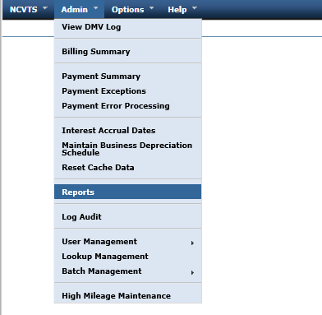
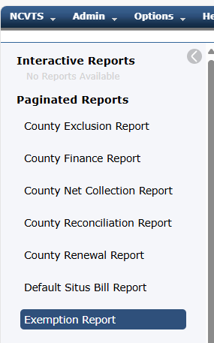
Instructions to Run the NCVTS “Exempt Report”
(Select and Run the Report)
Click on the to “Admin” pull-down menu, and choose “Reports”
Choose the Exemption Report.
Hint: Don’t pause too long between steps. If you pause for more than a minute or so, you may need to go back to the “Admin” and “reports” and start-over from the beginning.

Slide 3
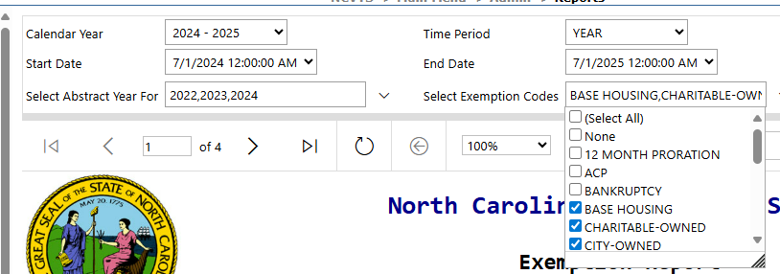
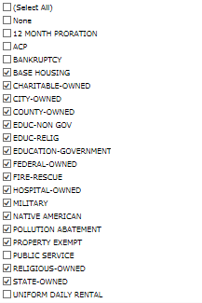
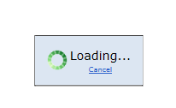
Instructions to Run the NCVTS “Exempt Report”
(Select Report Parameters)
The screen with the report will display. Below are the parameters that should be chosen.
For the 2025-26 AV-50 report due November 1, 2025, the following periods should be chosen:
Select Renewal Date Fiscal Year: “2024 – 2025”*
Select Abstract Year For: “2022, 2023, 2024,” (click each)
Select Renewal Date Time Period: “Year” or run a separate report for each quarter “Q1”, “Q2”, “Q3” and “Q4” and total them (if NCVTS times-out when you run it for the entire year). Alternatively, reports can be run for single years (“2022, 2023, 2024”).
The Following Exemption Codes Should Be Checked:
*The 2024-2025 fiscal year NCVTS data is used because the 2025-2026 fiscal year RMV assessments have yet to be processed.
*The choice of the 2024 year, will report the bills for the year starting 7/1/2024 – 6/30/2025.
The choice of the 2022 and 2023 years pulls abstracts that run over into the 2024-2025 fiscal year.
“Property Exempt” should only be reported to the extent to which it reflects the exemption codes “checked” above. If the county has used this category for miscellaneous items that do not match the checked parameters, the county may have to run a separate report for “Property Exempt” only, and filter on the applicable exemption codes. This is left to the county’s discretion.

Slide 4
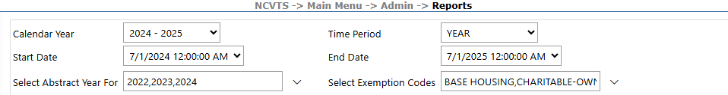

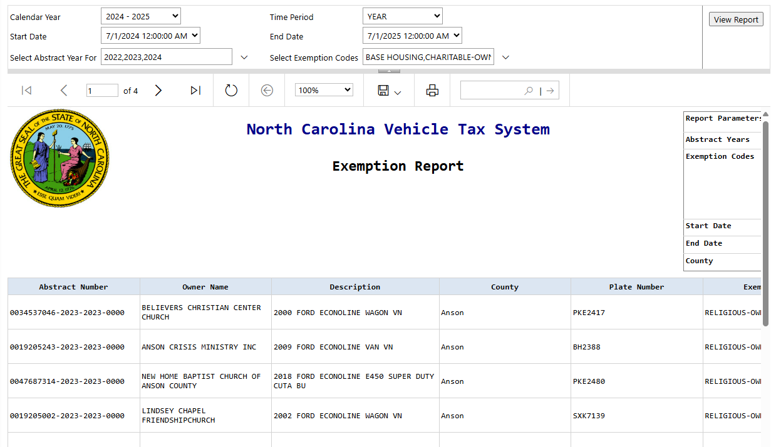
Instructions to Run the NCVTS “Exempt Report”
Once the parameters are chosen, click the “View Report” button to the right.
The display should show that the report is loading:
(Call 919-814-1290 if you have any technical questions regarding NCVTS reports).
Once the report has run, the results will be displayed as follows:
Hint: Don’t pause too long between steps. If you pause for more than a minute or so, you may need to go back to the “Select and run the reports” section of this document and start-over from the beginning.

Slide 5
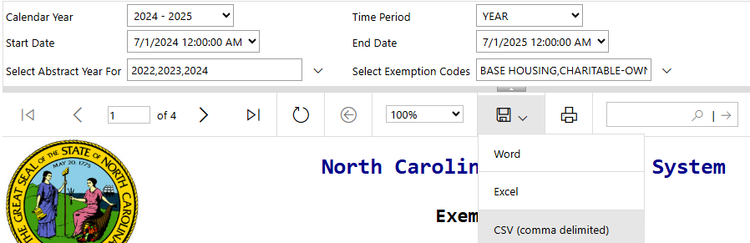
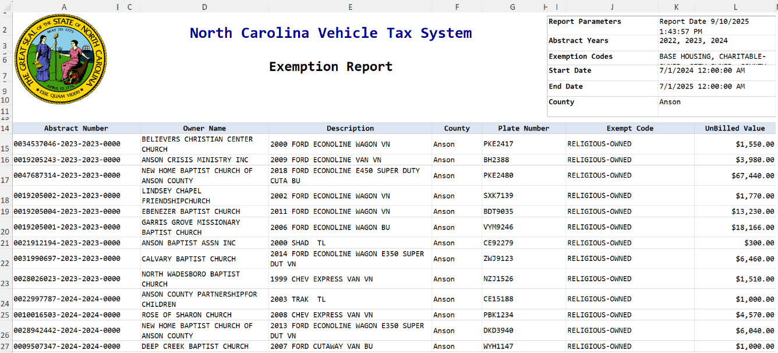
Instructions to Run the NCVTS “Exempt Report”
The export button is in the top ribbon, below the report parameters.
To export the data into excel, Click on the export icon below, to display the report format, and click on the format you desire, “Excel” in this example.
Hint: Don’t pause too long between steps. If you pause for more than a minute or so, you may need to go back to the “Select and run the reports” section of this document and start-over from the beginning.

Slide 6
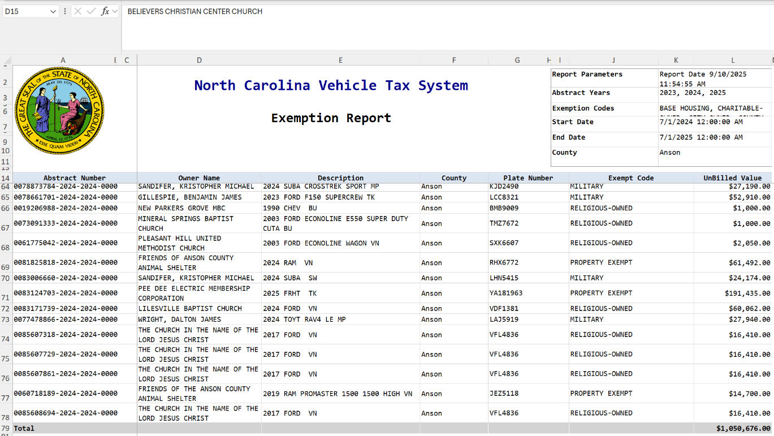
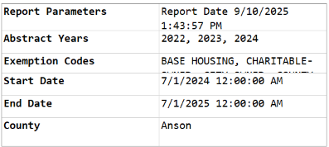
Instructions to Run the NCVTS “Exempt Report”
Once the data has exported, you will receive the following notification to open or save the data:
You can save the output to your computer or open it. The resulting excel file will look just like the file displayed above.
The amount to be included on the AV50 form, line 17.5 “Excluded & Exempt Registered Motor Vehicles (NCVTS)” is the total after the last row of data, or the combined totals if you had to run multiple reports.
Hint: Don’t pause too long between steps. If you pause for more than a minute or so, you may need to go back to the “Select and run the reports” section of this document and start-over from the beginning.

Slide 7
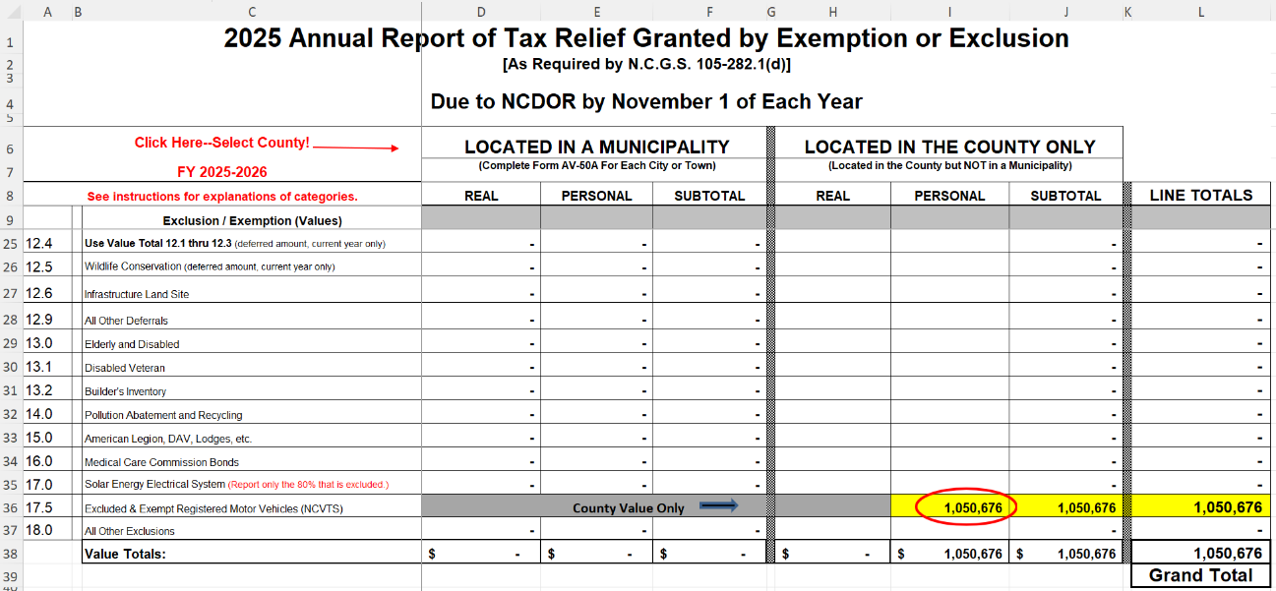
Instructions to Run the NCVTS “Exempt Report”
The total exempt value should be populated for the county only (not the municipalities) in the personal column as follows:
AV-50

