Slide 1
Income and Expense Data
Ryan Vincent
Vincent Valuations LLC

Slide 2
If you are holding a bee, what is in your eye?

Slide 3
What will we cover?
Why do we want Income and Expense Data?
Where to obtain Income and Expense data?
Sources
Accuracy
Cost
Advantages
Disadvantages

Slide 4
Why do we want Income and Expense data?
Basis of the income approach
Principal of anticipation
Current value of anticipated future benefits of ownership in property
Determine the value of properties bought and sold on income:
Offices
Apartments
Warehouses/Self Storage Warehouses
Retail/Big Box
Drug Stores
Restaurants/Fast Food
Industrial

Slide 5
Data Sources
Direct mail questionnaires
Realtors, brokers, appraisers, property managers, tenants
Sales and Listings
Appraisal firms
Subscription services
Business Journals
Appraisals
Appeals
Other Counties

Slide 6
Direct Mail Questionnaires
Pros
Directly mailed to commercial owners within the County
Information is obtained directly from the owner
Typically accurate and up to date
Cons
Labor intensive to process
Additional phone calls to office
Typically very low response rate
10% return is great
5% or less is typical
Cost (postage and printing)
Other Options
Mail questionnaire with annual tax bills
Develop online system for report income and expenses

Slide 8
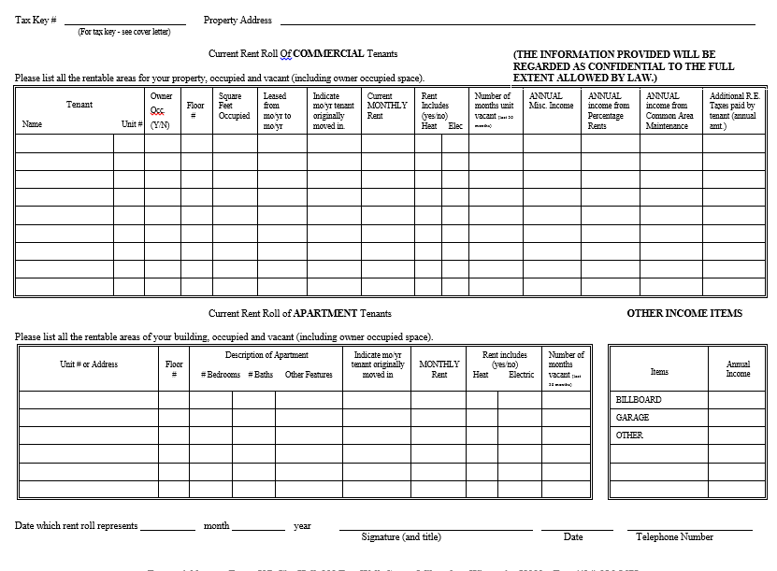

Slide 9
Realtors, Brokers, Appraisers, Property Managers, Tenants
This data could be obtained during field data collection
Send commercial appraisers out with income questionnaires
Pros
Data is usually free and a phone call away
Accurate
Fast
Cons
Time consuming to call and compile
These relationships take time to build

Slide 10
Sales and Listings Online, Loopnet
Pros
Property Specific
Information is free
If income was advertised, cap rate can be figured
Cons
Usually advertised on the high end of the income

Slide 11
Purchase from Appraisal Firms
Pros
Verified
Accurate
BER likes to see this type of data
Presentation
Cons
Cost
Turn around time
Expense data is anonymized for confidentiality

Slide 14
Subscription Services Co-Star, Xceligent, Smith Travel, Karns, Realty Rates, Boulder Group
Pros
Searchable
National data
Recognized across the industry
Cons
Cost
Data may be national and not local
Data may not be verified

Slide 16
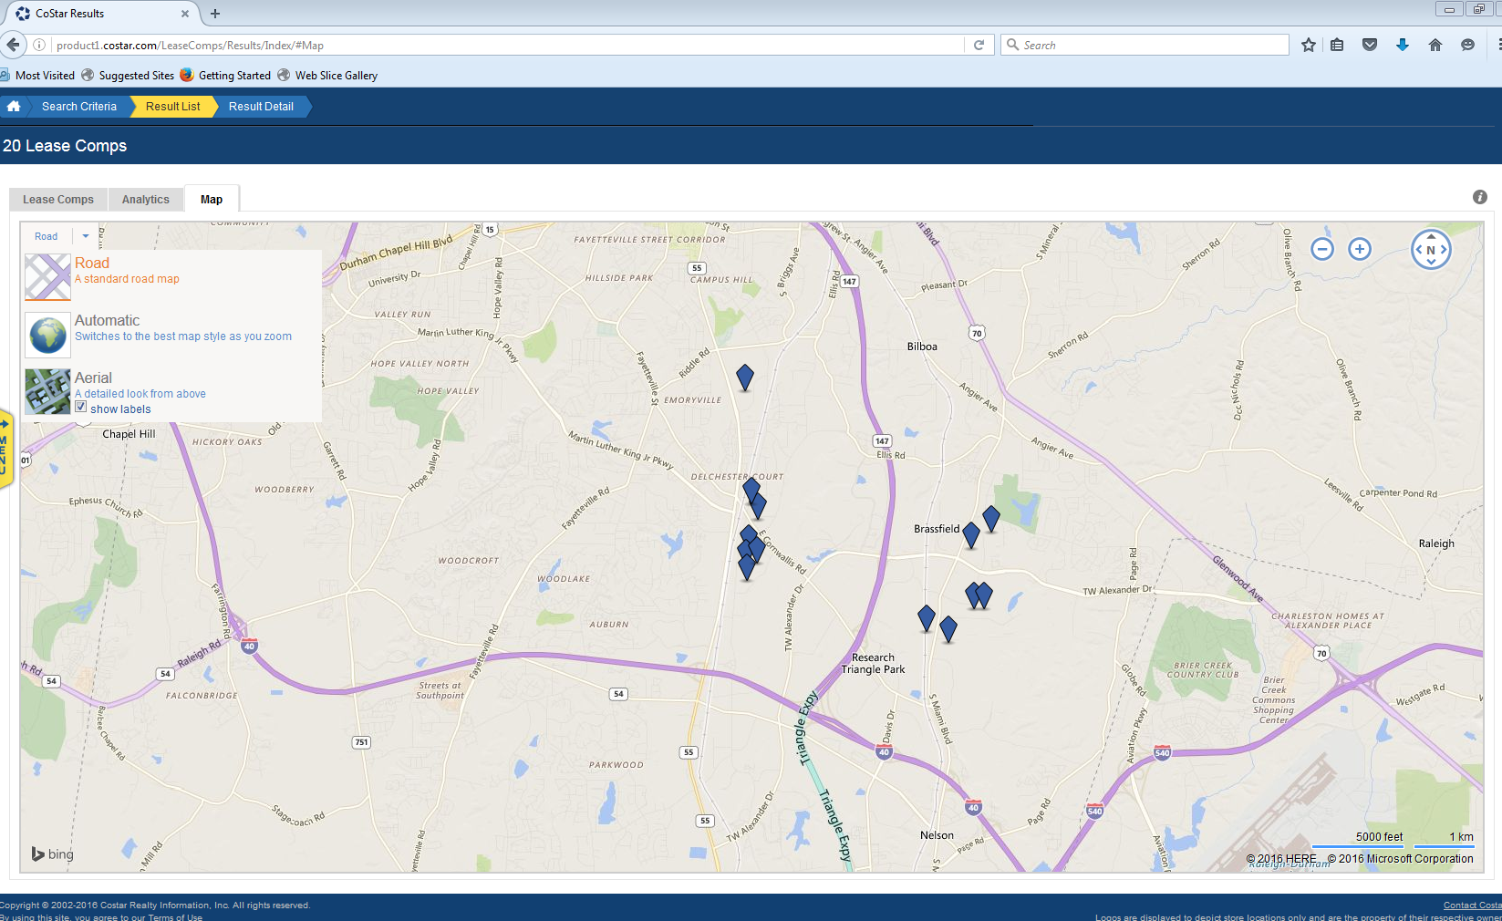

Slide 17
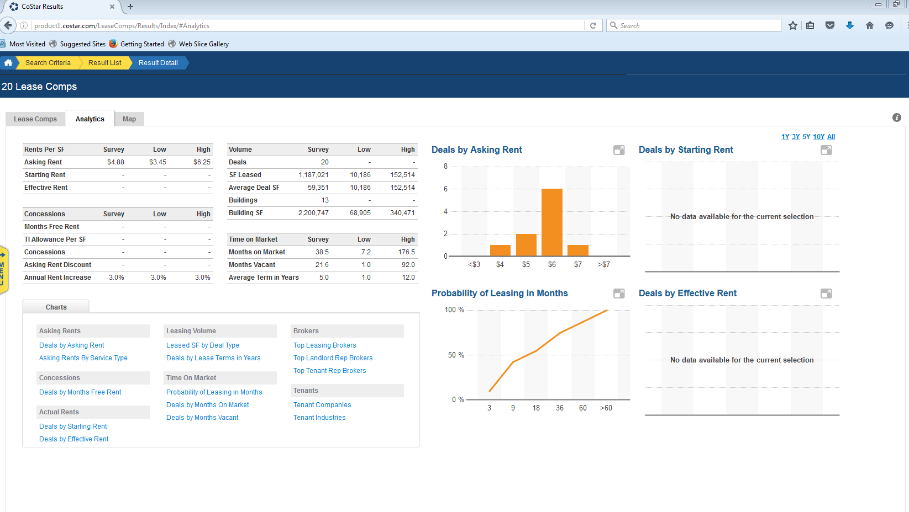

Slide 18
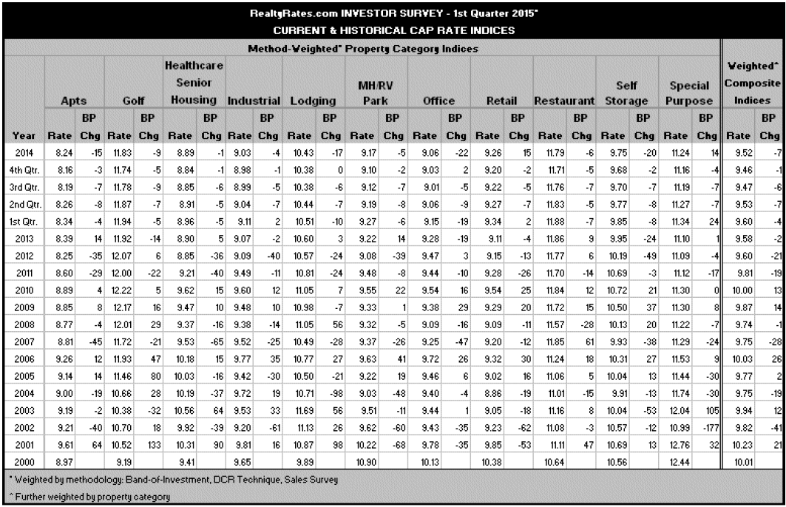

Slide 19
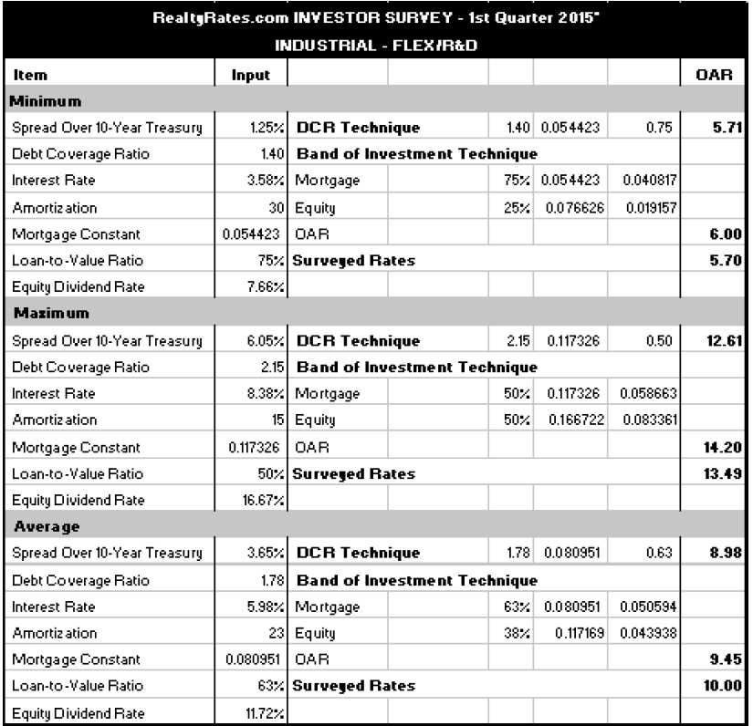

Slide 20
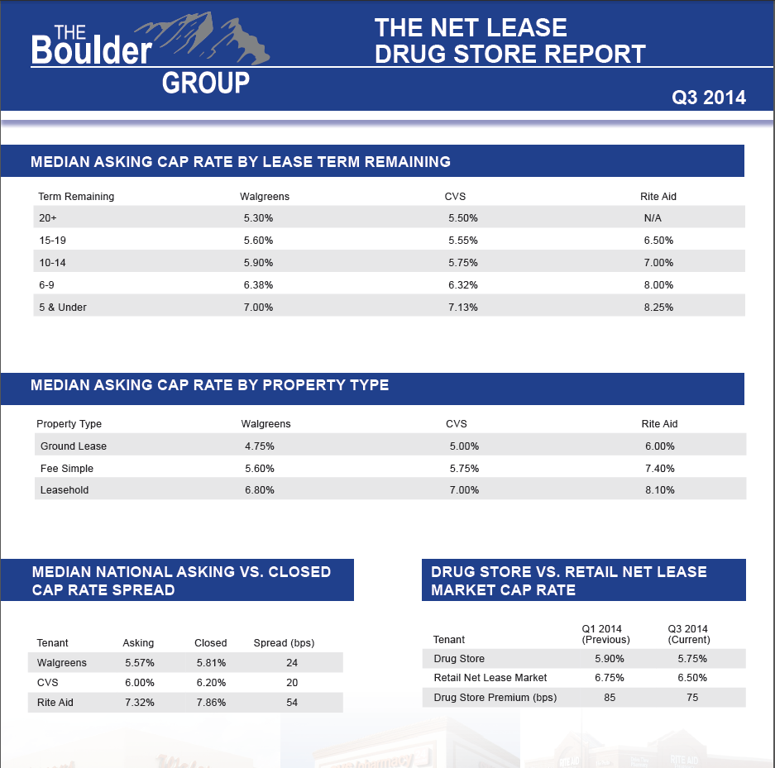

Slide 21
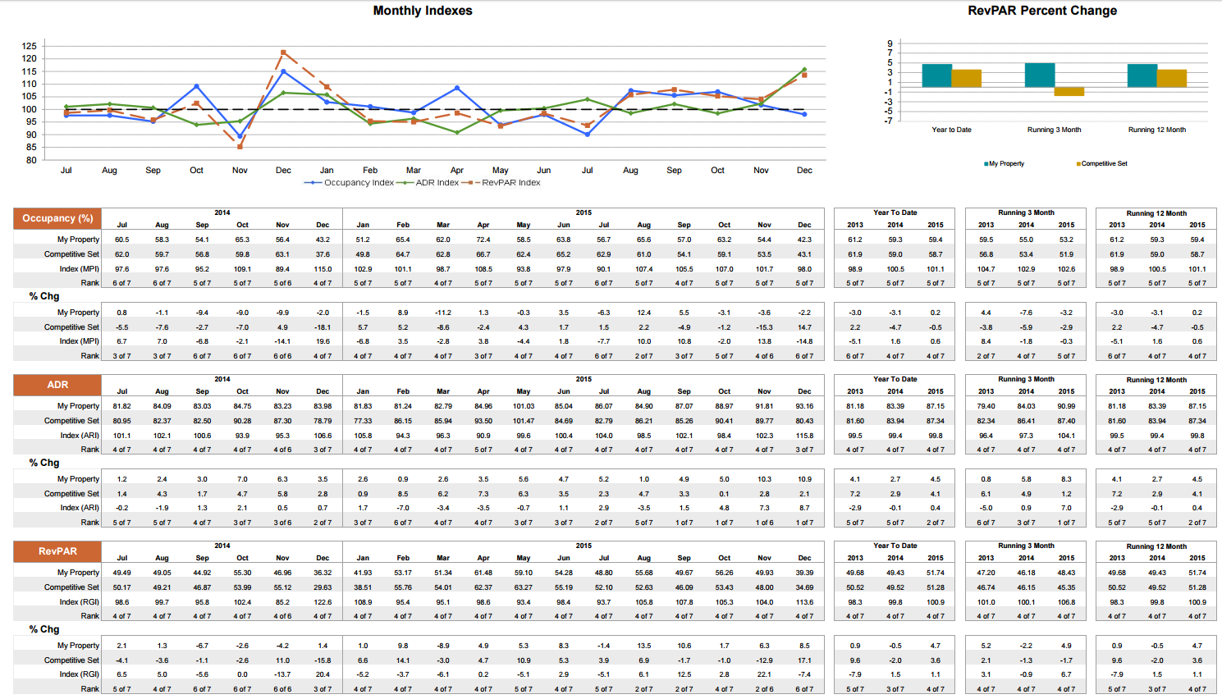

Slide 22
Real Data (apartments)
Pros
Inexpensive to buy vs other subscriptions ($600+/-)
Detailed data
Shows historical data to assist in trending
Local
Cons
Typically shows only larger complexes

Slide 23
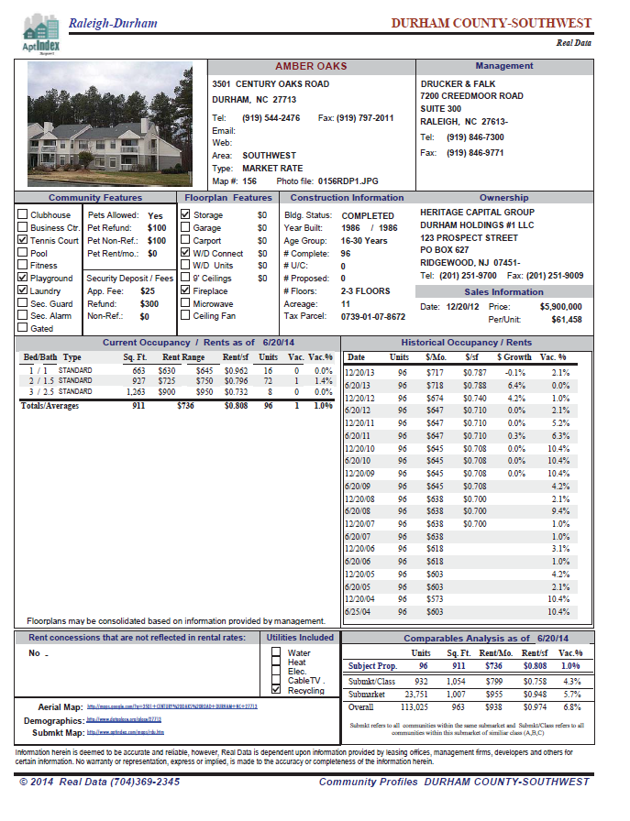

Slide 24
Business Journal Subscriptions
Triangle Business Journal, Charlotte Business Journal
Pros
Delivered weekly
Up-to-date information on rents, leases, and company moves
Local market information
Accurate Data (rents, sales, sf)
Inexpensive ($100 +/- per year)
Cons
Only in large markets

Slide 25
Appraisals
Pros
Free if submitted by tax payer
Data is typically accurate and verified
Can be ordered by the county for properties under appeal
Your BER/PTC likes to see appraisals
Cons
Can be costly if ordered by the county

Slide 26
Appeals
Pros
Accurate
Property specific
Free
Cons
Its an appeal

Slide 27
Other Counties Help one another, we’re all in this together
One of the best sources in my opinion
Pros
Accurate
Free
Verified
Local
Cons
Not within your county
Markets could be different

Slide 28
Data Sharing Examples Statewide
Statewide
Lowes
Walgreens
Walmart
Target
Home Depot
Franchise Fast Food
Regionally
Warehouse/Industrial
Retail
Apartments
Office
The rents may fluctuate a small amount but the data should be fairly similar
Land values may differ based on location

Slide 29
Suggestions How can all this make your life easier?
Compile this data into a searchable inter office data base
Continually add to this data base as new information comes in from any verified source
Searchable and sortable by:
Sales Price
Cap Rates
Rental Rates
Lease Structures
Property Types
Expense Percentages
Vacancy rates
Geographic area or NBHD
Selectable fields for upper/lower limit, mean and median of all the fields listed above

Slide 30
Questions

