Slide 1
Big Boxes Stores
Tony Simpson
Michael Brown
NC DOR

Slide 2
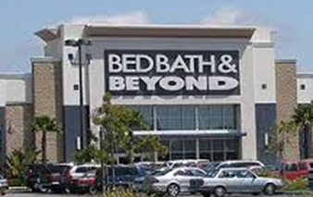
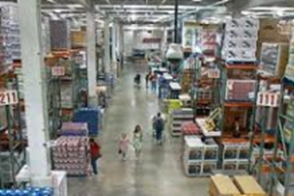
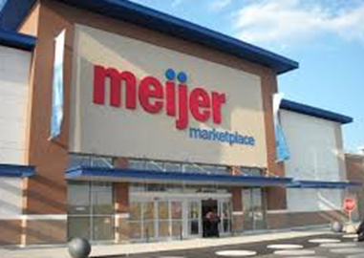
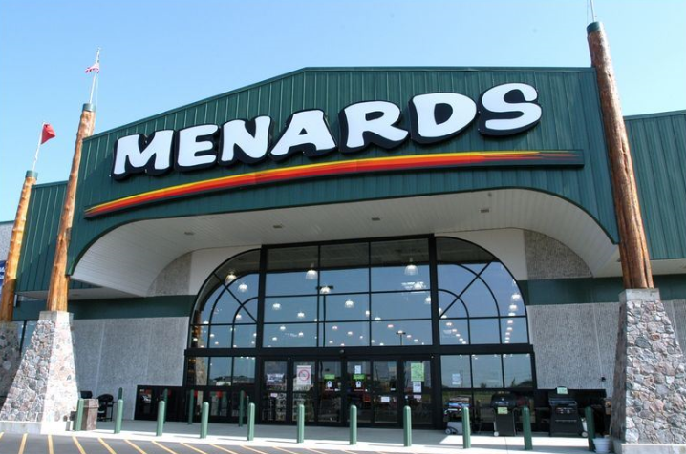
Examples of Big Box Stores

Slide 3
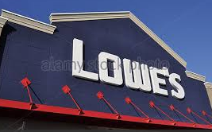
Are We Specifically Talking about Lowe’s
Yes and No.
Yes. They are the test case with the issue of big box stores in NC
No. If not Lowe’s. It would have been another big box store to push the issue.

Slide 4
The Argument
Dark Store Theory
Highest and Best Use
Fee Simple and Leased Fee
Three Approaches to Value
Deed Restrictions

Slide 5
The Numbers
Appeals to the PTC
Appeals from 45 counties
Over $750 million in assessed value under appeal
Taxpayer asking for value under $450 million
County Range per Square Foot $48.71 to $120.91
Taxpayer Range per Square Foot $30.72 to $55.15
No Appeal to the PTC
13 counties with no State level appeal

Slide 6
NC Property Tax Commission Hearing and Decision
Forsyth County appeal was the first case to be heard on issue
Hearing was held May 17-19, 2016
Decision entered August 24, 2016
Will there be an appeal to the Court of Appeals?

Slide 7
Related Articles Used in NC PTC Appeal
“You Can’t Get the Value Right If You Have the Rights Wrong” by David Lennhoff
“Valuation of Big-Box Retail for Assessment Purposes: Right Answer to the Wrong Question” by David Lennhoff
“Big Box Retail Properties: Pitfalls of Valuation” by Martin A. Skolnik and Gary E. Heiland II
“Valuing the Leased Fee Simple Estate: The Answer for Ad Valorem Taxation Isssues” by Thomas W. Hamilton
“Thinking Outside the Big Box” by Tim Wilmath and Patrick Alesandrini

Slide 8
Assessing the Big Box for Property Tax Purposes

Slide 9
Big Box Defined
No accepted definition but stores are easily recognized by shoppers based on their large size and windowless box like plain appearance.
Early stores appeared in the 1960’s and typically were around 50,000 square feet.
Today big box stores typically exceed 100,000 square feet and are located on 15-20 acre sites.

Slide 10
Categories of Big Box Stores
Discount Department Stores
Wal Mart
Target
Specialty Stores
Best Buy
Dicks Sporting Goods
Warehouse Stores
Home Depot
Lowes
Costco

Slide 11
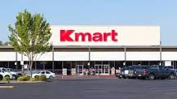
How do Assessors Value Big Box Retailers for Property Tax Assessments?
The first step is to do a Market Analysis to determine the Highest and Best Use of the property being assessed.

Slide 12
To Develop the Highest and Best Use the Appraiser should develop a Market Analysis
Required by USPAP in determining the Highest and Best Use of a Property
The first concept for the appraiser to realize in considering a Market Analysis is that a big box retailer cannot create new demand. It can only bring in customers by four ways
Attract customers from competing businesses in the trade area
Providing products other retailers are not providing
Filling vacuums created by obsolete buildings or the competition’s marketing weaknesses
Realizing sales growth from new sources of demand entering the trade area

Slide 13
Developing a Market Analysis
The second concept for appraiser to consider is that traditionally retail follows rather than leads community growth. A big box is similar to a magnet- the more customers it attracts the better it will be.
The third concept to understand is that the ability of a big box to secure a share of a market demand depends on the size of its trade area and how it compares to it’s competition in terms of the merchandise it offers and its links to customers. The appraiser must analyze the existing competition and any planned or potential competition.

Slide 14
Developing a Market Analysis
The fourth concept is retail clustering. Stores or retail located close together that sell similar type products to offer customers a wider selection of goods. This concept recognizes that a location in a retail cluster with similar but not identical retailers attracts more customer traffic than a singular retailer.
The last concept is based on the principle of intervening opportunities which recognizes that most customers will not bypass a dominant center to get to a subordinate center.

Slide 15
Market Analysis & Highest and Best Use
The valuation dilemma for big box retail is difficult. In appraising the big box the assessor must consider whether or not the subject real estate is still competitive as of the date of the appraisal, and is likely to be in the future.
Highest and Best Use is an economic analysis that is carried out to determine which market a property’s best use lies.

Slide 16
Highest and Best Use Defined
Highest and best use is defined as the most probable use of a property which is physically possible, appropriately justified, legally permissible, financially feasible, and which results in the highest value of the property being valued. An important component of determining the highest and best use of the Subject Property is that it helps frame the criteria for the selection of comparable sales in the sales comparison approach and comparable leases in the income approach. In the appraisal valuation, the comparable properties used in the analysis should have a similar highest and best use as the property it is being compared with. Dictionary of Real Estate Appraisal, Fifth Edition.

Slide 17
How do our statutes address Highest and Best Use?
When appraising real property in North Carolina, N.C. Gen. Stat. § 105-317(a) provides that it is the duty of the persons making the appraisal to consider the specific factors set forth in this statute. As to land, parcels and lots, the advantages and disadvantages as to location, zoning, quality of soil, water etc.; and as to buildings and improvements to consider at least its location, type of construction, age, replacement cost; cost, adaptability for residence, commercial, industrial or other uses, income; and other factors that may affect its value.

Slide 18
Assessing the value of the Big Box
After the highest and best use has been determined by the assessor the three approaches to value should be developed.
Sales Comparison Approach
Income Approach
Cost Approach

Slide 19
Sales Comparison Approach
Based on the economic principle of substitution
Compares the property being appraised with similar properties that have recently sold
Sold properties are compared to the subject property and adjusted for any differences between the sold property and subject property
Sales approach works best when there are sufficient sales in the market available for similar properties.

Slide 20
Weaknesses of the Sales Comparison Approach in Assessing Big Box Retail
Few if any comparable sales exist for special use or limited use properties.
The sales that do exist are typically net leased or dark non-occupied big box properties.
Big box properties are sold to second generation users with deed restrictions that have a different highest and best use than big box retail.
Built to be owner occupied, built to suit to lease, or sales leaseback transactions which may value the leased fee not the fee simple.

Slide 21
Income Approach
Based on the economic principle of anticipation
The present worth of future benefits arising from the ownership of property
Income producing property is typically purchased for the right to receive the future income stream of the property

Slide 22
Weaknesses of the Income Approach in Assessing Big Box Retail
Properties are owner occupied limiting comparable rent data.
Sale leaseback or build to suit to lease which values the leased fee and not the fee simple value.
Unique properties or special purpose properties without comparable rent data.
The long term lease is the basis of the purchase price not the real estate itself which indicates investment value not real estate value.

Slide 23
Cost Approach
Based on the economic principle of substitution.
The Value estimate is the sum of the depreciated improvement cost and the site value.
The cost approach is based on the premise that the depreciated cost of the improvement plus the value of the land will equal market value when supply and demand are in balance.

Slide 24
Weaknesses of the Cost Approach in Assessing Big Box Retail
Difficult to estimate the appropriate amount of depreciation. The cost approach works best with new properties.
Difficultly in determining functional obsolescence or economic obsolescence.
Lack of cost information for special purpose or unique properties
Difficulty in getting local cost information from owners, builders and developers in the assessment jurisdiction.

Slide 25
Reconciling the Value
Analyze the three approaches to value
Focus on the highest and best use of the property after completing a market analysis – do not exclude the current occupant or a similar occupant as a hypothetical buyer.
Consider the weaknesses inherent in the sales comparison and income approaches to value. If relying on the sales comparison approach be sure good first generation sale comps have been selected. If relying on the income approach consider the effect of sale leasebacks to the income stream.
The cost approach is usually the most supportable and straightforward approach to estimate the market value of a big box property for property tax assessments.

Slide 26
Why the Cost Approach for Tax Assessments?
Land values typically are well established by vacant land sales.
Cost Information is readily available to assessors and appraisers.
Very little functional or external obsolescence to consider with a first generation big box retail.
Cost approach does not have the inherent weaknesses of the sales comparison and income approach when assessing the big box.

Slide 27
Other Articles Around the Country
Valuing the Leased Fee Simple Estate: The Answer for Ad Valorem Taxation Issues
https://www.cre.org/real-estate-issues/valuing-the-leased-fee-simple-estate-the-answer-for-ad-valorem-taxation-issues/
Property Tax: It’s Based on Value-in-Exchange, not Value-in-Use
https://www.dmainc.com/about/the-dma-way/property-tax/property-tax/2015/10/02/property-tax-it-s-based-on-value-in-exchange-not-value-in-use
Indiana Lawmakers Developing Solution
http://www.wfyi.org/news/articles/indiana-lawmakers-developing-solution-to-big-box-store-property-taxes

Slide 28
Related Discussion and Court Cases Around the Country
The Impacts of Menards Inc. v City of Escanaba
http://www.fosterswift.com/publications-Impacts-Menards-Inc-City-Escanaba.html
CVS Case from Florida
http://www.korpaczra.com/wp-content/uploads/2014/04/CVS-vs-Hillsborough-City-FL.pdf
Supreme Court of Ohio
http://www.sconet.state.oh.us/pdf_viewer/pdf_viewer.aspx?pdf=639390.pdf

Slide 29
Related Discussion and Video
Videos and big box presentations
http://boxedin.news/.

