Slide 1
VALUATION OF AIRCRAFT
2015 ADVANCED PERSONAL PROPERTY SEMINAR
MEGAN WILLIFORD
CUMBERLAND COUNTY

Slide 2
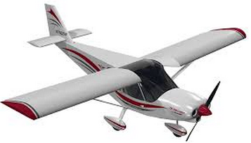
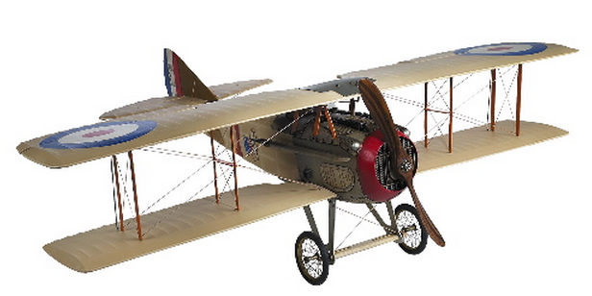
WHAT IS AN AIRCRAFT?
“Any apparatus now known, or hereafter invented, used or designed for navigation of, or flight in the air.”

Slide 3
DETERMINATION OF SITUS
How long has the aircraft been located in the county?
Does the owner of the aircraft live in the county?
Does the owner of the aircraft have real property in the county?
Does the owner of the aircraft own or lease a hanger in the county?
Does the owner pay taxes in another taxing jurisdiction?
Which airports are used by the aircraft and how often?
Is the aircraft used by a business located in North Carolina?
Notes:
FAA, AIRPORT LIST BEST SOURCES OF INFORMATION TO ANSWER THESE QUESTIONS

Slide 4
FEDERAL AVIATION ADMINISTRATION
Aircraft Inquiries
N-Number
Serial Number
State & County
Name
Accident & Incident Data
Certified Copies of Aircraft Records
Historical Date of Aircraft
No Charge to Government Offices

Slide 5
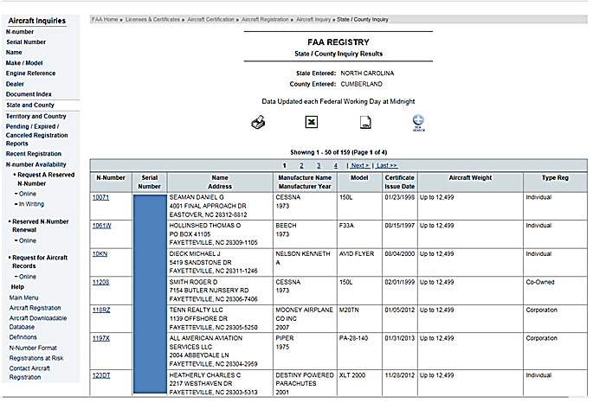
FAA REGISTRY: STATE/COUNTY INQUIRY

Slide 6
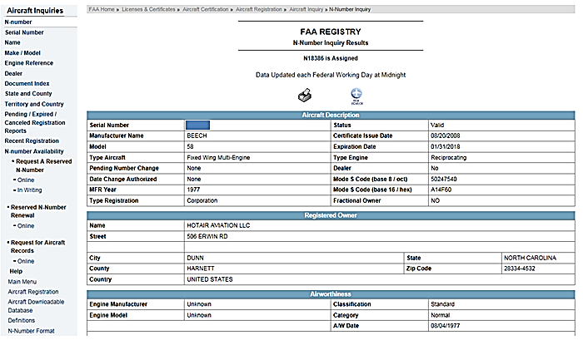
FAA REGISTRY: N-NUMBER INQUIRY

Slide 7
REPORTS BY AIRCRAFT STORAGE FACILITIES
Required by NC General Statute §105-316
Report Annually as of January 1st
Operators Storing Three or More Aircraft Required to Submit Report
List Includes Name of Owner & Description of Aircraft
Must Report to County by January 15th
Failure to Report Results in Fine & Penalty
Notes:
Fails to make any report by Jan 15th liable for penalty measured by any portion of the unpaid tax + $250 fine.

Slide 8
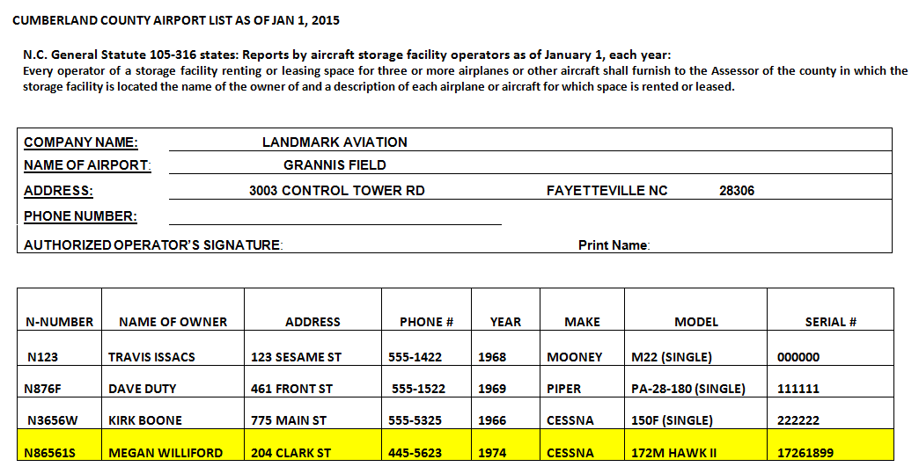
REPORTS BY AIRCRAFT STORAGE FACILITIES

Slide 9
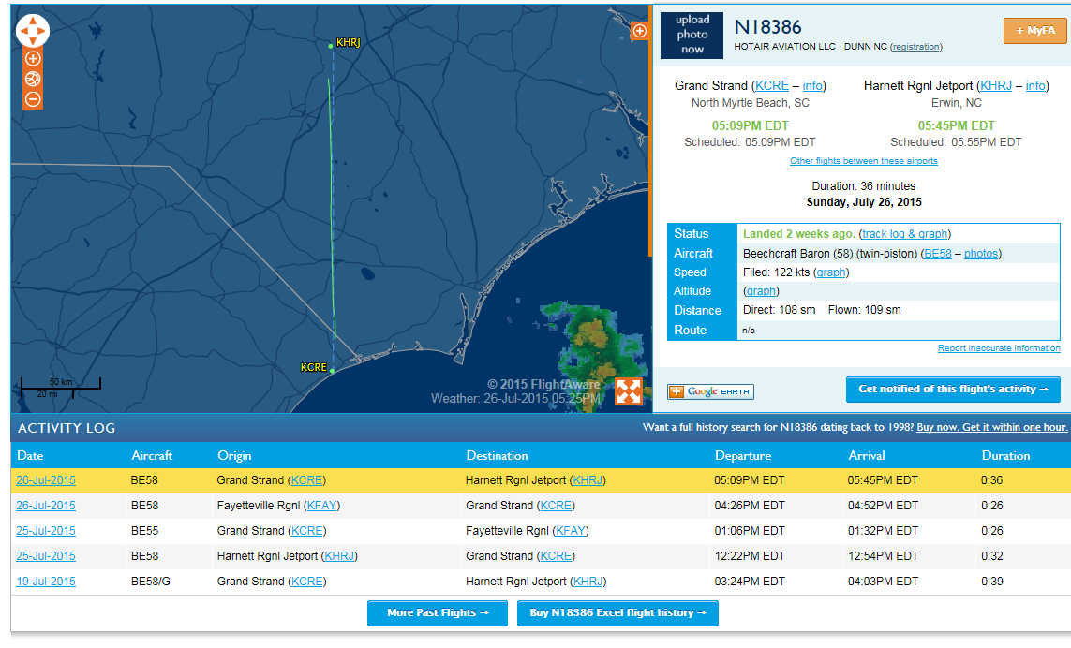
FLIGHTAWARE.COM

Slide 10
AIRCRAFT VALUATION
Market Approach Best Method of Appraising Aircraft
Most Counties Use Industry Pricing Guides
Cost Approach Method for Kit & Ultralight Airplanes
Use Original Cost & Year Purchased - B25
Special Circumstances:
Older Aircraft
Foreign Aircraft
Further Value Research Necessary

Slide 11
ADDITIONAL RESOURCES
AIRCRAFTDEALER.COM
trade-a-plane.com
controller.com
planedesire.com
globalplanesearch.com

Slide 12
VALUATION PROCESS
Megan Williford
Landmark Aviation
1974 Cessna 172M Hawk II
Serial: 17261899

Slide 13
1974 CESSNA 172M HAWK II ABB VALUE
Year
Model
Serial Number
Average Retail
TBO Engine Hours

Slide 14
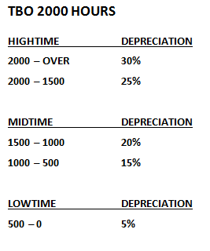
1974 CESSNA 172M HAWK II ENGINE LOG
LOG DATE: 9/2/13 TACH: 224.3 SMOH: 1969.8 TBO: 2000

Slide 15
1974 CESSNA 172M HAWK II APPRAISAL
Valuation Based on January 1
Engine Logs Dated 9/2/13
Average Engine Hours are 75-100 Hours per Year (Cumberland County = 100 HPY)
Exception: Trainer Planes 600 Hours per Year
Twin Engine Aircraft: Both Engines Depreciated Individually Based on Hours
100 Hours/12 Months = 8.33
September 2013-January 2014= 4 months
8.33 x 4 = 33.32
Since Major Overhaul Hours (SMOH) at Inspection: 1969.8 + 33.32 = 2003.12
Use depreciation chart for TBO 2000 hours to determine percentage of depreciation.
TBO 2000 Hours
Hightime Depreciation
2000 – Over 30%
2000 – 1500 25%

Slide 16
1974 CESSNA 172M HAWK II APPRAISAL TOTAL TIME ON AIRFRAME
ABB Supplemental Pricing Information
Airframe Total Time Table & Chart Page A-2
Gives Average Airframe Hours per Year
191 Hours Per Year

Slide 17
1974 CESSNA 172M HAWK II APPRAISAL TOTAL TIME ON AIRFRAME
TTAF: 4641.5 in 2014
Average Airframe Hours Per Year: 191
Airplane Age: 40
TTAF/AGE = HOURS PER YEAR
4641.5/40 = 116.04
No Overage = No Airframe Depreciation

Slide 18
1974 CESSNA 172M HAWK II APPRAISAL TOTAL TIME ON AIRFRAME
If the aircraft is over the average, you must calculate the percentage the overage represents.
Determine if your aircraft is a late-model series or early-model series by the year range on the Airframe Total Time Table & Chart.
Ex. Cessna 1974 Range 1956-1974: Late-model Series.
TTAF/AGE = HOURS PER YEAR
HOURS PER YEAR- AVG HRS = EXCESS
AVG HRS/EXCESS = %
Locate your % at the bottom of chart (x-axis) and follow the line up to the shaded area of the “deduct arc” (shaded for the model series).
Trace that line over to the left side (y-axis) to find the % you will deduct from the aircraft value.

Slide 19
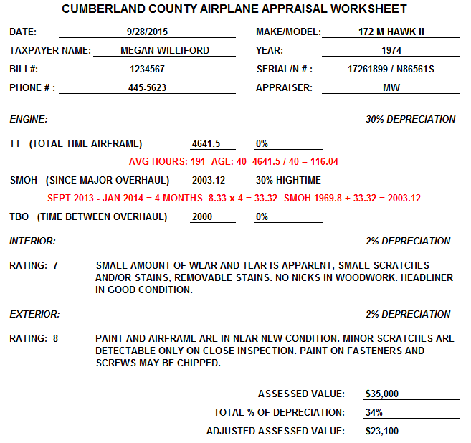

Slide 20
IS EVERYONE STILL WITH ME?

Slide 21
1974 CESSNA 172M HAWK II APPRAISAL INTERIOR & EXTERIOR
Taxpayer may provide photos of the interior and exterior of the aircraft.
The Aircraft Blue Book provides a rating scale to determine the percentage of depreciation for the interior and exterior.
The rating scale is from 1-10, 1 being the worst condition, 10 being a new aircraft. Each rating is also given a percentage of adjustment.
Rating 1 Interior 10% - Interior is so dirty and worn that most people would be hesitant to sit in it.
Rating 1 Exterior 20% - Exterior is so full of corrosion, heavy dents, or tears that it will not pass annual inspection without repairs.

Slide 22
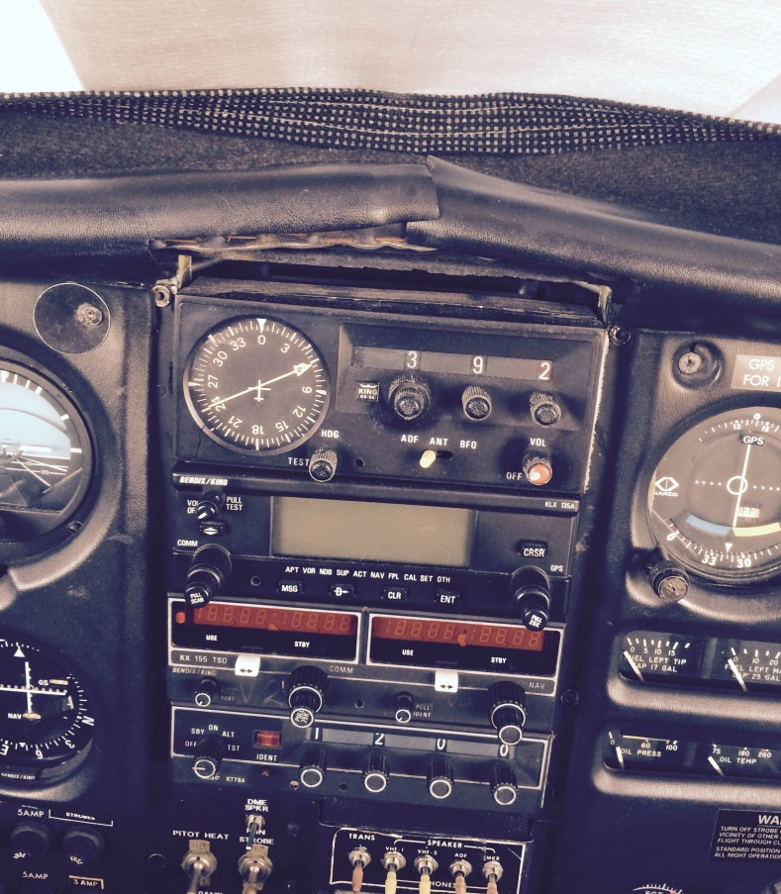
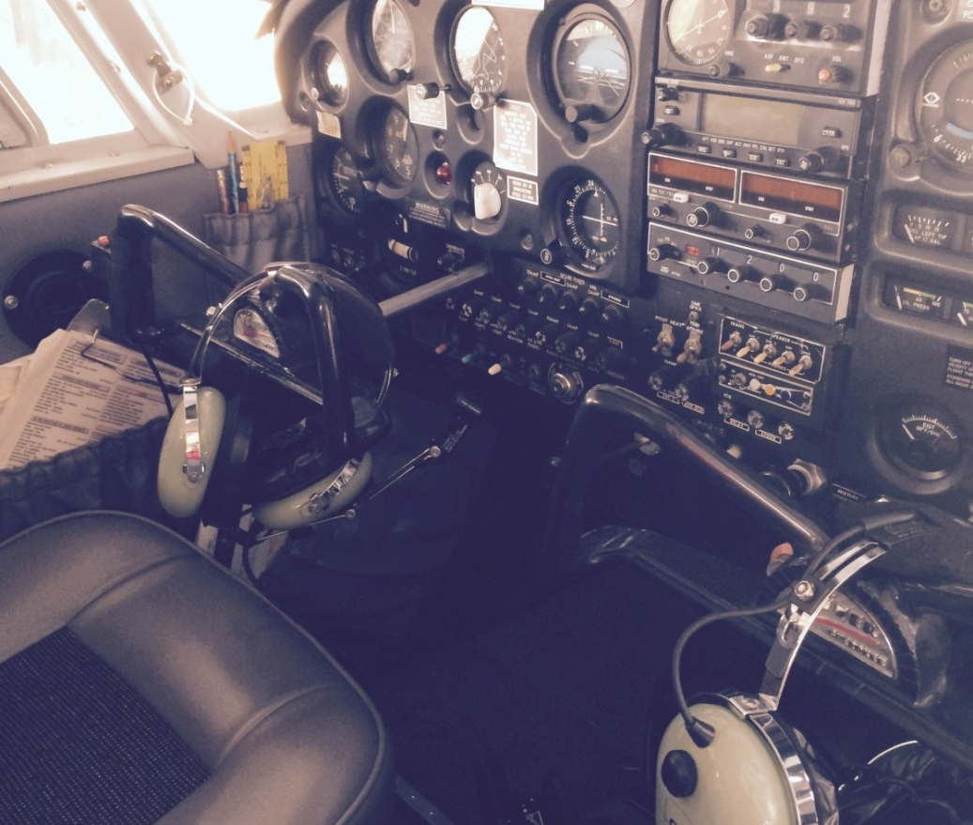
INTERIOR AIRCRAFT RATING
RATING: 7 2% ADJUSTMENT
A SMALL AMOUNT OF WEAR IS APPARENT. SMALL SCRATCHES AND/OR STAINS. REMOVABLE STAINS. NO NICKS IN WOODWORK. HEADLINER IN GOOD SHAPE.

Slide 23
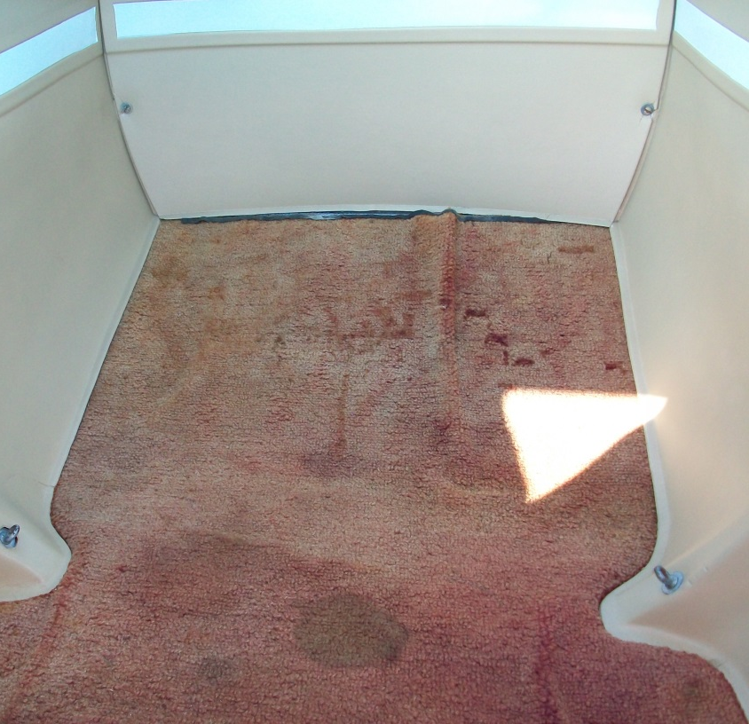
INTERIOR AIRCRAFT RATING
RATING: 2 9% ADJUSTMENT
CRACKS, STAINS, TEARS AND SNAGS. EXPOSED FOAM IN SEATS. INTERIOR IS DIRTY.

Slide 24
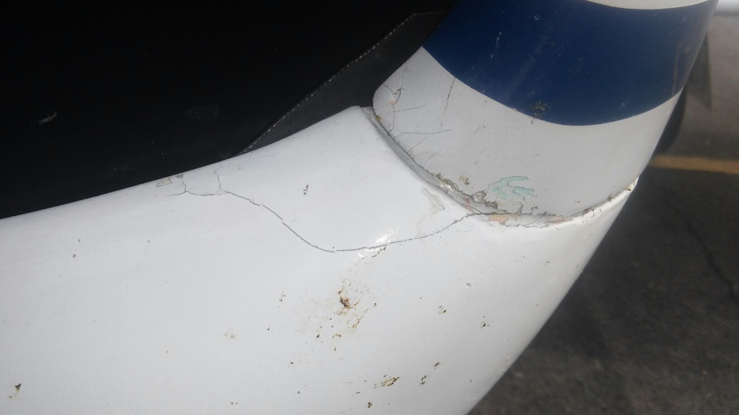
EXTERIOR AIRCRAFT RATING
RATING: 8 2% ADJUSTMENT
PAINT AND AIRFRAME ARE IN NEAR NEW CONDITION. MINOR SCRATCHES ARE DETECTABLE ONLY ON CLOSE INSPECTION. PAINT ON FASTENERS AND SCREWS MAY BE CHIPPED.

Slide 25
EXTERIOR AIRCRAFT RATING
RATING: 1 20% ADJUSTMENT
AIRFRAME IS SO FULL OF CORROSION, HEAVY DENTS AND/OR TEARS THAT IT WILL NOT PASS AN ANNUAL INSPECTION WITHOUT REPAIRS.

Slide 26
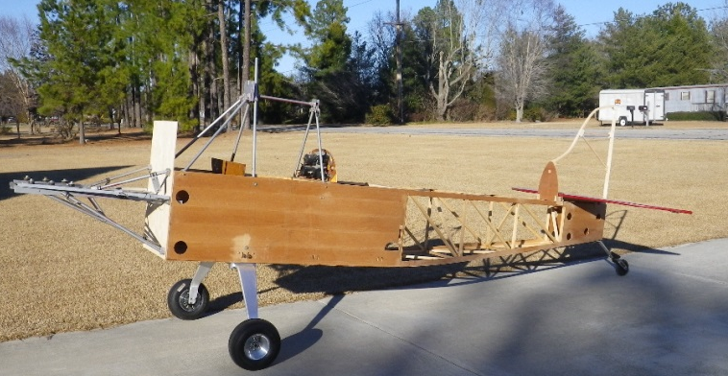
KIT AND ULTRA LIGHT AIRPLANES
Use Cost Approach
Need Bill of Sale
Determine Purchase Year and Cost
Depreciate Aircraft on Schedule B25
25 Year Life – Residual 25%
Cumberland County:
Default Value $25,000
Default Residual $6,250

Slide 27
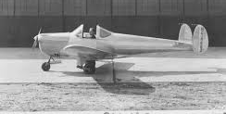
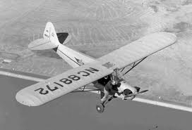
ANTIQUE AIRPLANES
N.C.G.S. §105-277.12 provides for a special valuation of aircraft that meet the following conditions:
Model Year 1954 or Older & Registered with the FAA
Primary Use: Exhibitions, Club Activities, Airshows, Other Public Interest Functions
Only Occasional Use for Other Purposes
Not Used for Income Production
Must apply by January 31st and provide copy of FAA registration.
Assessed at lower of market value or $5,000.

Slide 28
QUESTIONS?
MWILLIFORD@CO.CUMBERLAND.NC.US

