Slide 1
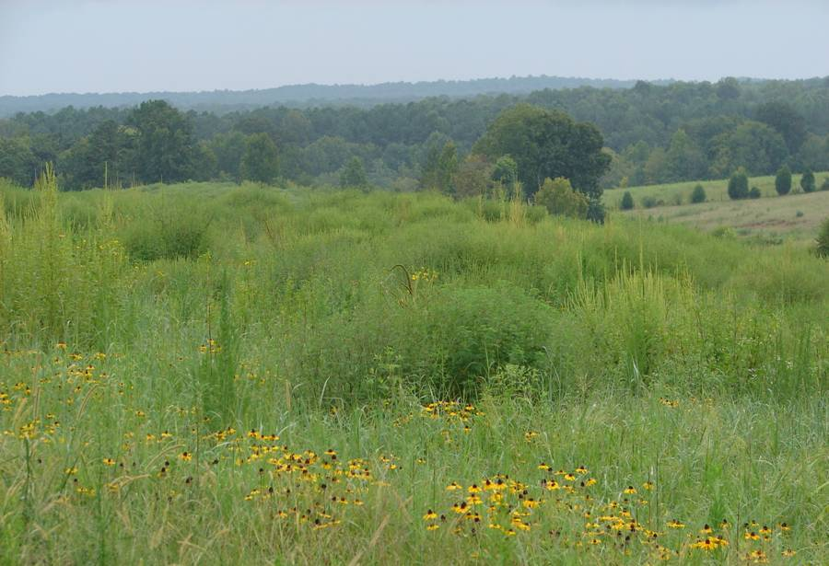
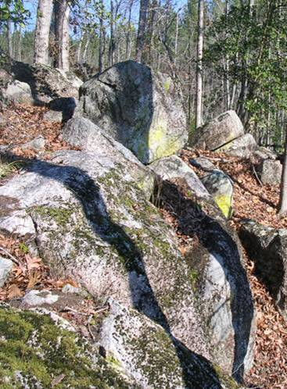
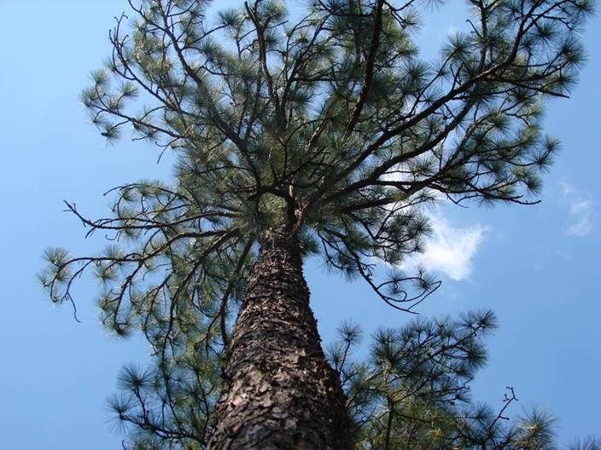
Wildlife Conservation Lands Program
Presentation Prepared by
Kelly Douglass
Technical Assistance Biologist

Slide 2
Introduction
Legislation that recognizes wildlife conservation land as a special class of property that must be assessed at a reduced value
Signed into law in 2008
Effective January 1, 2010
Administered by NCWRC
Incorporates priorities from the NC Wildlife Action Plan

Slide 3
Program Structure
Modeled after the Present Use Value programs, but NOT one of them
Tax evaluation at agricultural PUV rate
Carries the same penalties as PUV programs

Slide 4
Benefits of WCLP
Provides deferred taxes for landowners whose management objectives are:
Conserving priority wildlife habitat
Providing habitat for protected species

Slide 5
Acreage & Mgmt
Qualifying acreage 20-100 contiguous acres
Within each county
Land managed for WCLP purposes for ≥3yrs prior to application or it must be enrolled in one of the PUV programs
Signed agreement and management plan/map

Slide 6
Ownership
Property ownership of ≥5yrs prior to WCLP application
Property must be owned by individual, family business, or family trust
No publicly traded corporations
WCLP transfers with property if new owner files application with county within 60 days of land transfer

Slide 7
Application Process
Landowner submits the Application for Assistance to WRC
WRC conducts site visit to determine eligibility
WRC provides assistance to prepare the Wildlife Habitat Conservation Agreement

Slide 8
Application Process
Landowner submits the Wildlife Habitat Conservation Agreement and the tax assessment application to the county tax office
The county assessor will determine if the property qualifies for tax deferment

Slide 9
Components of the WCLA
Landowner information
Tract location and Property Tax ID number
Priority habitat or species managed
Parcel acre and mgmt acre
Enrolled in PUV?
Tract map with aerial and mgmt acreage indicated
Planned mgmt actions

Slide 10
WRC Provided Assistance
Help landowner decide if WCLP is the right program for them
Help landowner understand the requirements of WCLP
Assist landowner with the documentation process (species and habitats)

Slide 11
WRC Provided Assistance
Assist landowner with the application process
Connect the landowner to the appropriate resources (WRC biologist, county tax office, private consultants, habitat or species specialists)

Slide 12
Priority Species

Slide 13
Priority Habitats

Slide 14
Early Successional Habitats

Slide 15
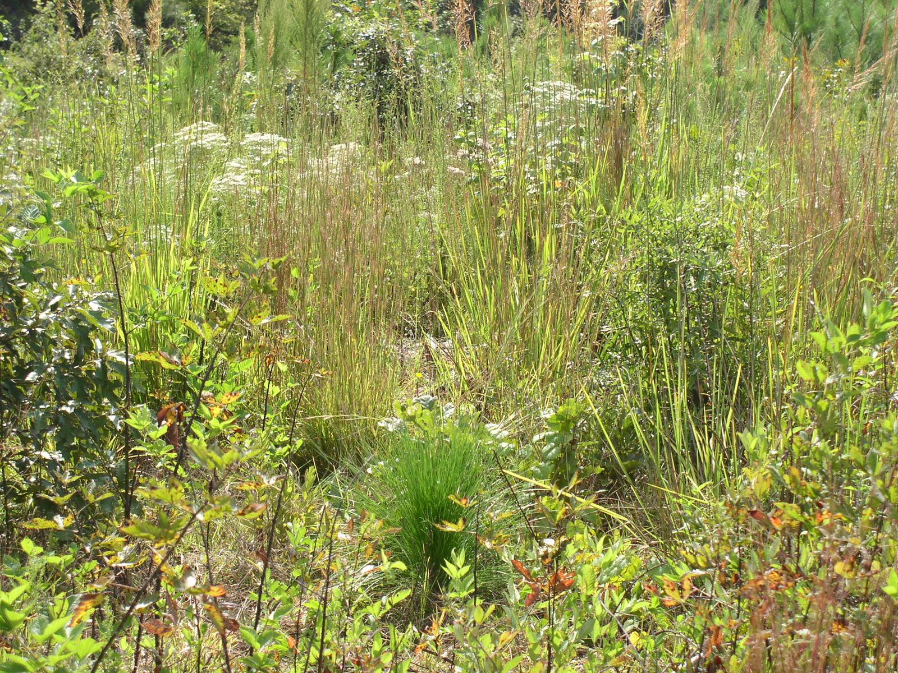

Slide 16
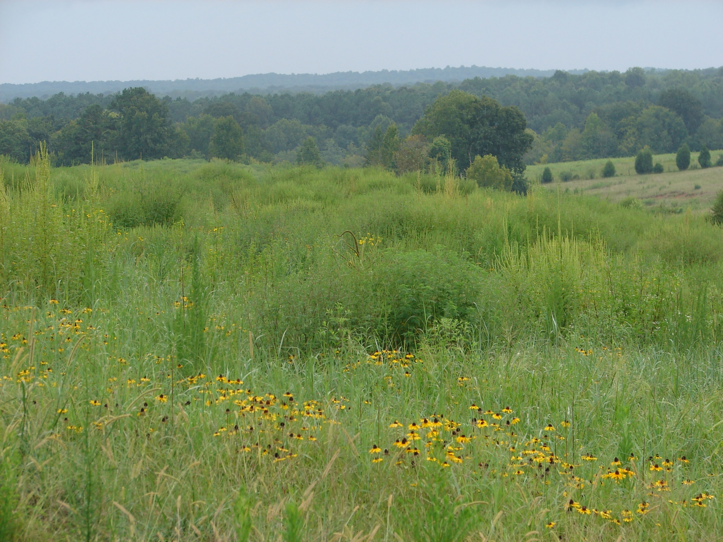

Slide 17
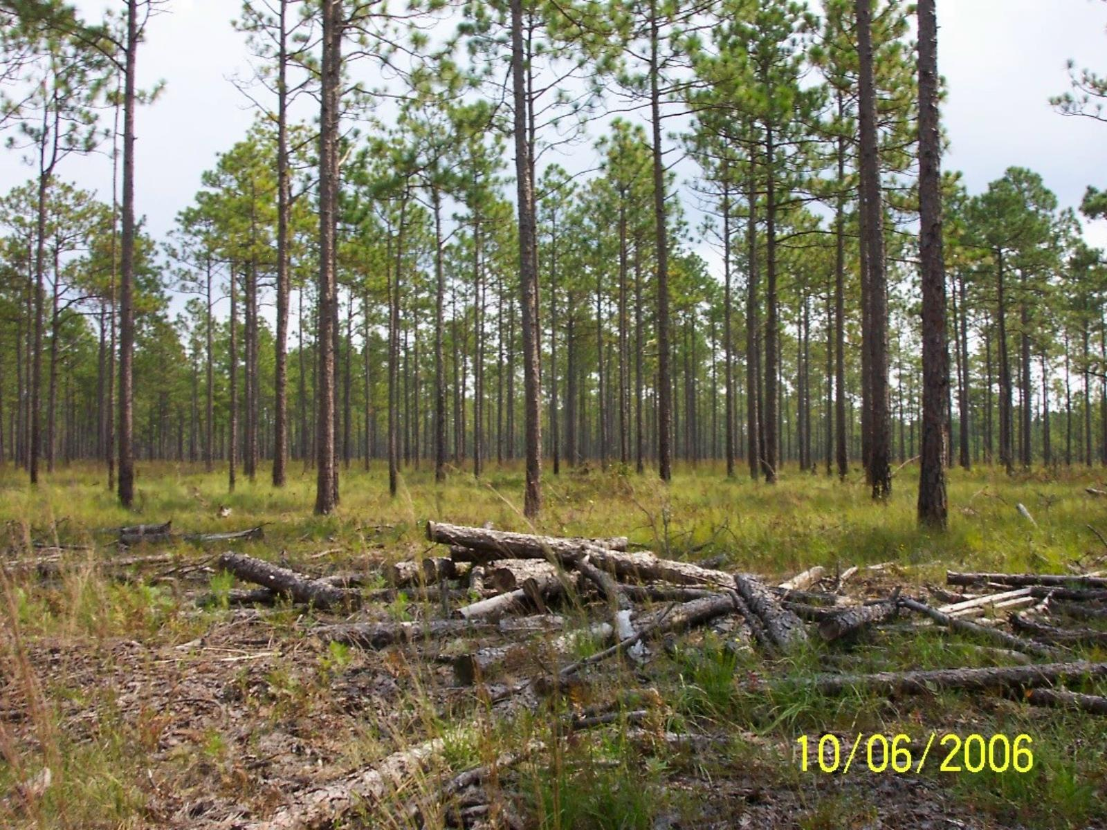

Slide 18
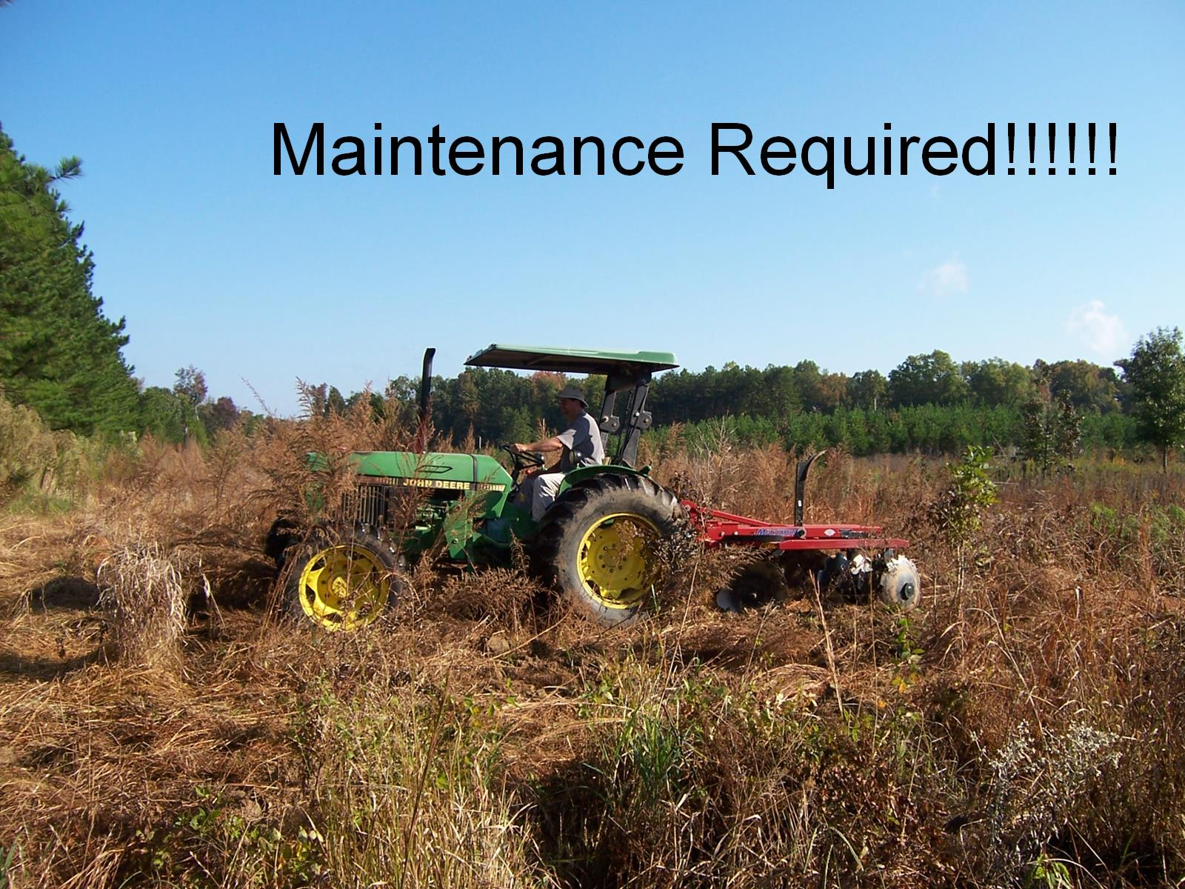

Slide 19
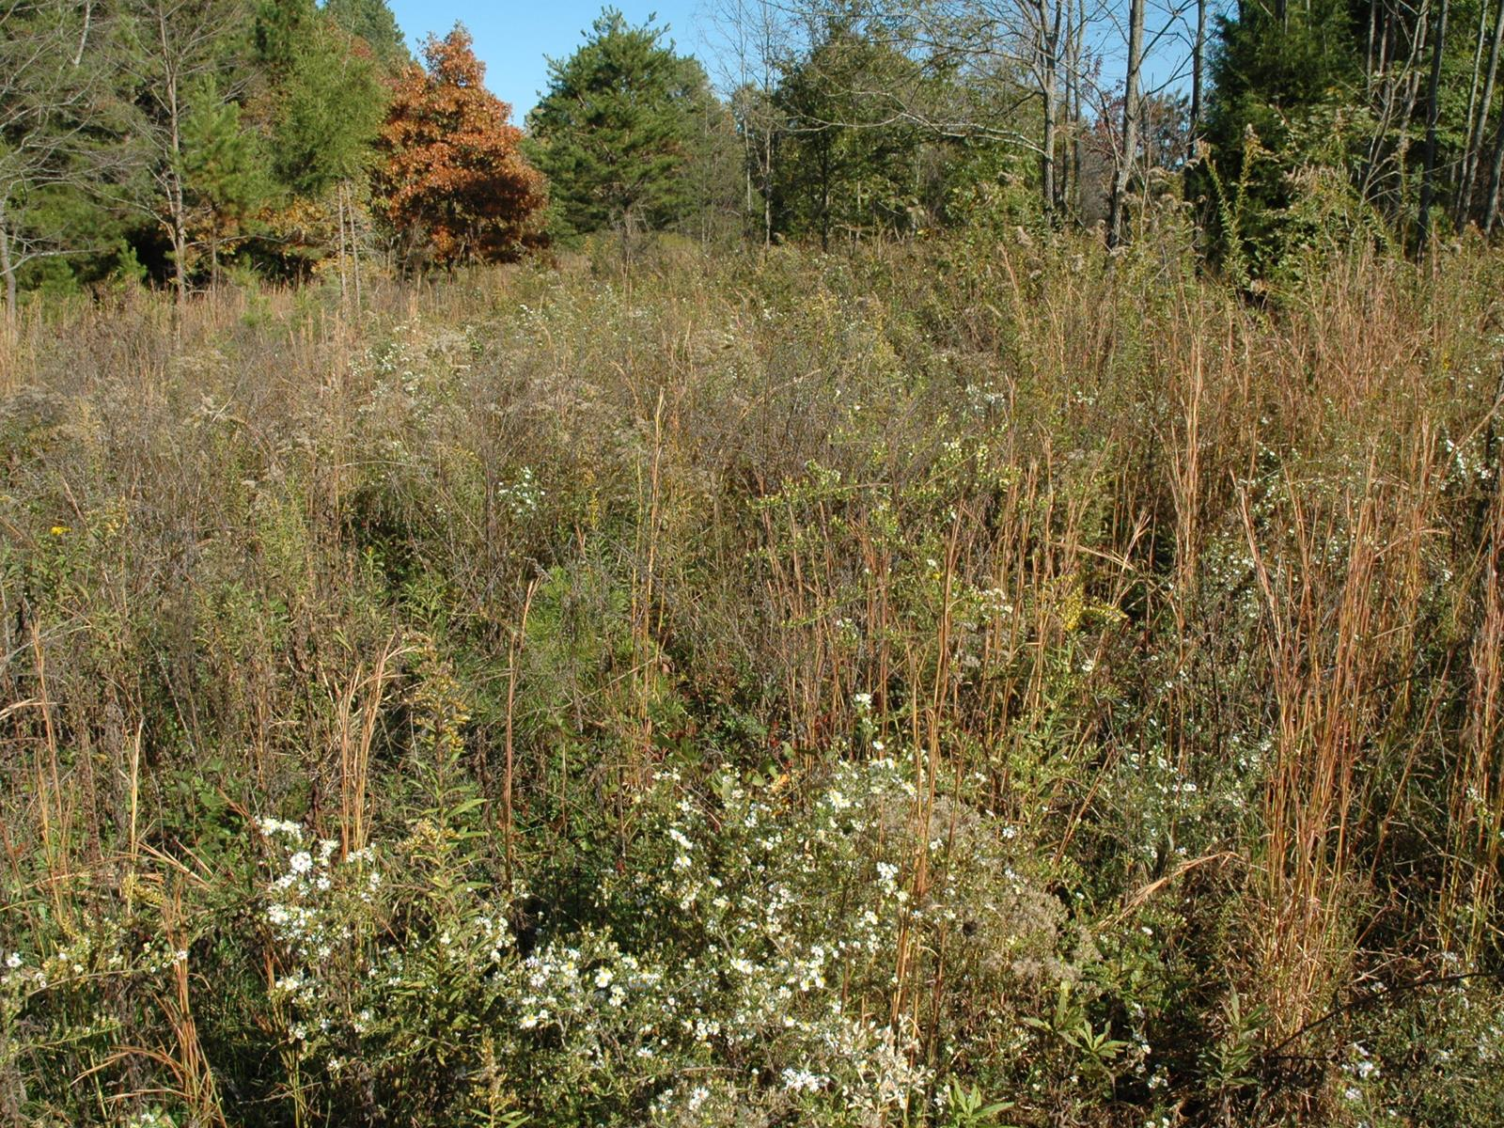

Slide 20
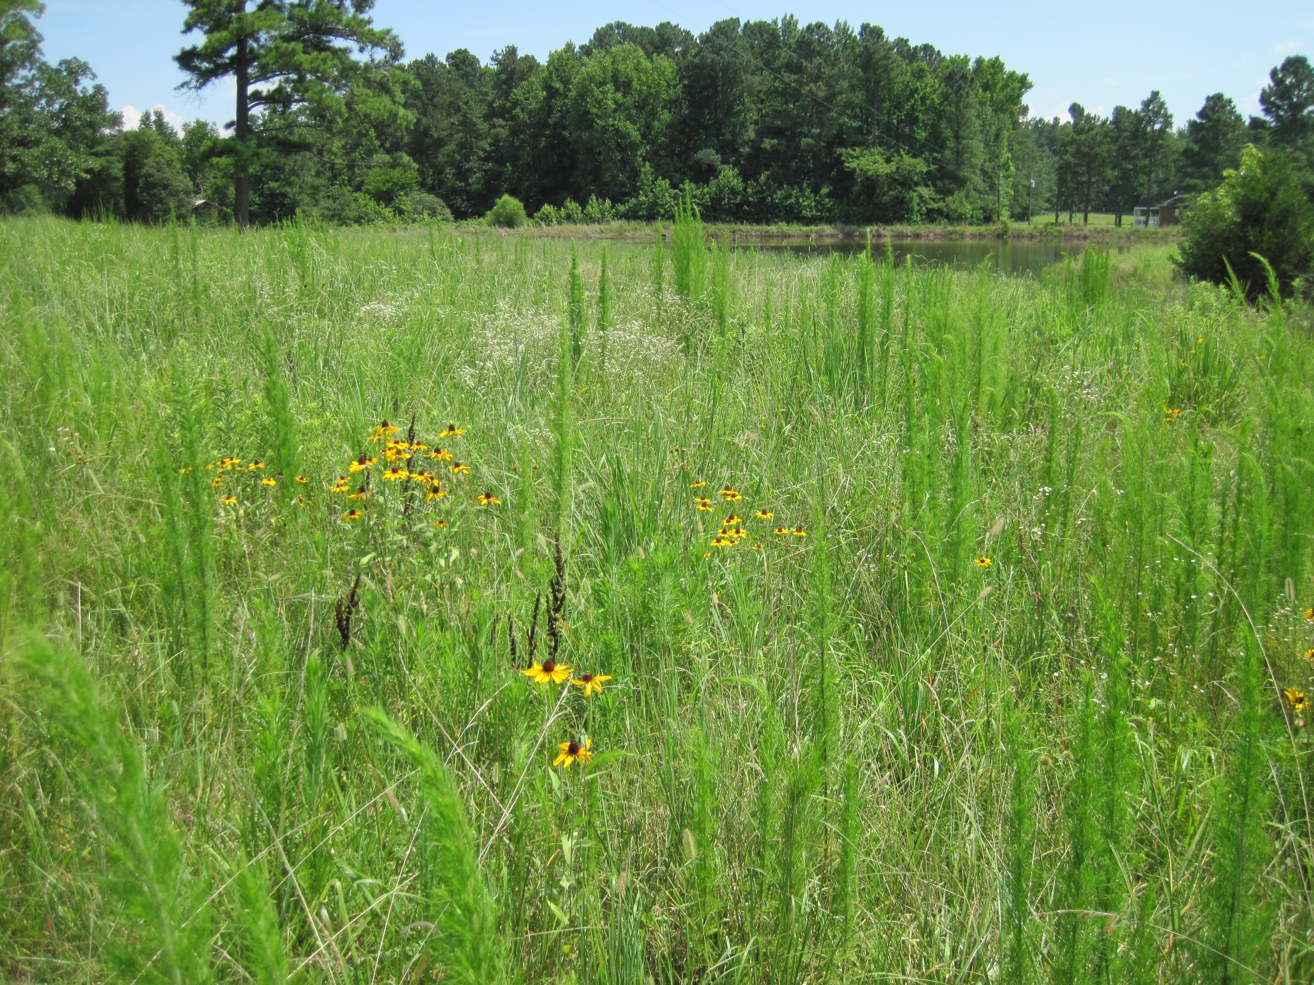

Slide 22
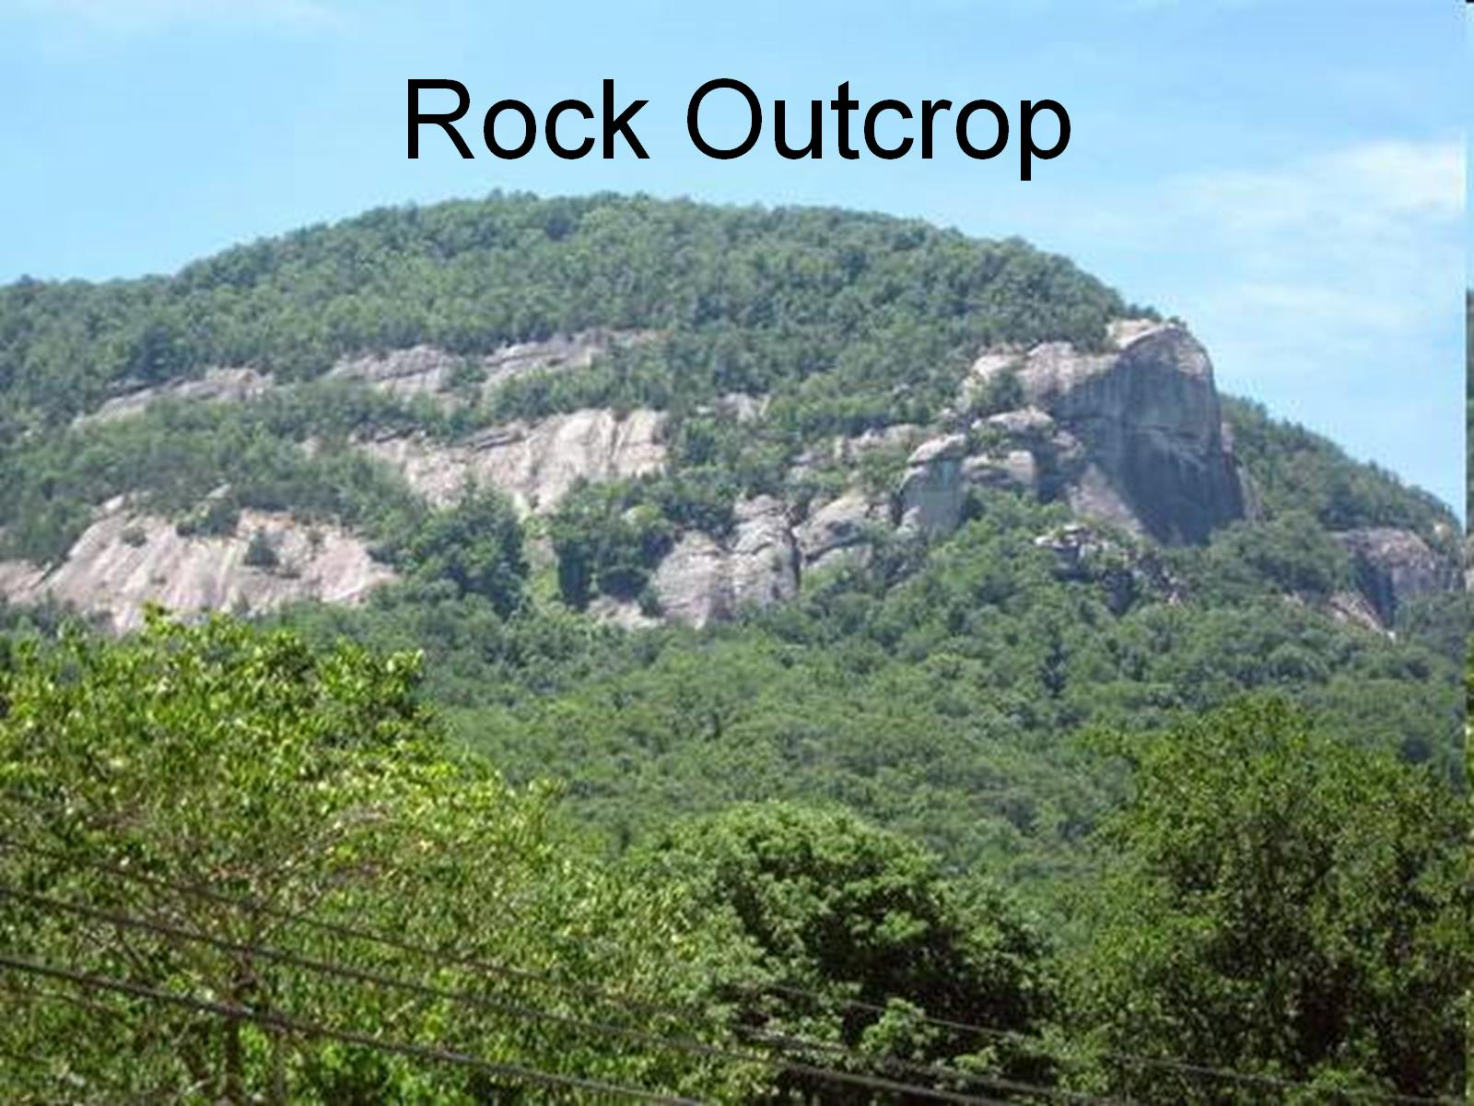
Rock Outcrop

Slide 23
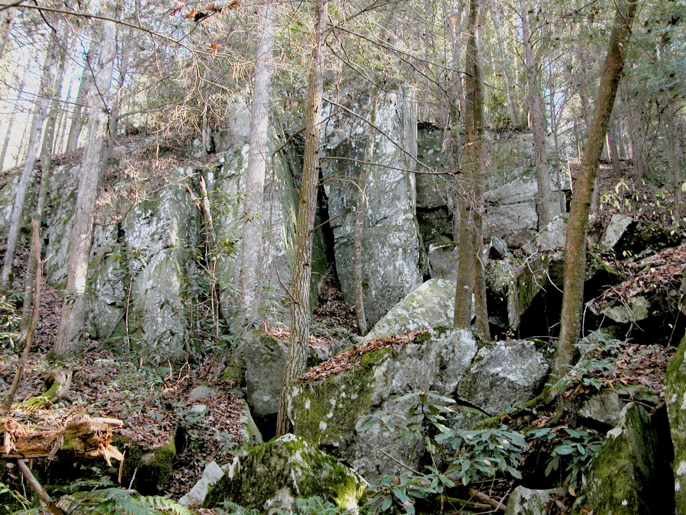

Slide 24
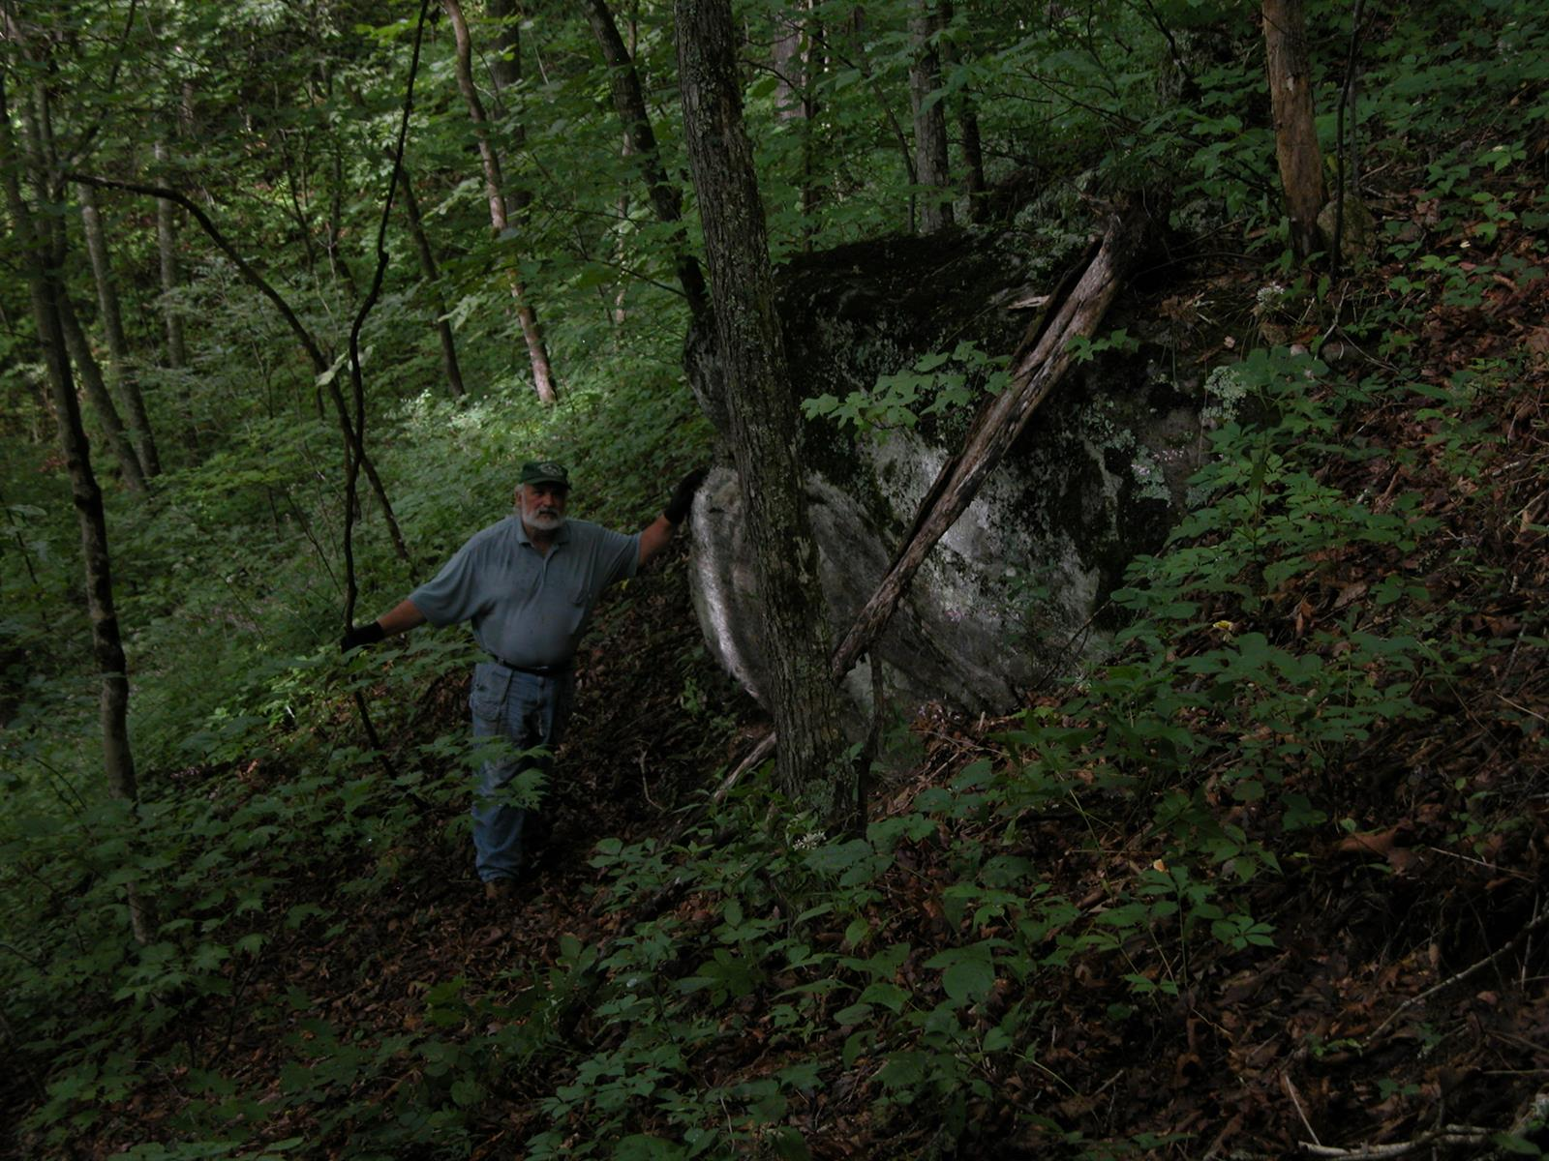

Slide 28
Stream & Riparian Habitat

Slide 29
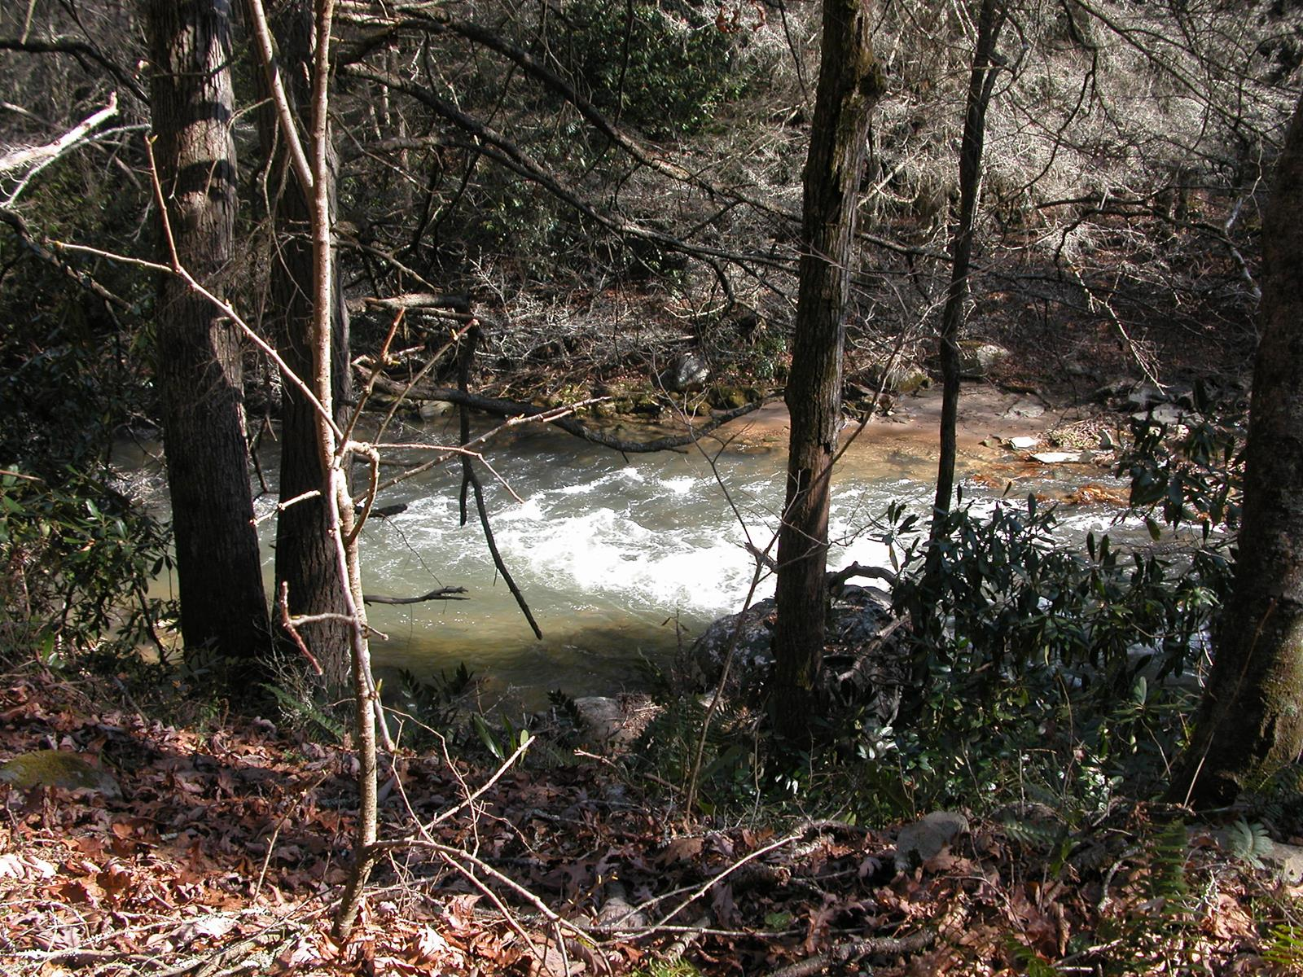

Slide 30
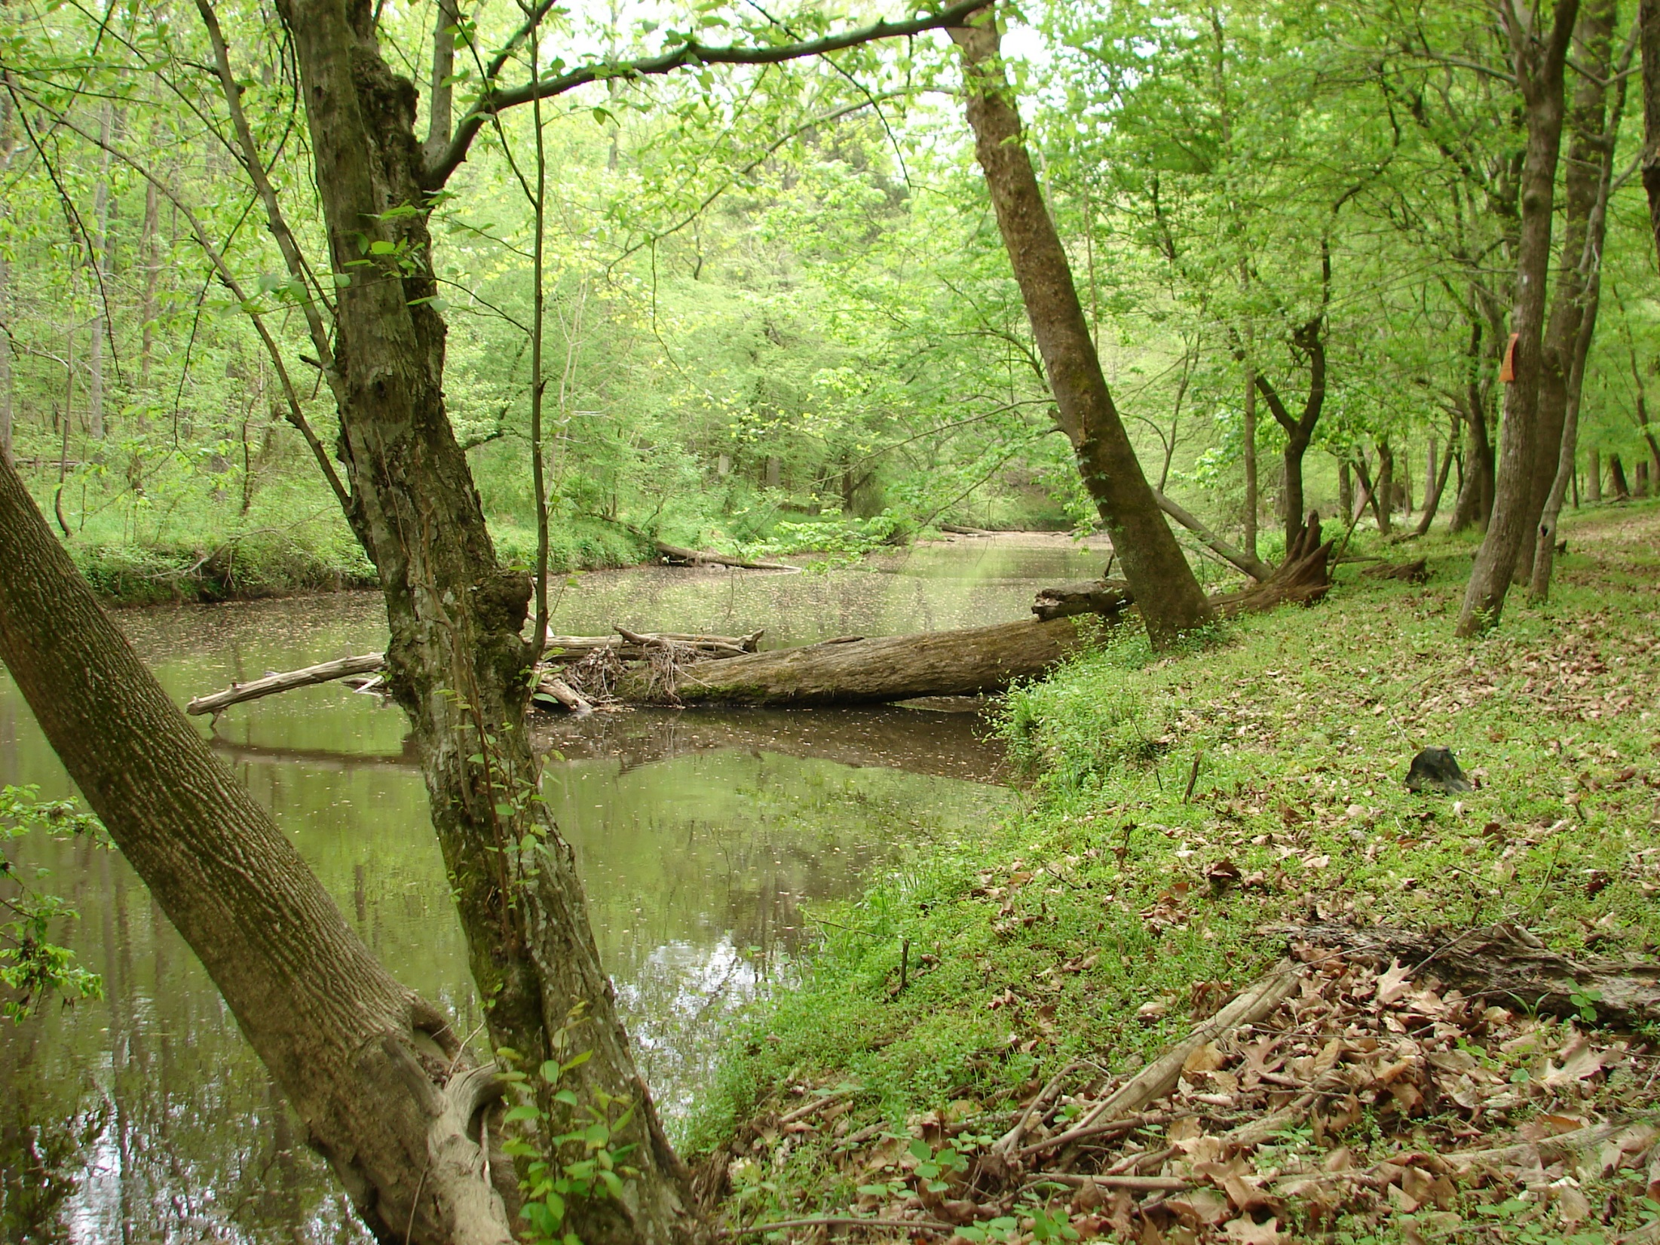

Slide 31
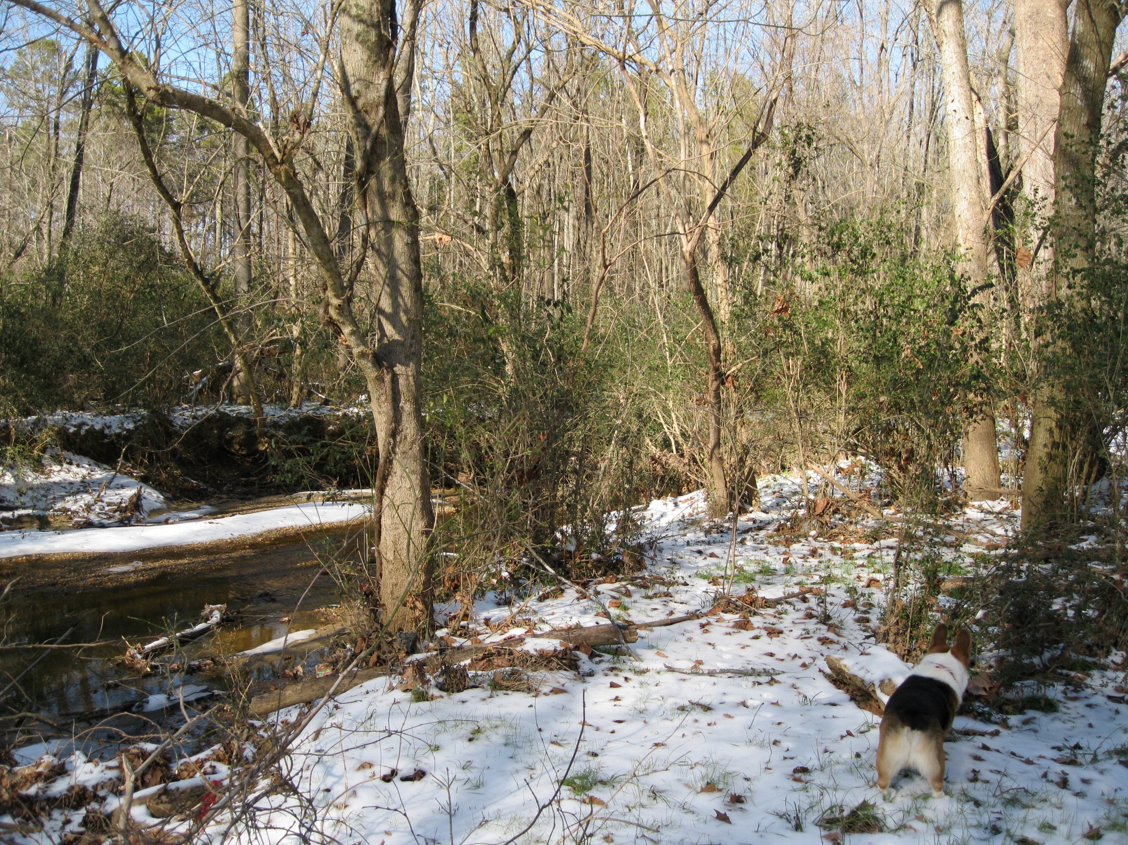

Slide 32
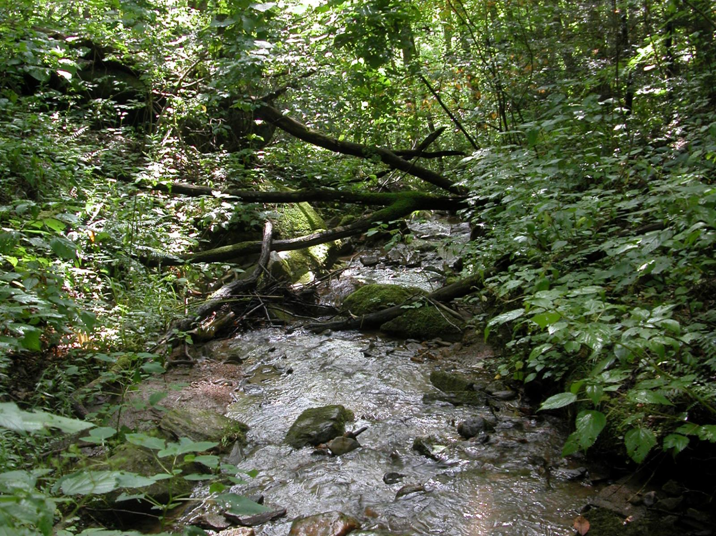

Slide 33
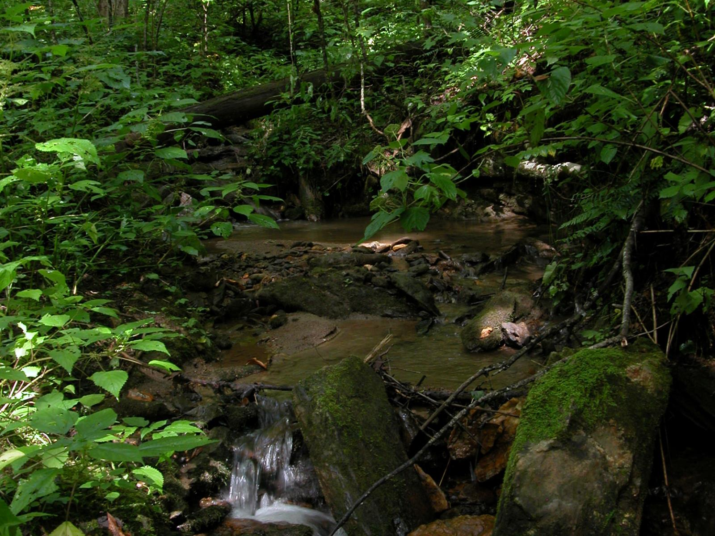

Slide 36
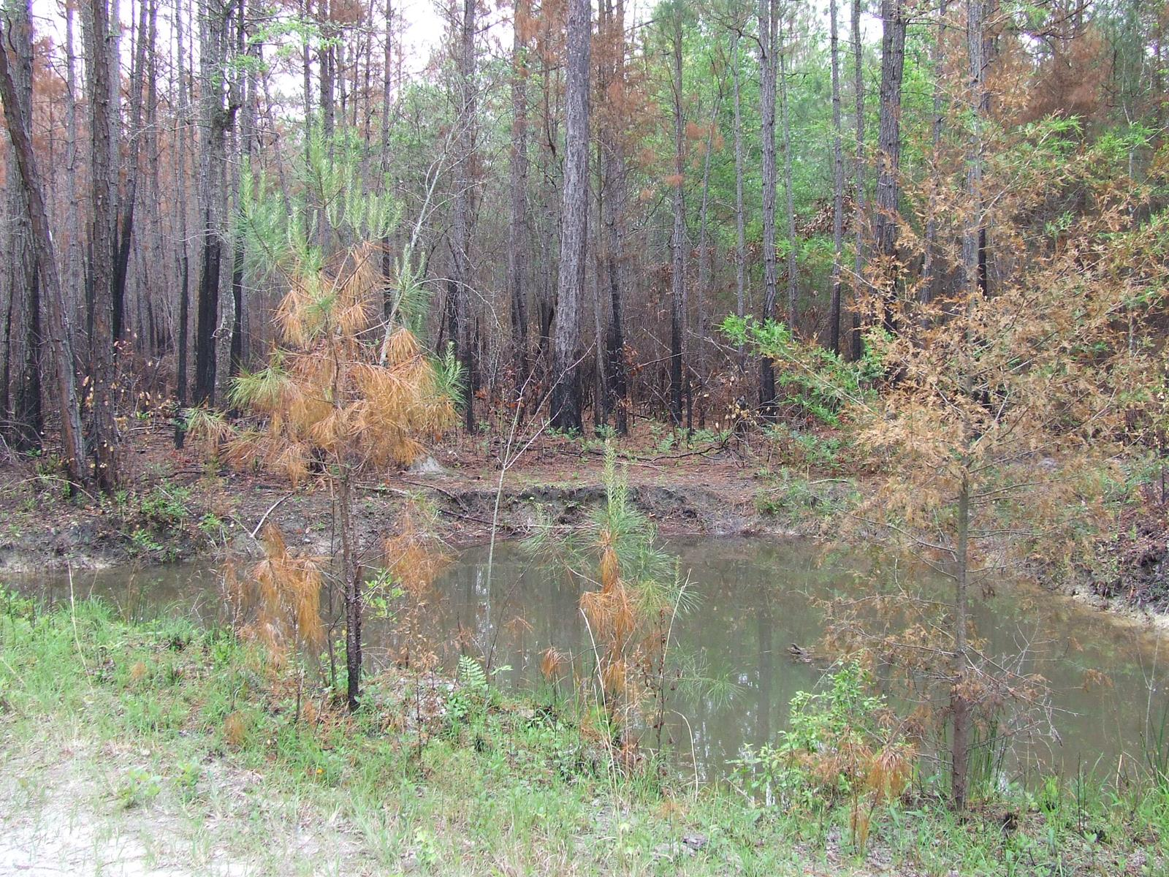

Slide 37
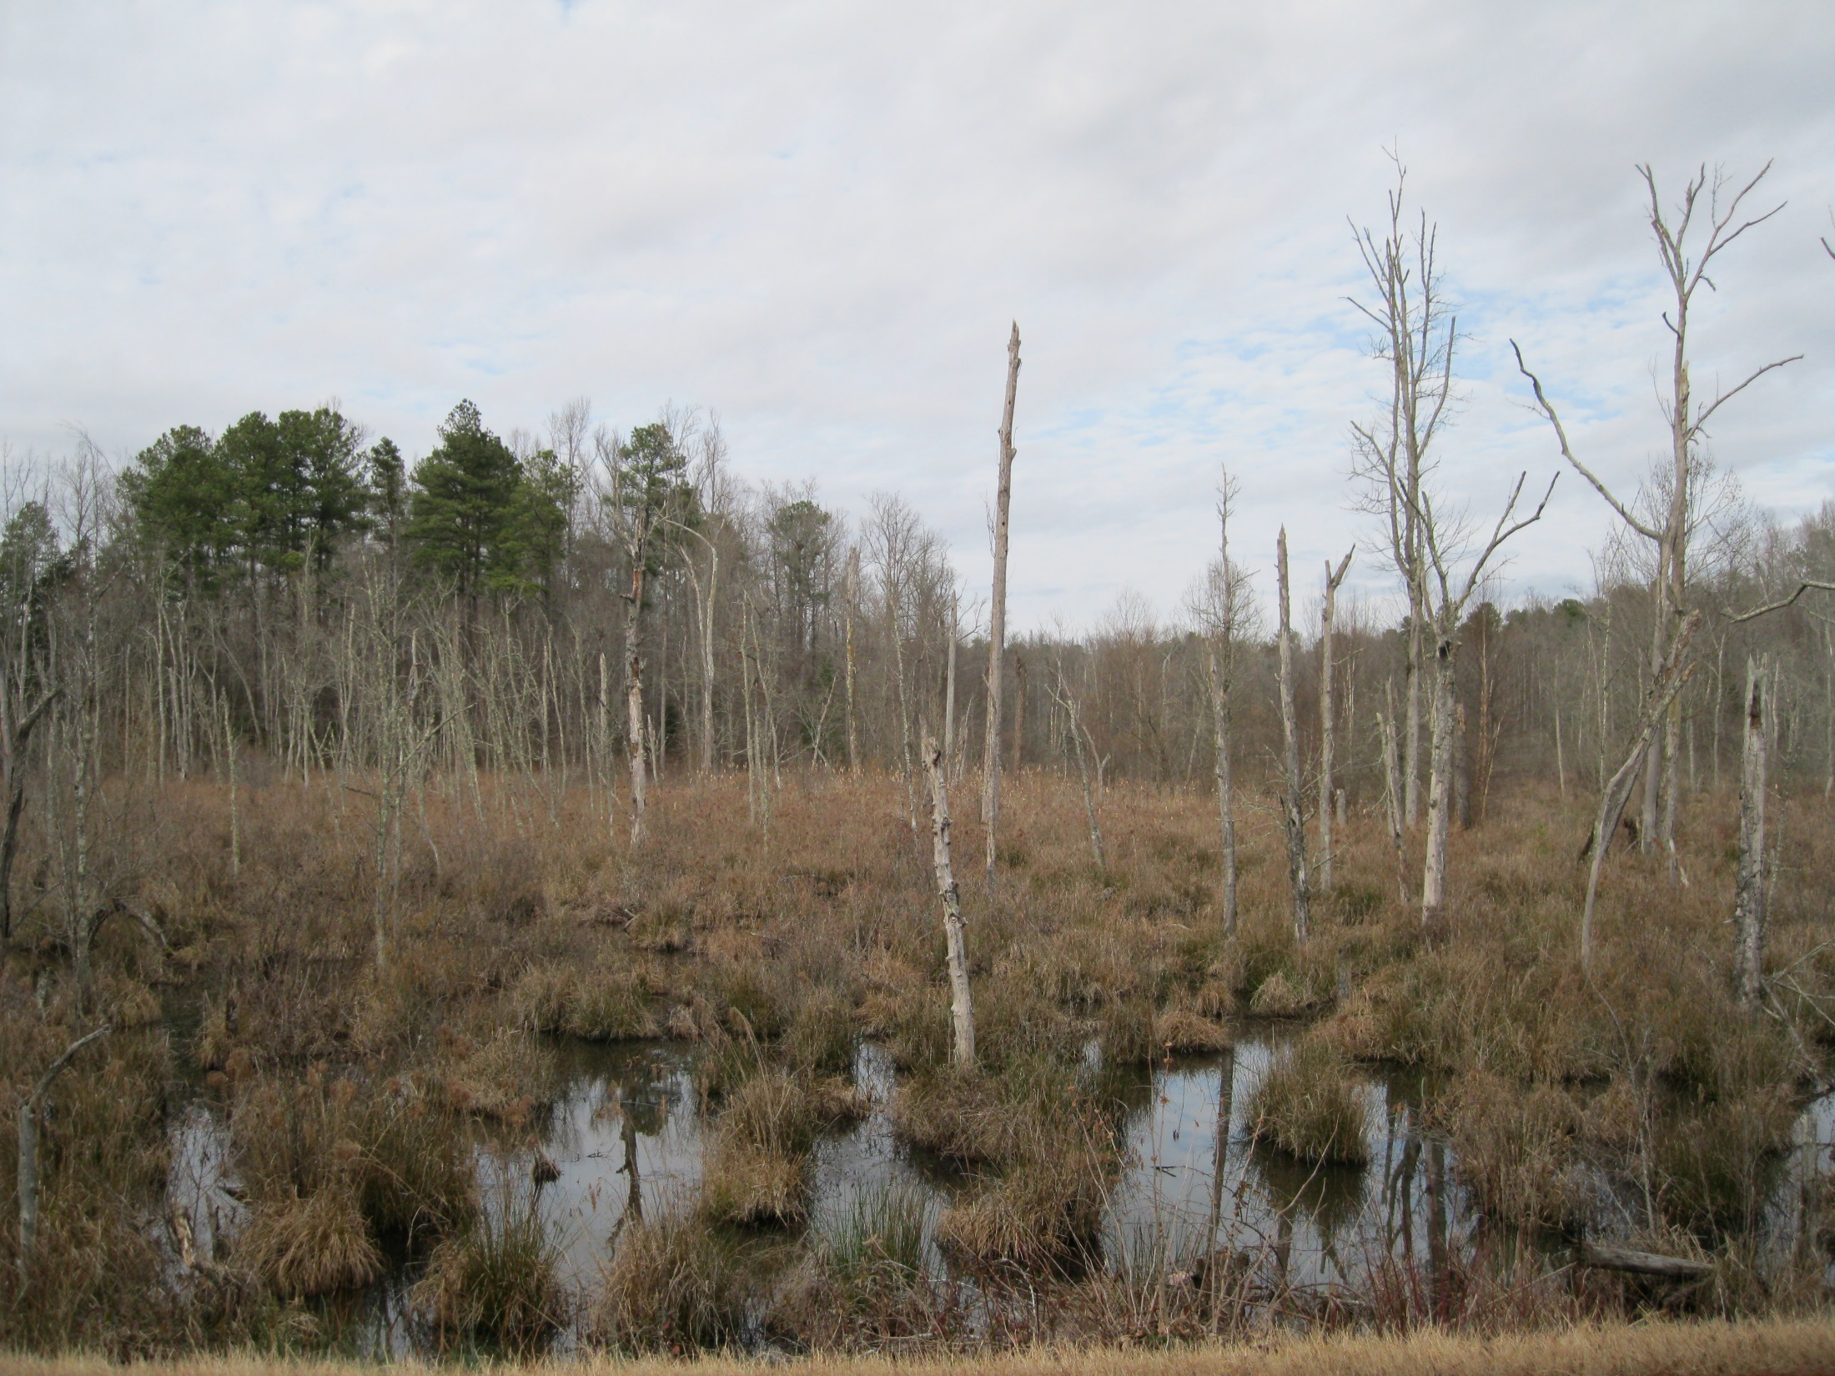

Slide 38
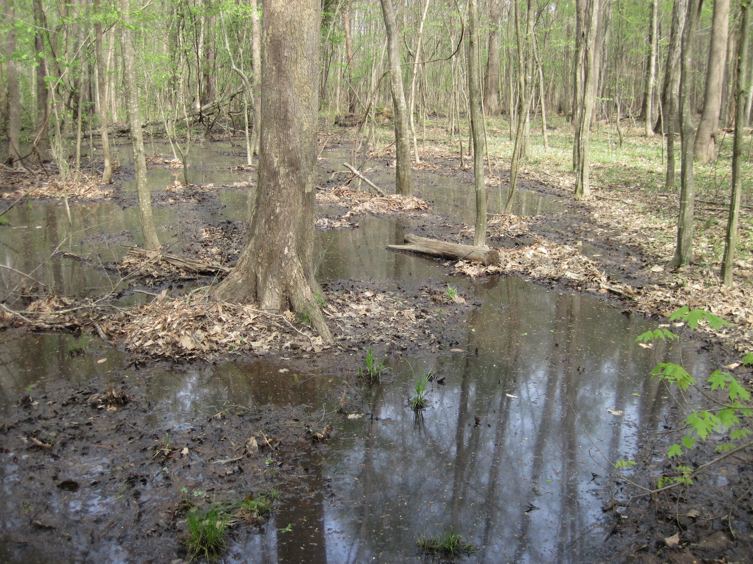

Slide 40
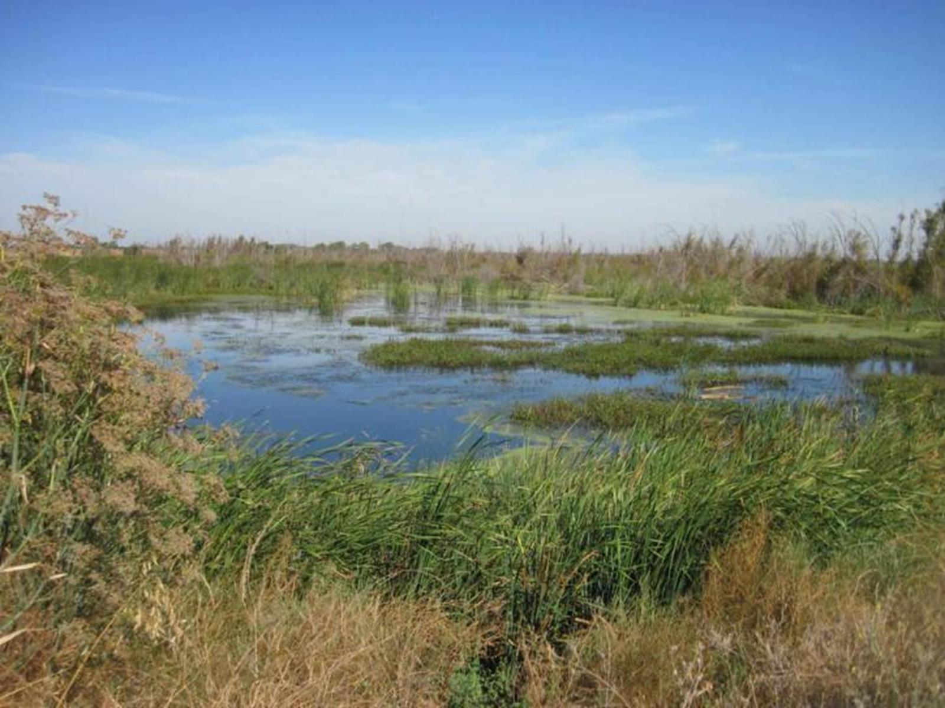

Slide 41
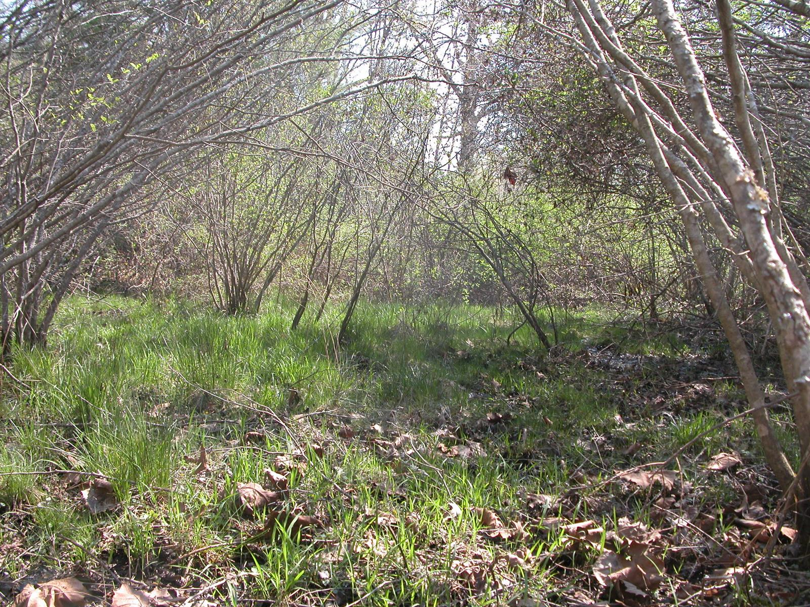

Slide 42
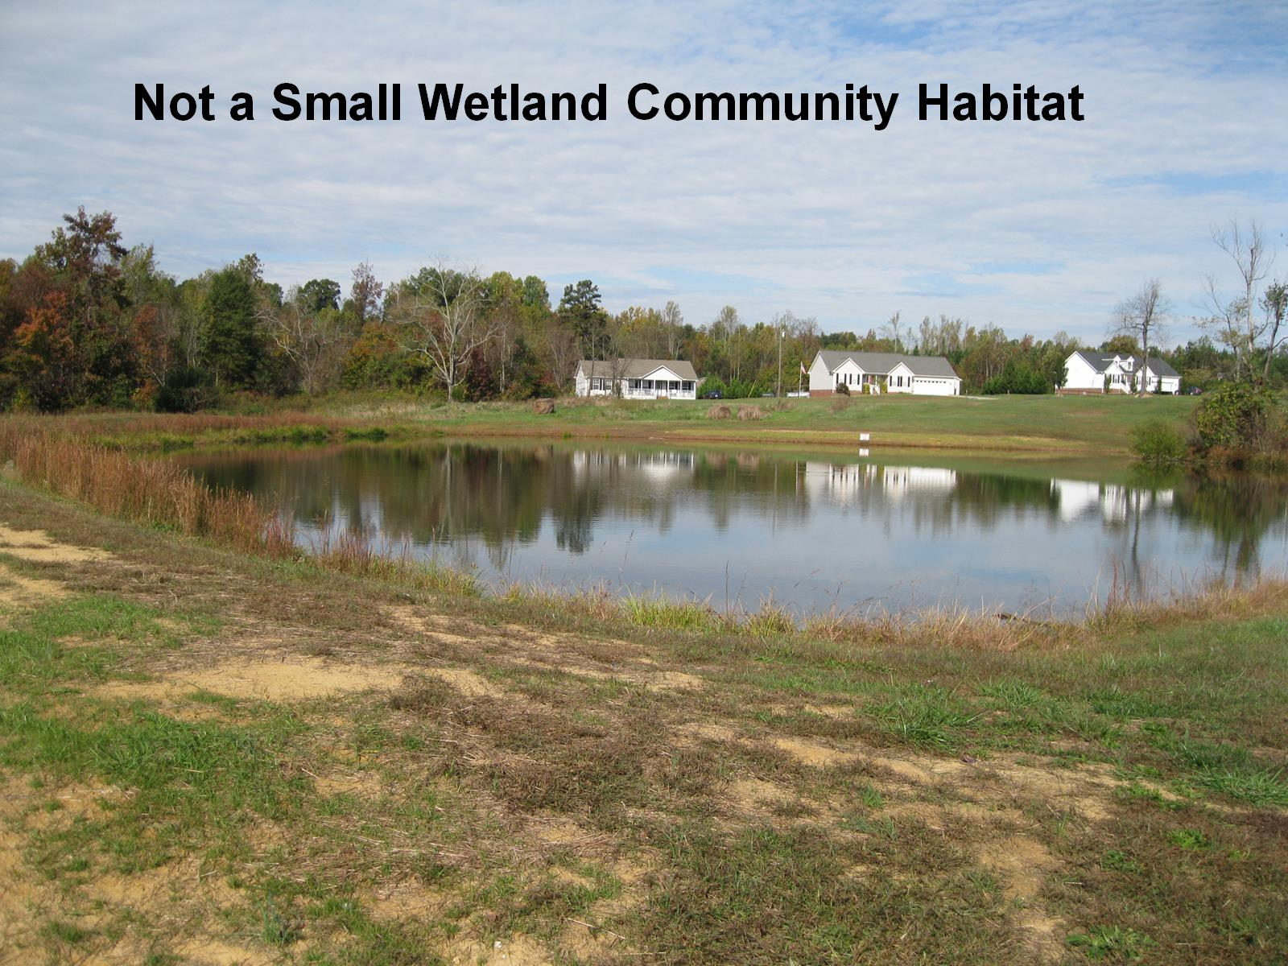

Slide 43
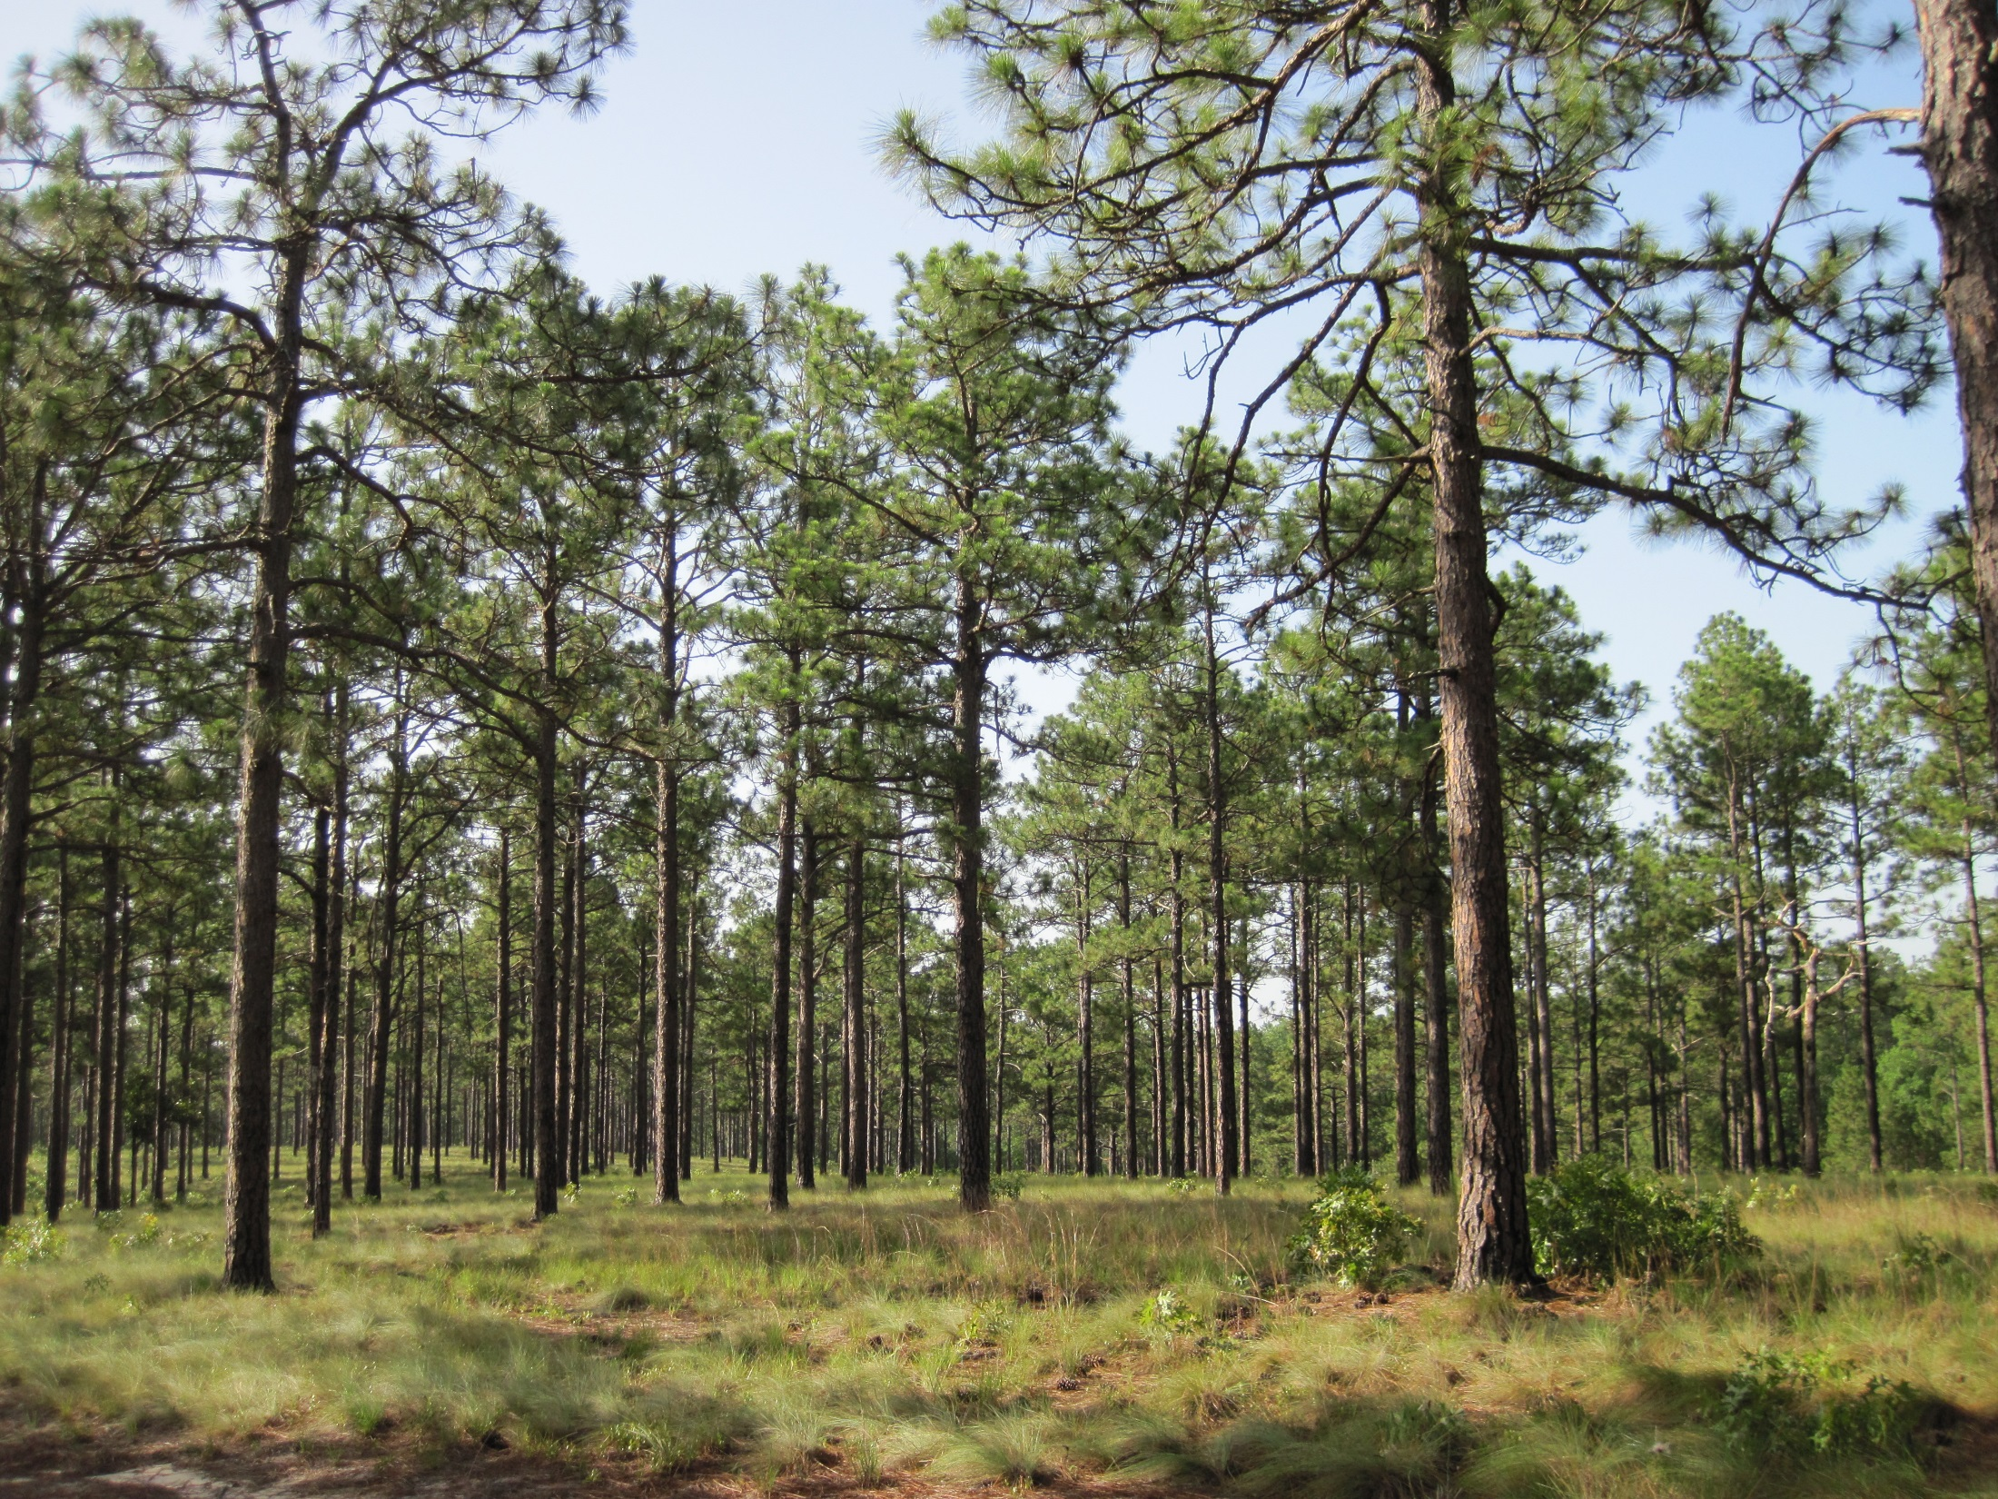
Longleaf Pine Habitat

Slide 44
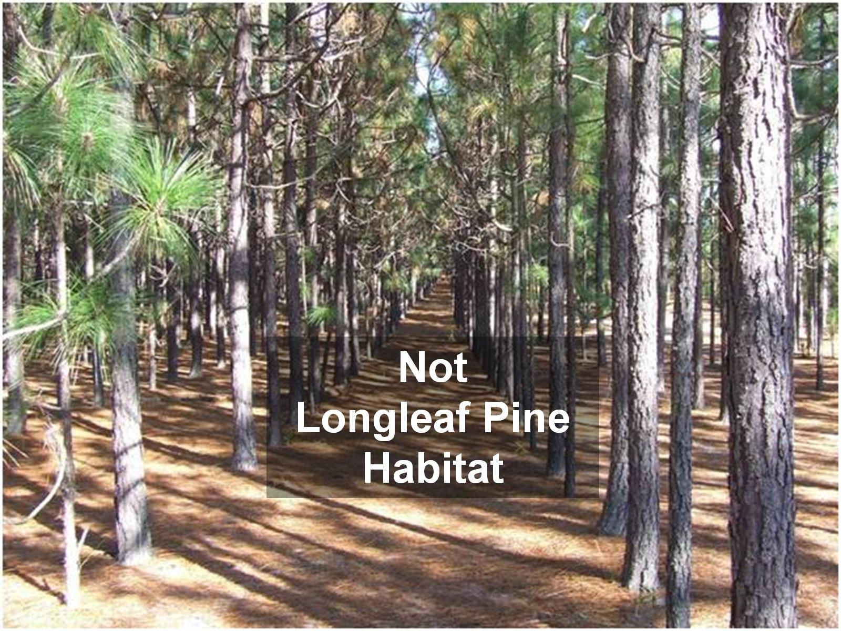

Slide 46
Contact Information
For additional information on the WCLP or for applications, contact the WRC at:
http://www.ncwildlife.org/Wildlife_Species_Con/index.htm
1722 Mail Service Center, Raleigh, NC 27699-1722
919-707-0050

