Slide 1

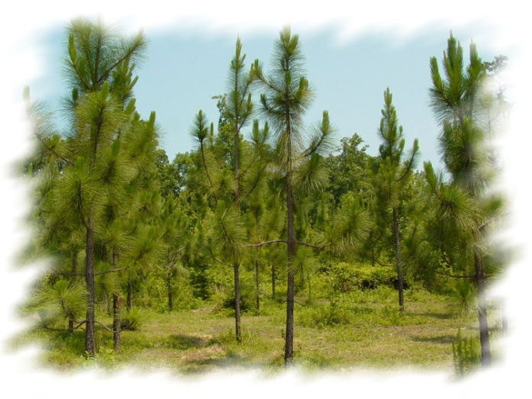

Forest Management Plans
and Programs
Sean Brogan, NCFS
2015 Advanced Real Property Seminar
Greensboro, NC

Slide 2
Overview
Woodland plans
Forestry PUV
Forestry programs

Slide 3
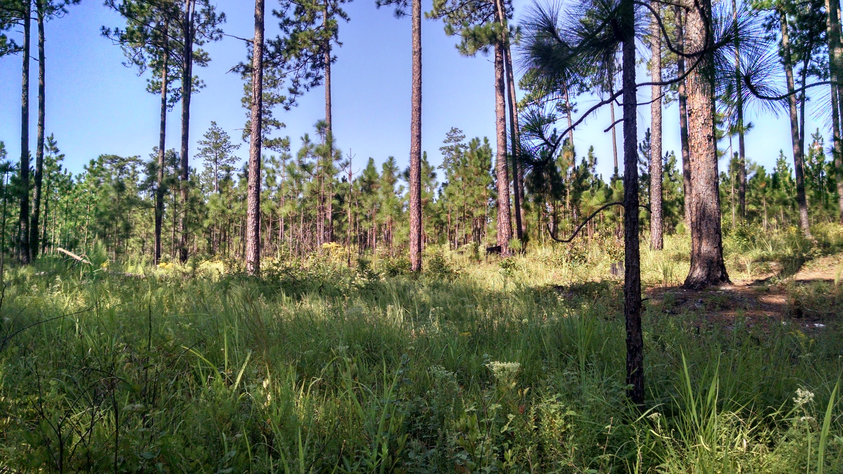
Woodland Plans

Slide 4
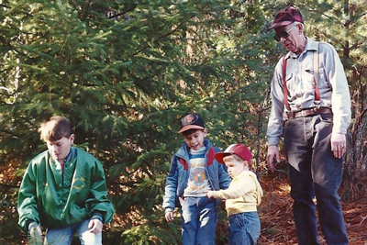
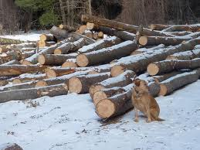
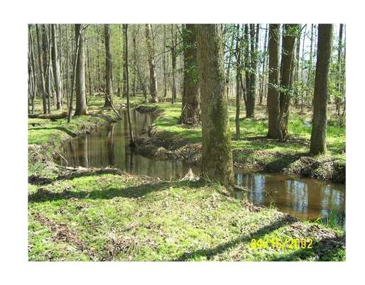
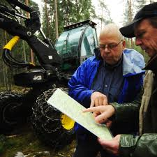
Woodland Plans - Benefits
Pass on to heirs
Maximize financial benefits
Protect sensitive areas

Slide 5


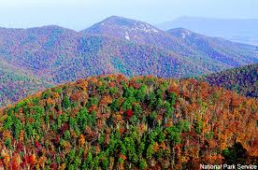

Woodland Plans - Benefits
Manage wildlife
Improve aesthetics
Increase recreation

Slide 6




Woodland Plans - Benefits
Qualify for Forestry Present Use Value
Show you are “practicing forestry” if questioned
Qualify for costshare

Slide 7

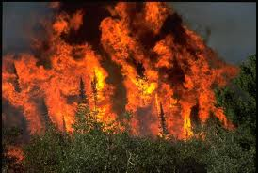
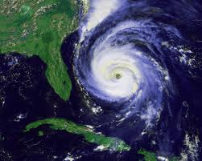

Woodland Plans - Benefits
Qualify for forestry certification programs
Recover losses from wildfires & storms
Help heirs “pick up the pieces”

Slide 8
Woodland Plans - Types
Typically
“PUV-worthy”
Overarching Plans
Forest Management
Forest Stewardship
Supplemental Plans
Regeneration
Replanting
Practice
Pre-Harvest
Rehabilitation

Slide 9
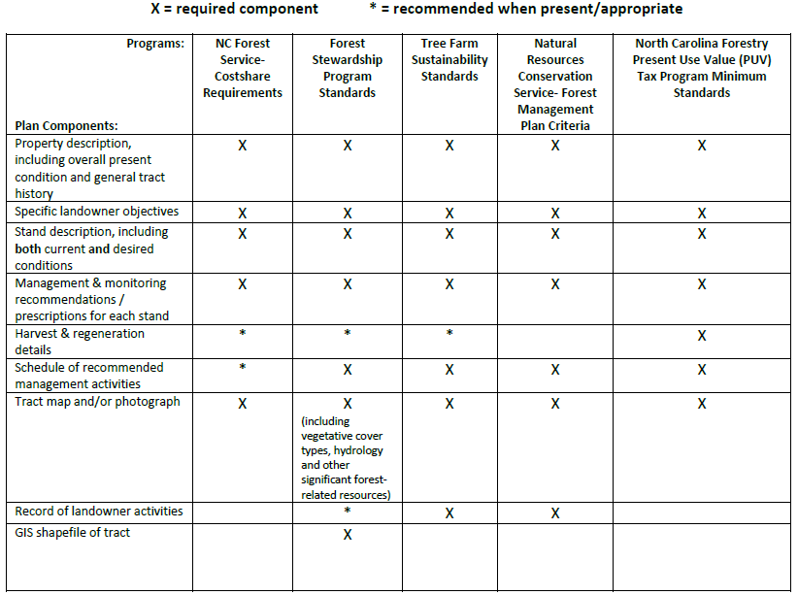
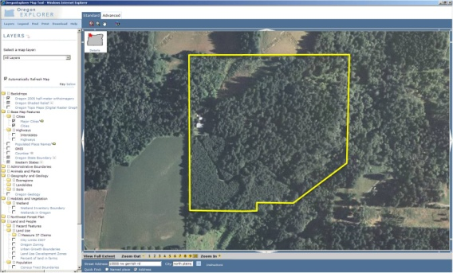
Woodland Plans - Components
Forestry PUV

Slide 10
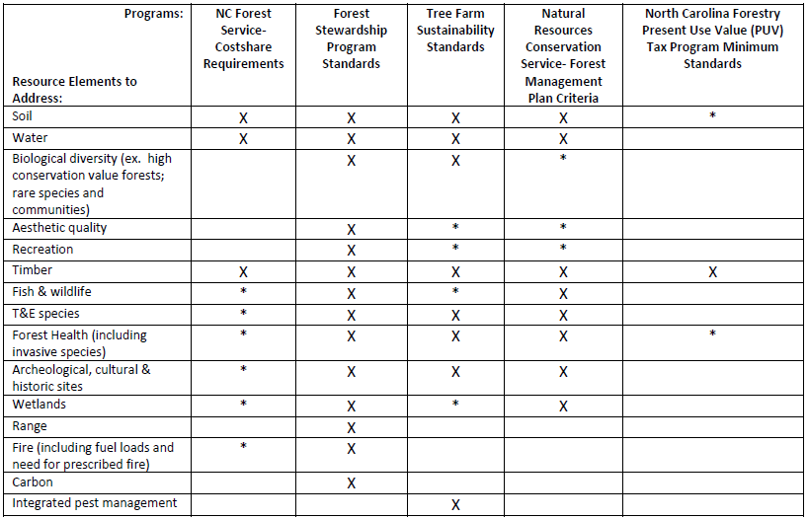

Woodland Plans – Resource Elements

Slide 11
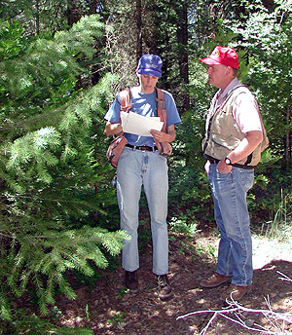
Woodland Plans – Typical Authors
  NCFS
  Consulting Foresters
    NCFS refers 2,173 tracts & 114,146 acres /yr
  Tree Farm Inspectors
  NC Wildlife Resources’ Biologists
  industry Foresters
  landowners (be careful)

Slide 12
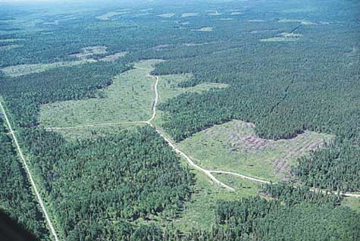
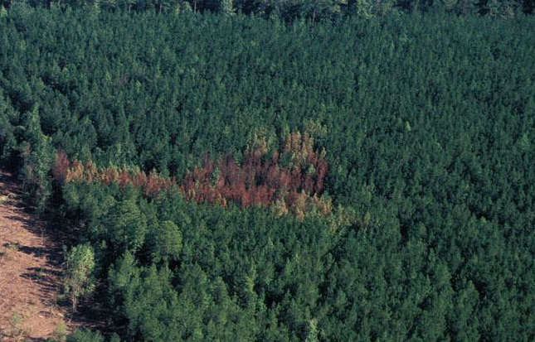
Woodland Plans – Updates
new road
system
beetle outbreak
Overarching plans typically updated every 10 years, but…
Update as needed: changing objectives; new owners; insect or disease; fires or storms; improvements;
invasive species

Slide 13
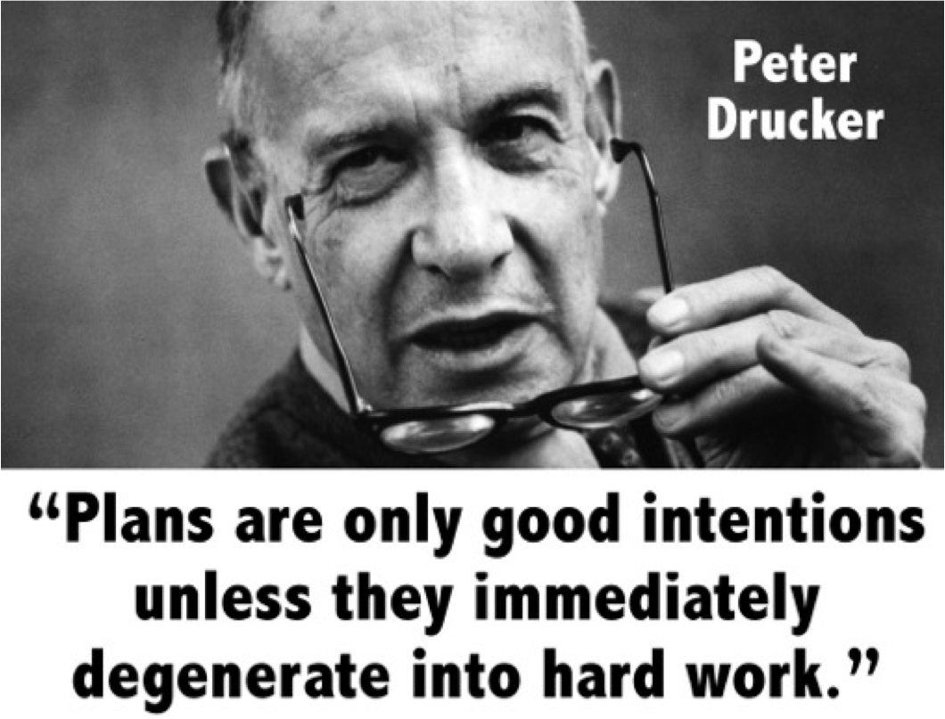

Slide 14
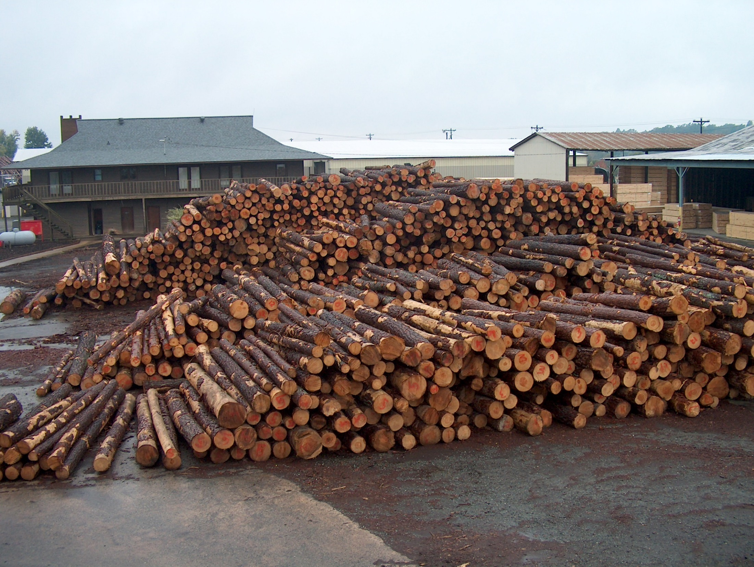
Forestry PUV

Slide 15
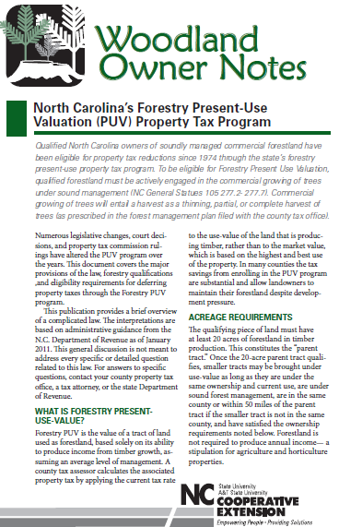
“NC Forestry PUV
Property Tax Program”
Woodland Owner Note (8/2011)

Slide 16
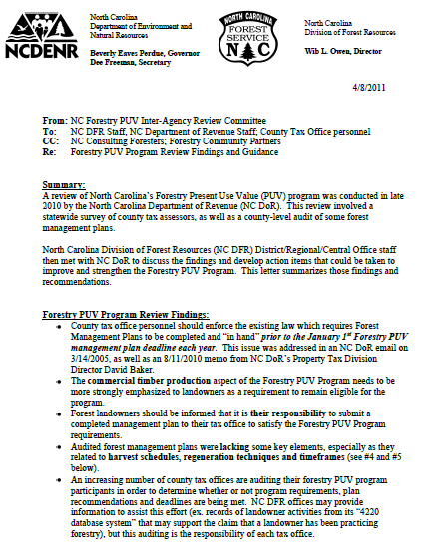
2010 Inter-Agency
Review of Forestry PUV
(DoR, NCFS & NCSU)

Slide 17
2010 Inter-Agency Review of Forestry PUV
Key Findings
harvesting requirements
January plan submittal
plan elements (harvests, regen, timelines)
increase in audits

Slide 18

“So how can we work together?”

Slide 19
“What can Tax Offices do to Make
Forestry PUV Run Smoothly?”
stress harvesting requirements
stress January plan submittal
talk with County Ranger (backlogs)
stagger re-assessments
Woodland Owner Note #40

Slide 20
“What can NCFS/Foresters do to Make
Forestry PUV Run Smoothly?”
stress harvesting requirements
identify “non-PUV” landowners
plan components/elements
communicate backlogs
Woodland Owner Note #40

Slide 21
“What can landowners do to Make
Forestry PUV Run Smoothly?”
understand harvesting requirements
get plan early / update
understand guidance and Woodland
Owner Note #40
document management
communicate (tax office, NCFS, etc.)

Slide 22
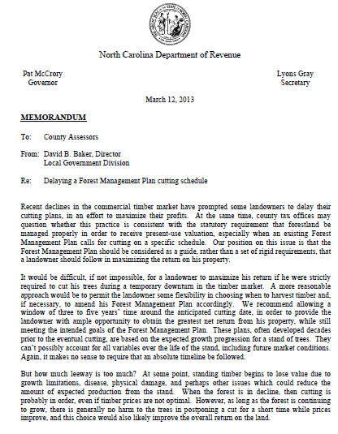
DoR Memo:
Forestry PUV
&
Delayed Harvests
D. Baker 3/2013

Slide 23
DoR Memo:
Forestry PUV & Delayed Harvests
“…the Forest Management Plan should be considered as a guide, rather than a set of rigid requirements, that a landowner should follow in maximizing the return on his property.”
“We recommend allowing a window of three to five years’ time around the anticipated cutting date, in order to provide the landowner with ample opportunity to obtain the greatest net return from his property, while still meeting the intended goals of the Forest Management Plan. “

Slide 24
DoR Memo:
Forestry PUV & Delayed Harvests
“If the county questions the soundness of a landowner’s decision to postpone a cut beyond that called for in the plan, then perhaps a review of the property with a forester would be appropriate. We have previously recommended that counties contract with a forest consultant to provide assistance and expertise in conducting audits of forestland . “

Slide 25
“Who Decides if Landowners are Meeting
the Forestry PUV Requirements?”
tax office responsibility
counties can hire consultants
NCFS can provide supporting info of
known forestry activities

Slide 26
“Sources of Assistance for
Forestry PUV Questions”
DoR
NCFS
    County Ranger
    District Forester
    Central Office staff
NCSU Extension Forestry
Contracted Consultant

Slide 27
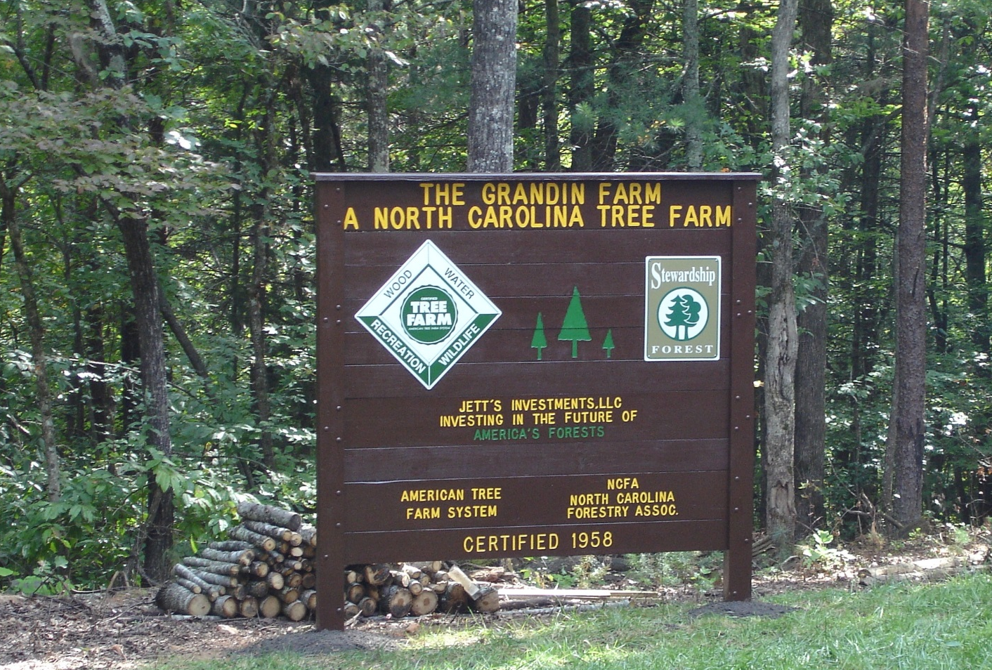
Forestry Programs

Slide 28
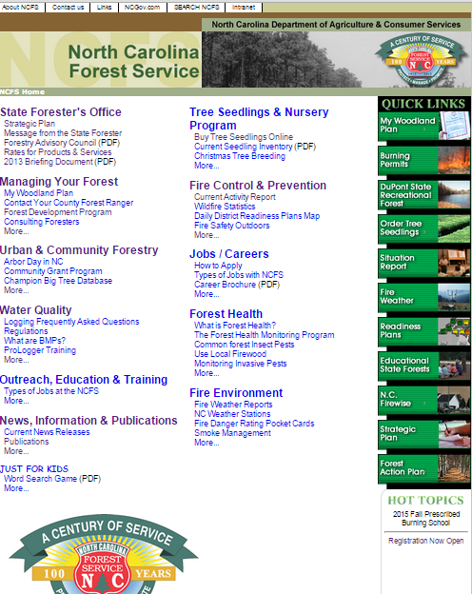
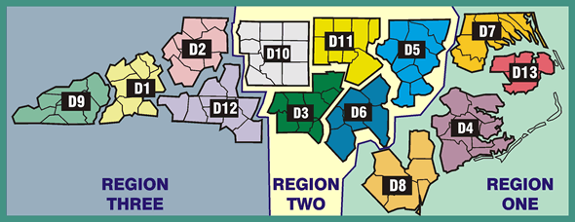
“Contact Us” link
http://ncforestservice.gov
phone list, org chart, office locations

Slide 29
“Managing Your Forest” link

Slide 30
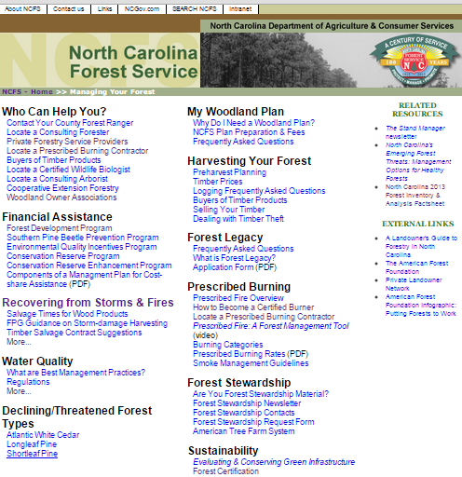
“NCFS Plans” FAQs, rates, etc.
“Forestry Professionals” links
“Forestry Costshare” links

Slide 31
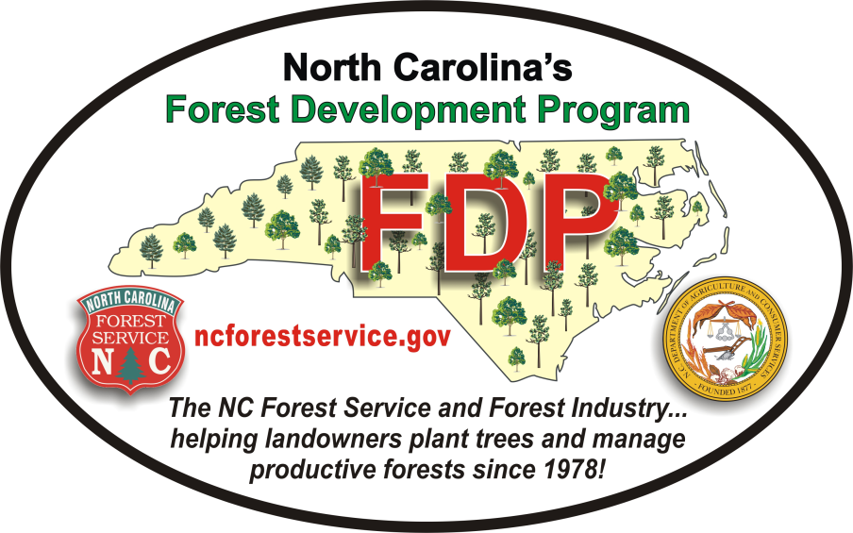
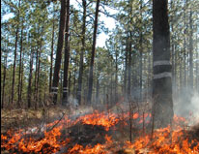

NCFS Programs & Services
Annually
  6,500 plans (350,000 acres)
  6,000 water quality inspections
  1,500 FDP costshare participants
  Insect/disease detection
  Environmental education
  Prescribed burning

Slide 32
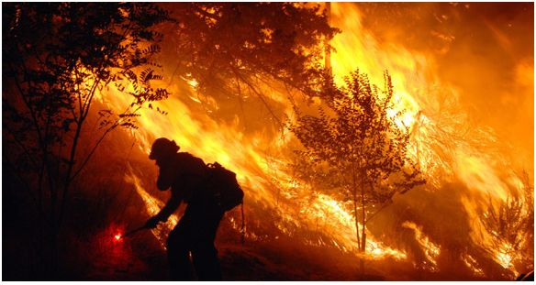
NCFS Emergency Response
      5,000 wildfires, 25,000 acres/yr
      hurricanes, floods, ice-storms (bird flu?)
      North Carolina & elsewhere
      plan delivery times can be impacted

Slide 33
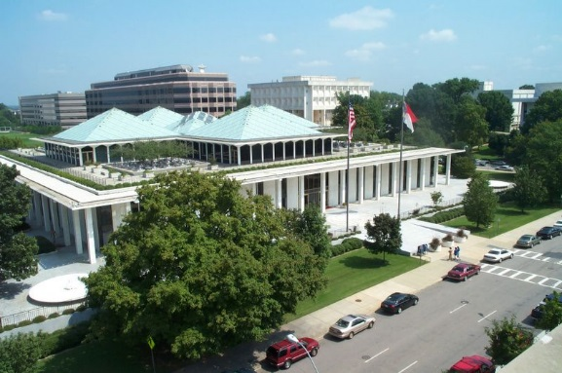
NCFS Management Plan Fees
Legislatively-mandated
implemented 8/2014
$760,000+ appropriations
Rulemaking exemption (7/1/16)
details on NCFS website
does not apply to all plan types
most NCFS services still no-cost

Slide 34
SESSION LAW 2014-100 SENATE BILL 744
"§ 106-1004. Fees for forest management plans.
The Board of Agriculture shall establish by rule a schedule of fees for the preparation of forest management plans developed pursuant to Article 83 of this Chapter. The fees established by the Board shall not exceed the amount necessary to offset the costs of the Department of Agriculture and Consumer Services to prepare forest management plans."

Slide 35

NCFS Management Plan Fees – Impacts*
NCFS-written plans 40% (50% less acres)
“Supplemental Plans” reduced more than “Overarching Plans”
  Stewardship Plans 15%
  Forest Mngt. Plans 45%
  Regeneration Plans & Urban Plans 60%
  Practice Plans 70%
Site Preparation / Establishment 25%
NCFS Referrals to Consultants 30%
Plans by “Others” 15%
* 9-mth comparison between 2013-14 & 2014-15

Slide 36


Slide 37

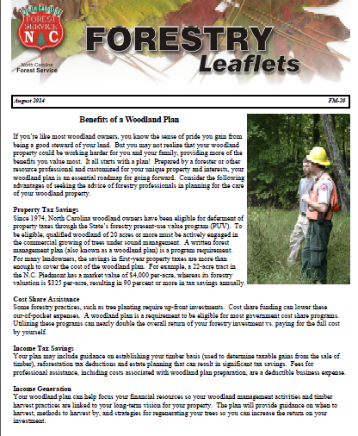
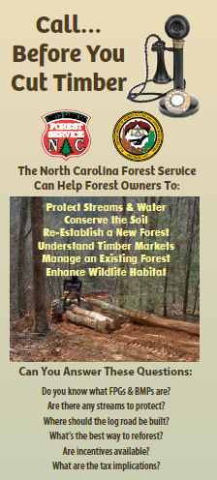


NCFS Response
Outreach…training …salesmanship

Slide 38
NCFS Response
  Emphasis on tailored, quality plans
  NCFS staffing re-organization?
  (consider historical/expected fire control)

Slide 39

NCFS Response
personnel shifted to “busy” counties
low-request counties = more time for other duties

Slide 40
Big Picture Impact
Effective landowner outreach key to avoiding longterm drop in:
soundly-managed acres…
properly-harvested sites…
timely reforestation…
sustainable timber economy

Slide 41
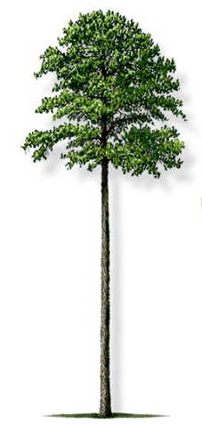
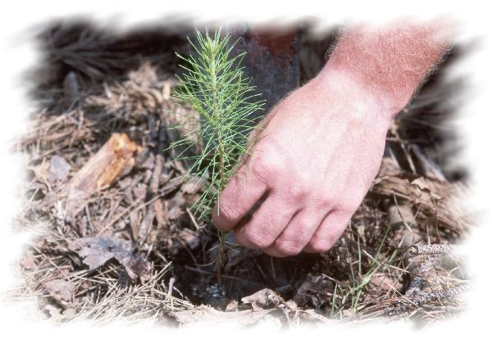
Final Thought
“You can’t see the forest through the trees”
The “trees” (plan requirements, Legislative mandates, budget impacts) can blind us all…..
Don’t lose sight of the “forest”
(sustaining NC’s healthy, productive forests)

Slide 42
Thanks so much for all you do
to keep working forests working
Sean Brogan
Director of Forest Management & Development
sean.brogan@ncagr.gov
919-857-4818

