Slide 1

Tag and Tax Analysis
By William Samuel Godwin
VTS Analysis Intern NC DOR

Slide 2
Intro
What is VTS (Tag & Tax program)?
  Implemented in 2013
  Combined motor vehicle registration renewal and property tax collection system.
  Transferred the responsibility for motor vehicle tax collection from the 100 counties across North Carolina to the (DMV).
Who are all the stakeholders?
  NC DMV, NC DOR, NC Association of Assessing Officers, North Carolina Tax Collectors Association
  (Farragut and LPAs)
  Most of all, the Citizens of North Carolina

Slide 3
Change Control Board
  Any functionally or data changes/updates associated with Tag and Tax approved by the voting members of the CCB
    DMV Commissioner, DOT CIO, LGD Director, DOT Fiscal Director, NC League of Municipalities and Association of County Commissioners
  CCB meets to review change requests, vote on the change and prioritize based on critical, urgent, or ordinary need
  CCB must approve any changes of Tag & Tax that may impact its scope, budget, and system interface
  CCB’s voting members accept changes based on majority rule

Slide 4
Service Level Agreement

Slide 5
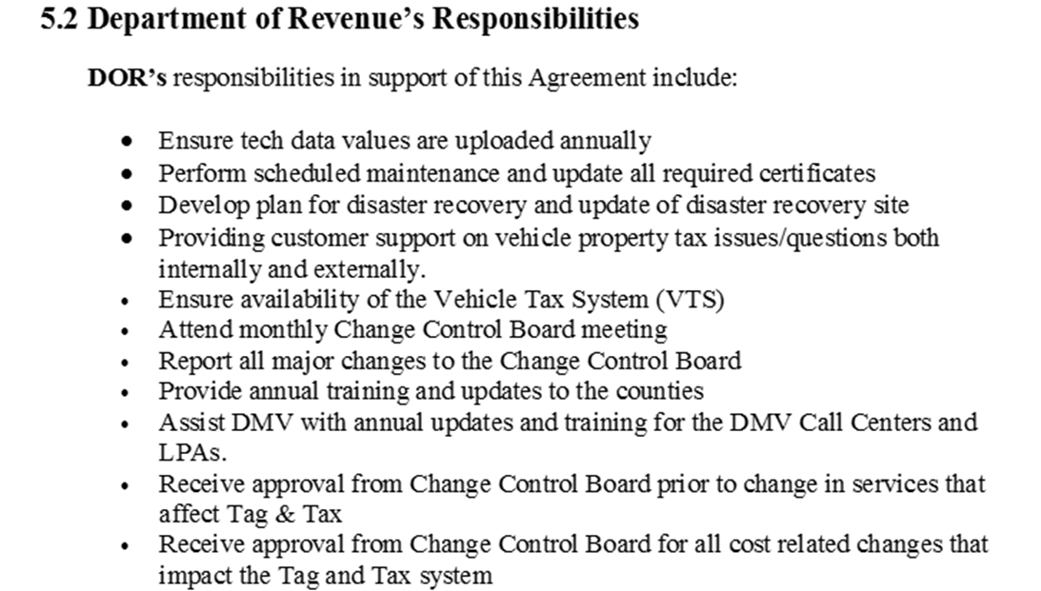
Service Level Agreement

Slide 6
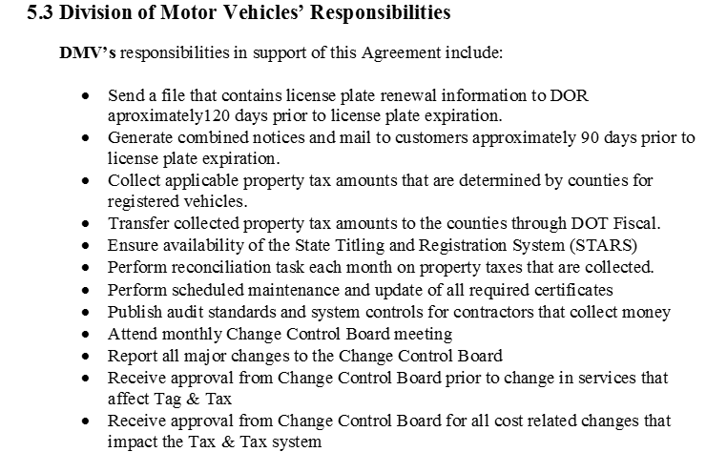
Service Level Agreement

Slide 7
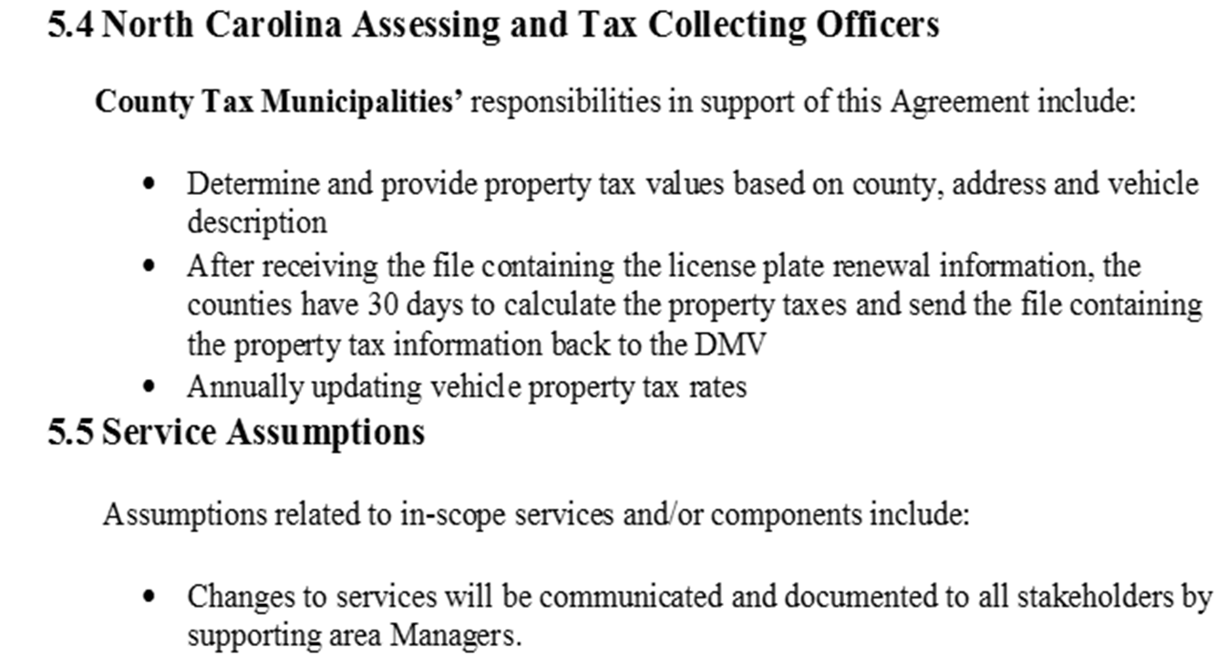
Service Level Agreement

Slide 8
MOU Major Objectives
Improve motor vehicle collection percentage in NC
Reduce the percentage of delinquent vehicle taxes
Improve customer service
Support an improved valuation process for NC Registered motor vehicles

Slide 9
Further Objectives
Analyze overall operating cost by county size
Difference in cost between county and DMV
Compare how and why of cost increase over the last 5 years
Who controls the budget?
Communication between stakeholders
Analyze current vendor contracts for vehicle valuations and printing

Slide 10
Current Cost per Transaction Type
LPA Comp- $1.08 per transaction when renewed at LPA
LRP Comp for LPA- $1.30 per LRP issued

Slide 11
Cost per Transaction Type
LRP - $0.50 for each LRP noticed mailed for taxes due
Overhead Fee- $1.26 per notice (printing, postage, valuation service, etc)
DMV VPT collection fee- $0.71 per transaction (property tax included LPA/online)

Slide 12
Current Cost per Transaction Type
POS Debit/Credit- 1.10 monthly avg credit and/or debit card fees when paid at LPA
PayPoint Fee- $0.04 point of sale credit/debit collections gateway fee per transaction
PayIt- Monthly blend
  1.85% credit cards & $1.25 ACH transaction.

Slide 13
Important Fee Changes
Present *(0.50 to 0.52) postage increase
PayPoint Fee (0.04) disappearing
Pay It fee recently replaced CPS and internet fee
Recent overhead fee increase

Slide 14
Fees at a Glance

Slide 15
Analysis
Cost Impact in relation to county size ( population)
Statewide county average 3-4%
Per DMV net collection smaller counties on average experience higher fees % of collections (FY 14-18 collection data)
  Swain-10%
  Jackson-7.97%
  Clay-7.079%

Slide 16
Fee Increase Impact
$0.02 increase mailing LRP notice
  FY 2018-19 July-June $17,008.30
  AVG annual fee increase per county- $170.08
FY 18-19 average fees per county
  July-April, $252,036.87
July-April Statewide renewals
  7,886,189

Slide 17
Fee impact results
County results varied on greatest increase in fee percentage
  Smaller counties tend to vary more
  Orange is one of the lowest (#90), Mecklenburg and Wake in the middle (#52, 36), and Cumberland (#2)
  Military (LRP) is the common denominator in impact of increase

Slide 18
Military counties seem to be where the fee increase impacts most

Slide 19

SAS Study data
A SAS study of Pitt, Wake, Buncombe, and Mecklenburg counties is currently being conducted.
Additional VTS DATA gathered separate from SAS Study 2018-2019 YTD (COUNTY only)
  PITT Avg. fee % of collection, FY14-18, 2.680%
  WAKE Avg. fee % of collection, FY14-18, 2.53%
  BUNCOMBE Avg. fee % of collection, FY14-18, 3.321%
  MECKLENBURG Avg. fee % of collection, FY14-18, 2.04%

Slide 20
County Tracking Fee Increases/Decreases
Reviewed by county size
  Dare, Wayne, Alamance & Wake
Hard to track and provide realistic results
Difficult to track to that detail for specific increase impacts such as postage
Track lump sum cost and collection to predict future % of overall revenue stream
Communication on fee changes constant work in progress
Not familiar with “fee decreases”

Slide 21
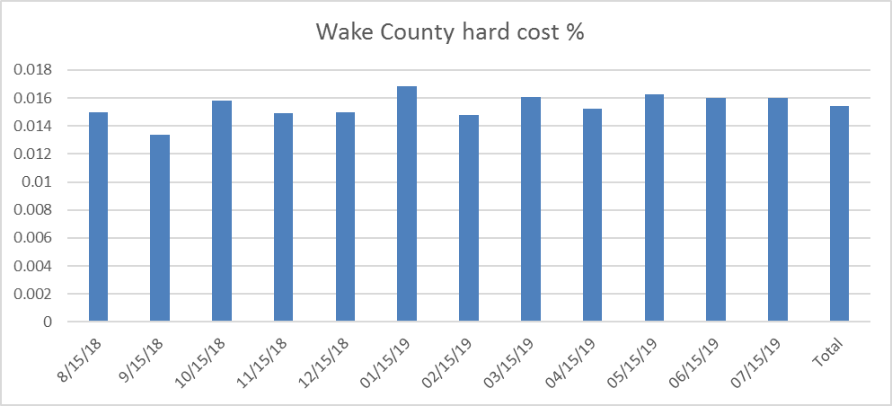
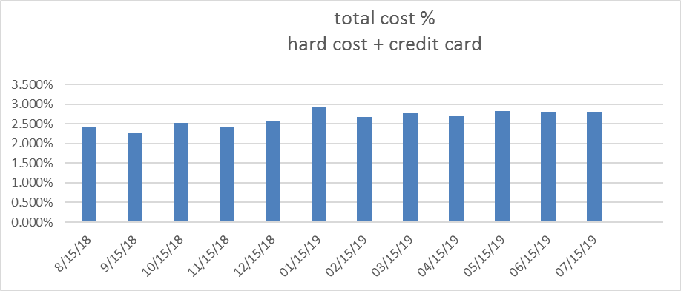
Wake County data, in respect to percent of collections
“Hard costs are the sum of all costs held back by the State with the exception of credit/debit card costs, which I track separately in the line below.”
 | Wake County hard costs
 | $ 93,291.28 | $ 90,377.19 | $ 81,553.75 | $ 90,812.64 | $ 80,545.64 | $ 89,288.89 | $ 95,134.76 | $ 92,331.47 | $ 99,509.37 | $ 98,092.64 | $ 106,846.85 | $ 109,156.43 | $ 1,126,940.91
 | Wake County credit card costs
 | 0.936% | 0.932% | 0.952% | 0.936% | 1.081% | 1.248% | 1.205% | 1.165% | 1.190% | 1.197% | 1.200% | 1.200% | 1.105%
hard cost % | 1.499% | 1.339% | 1.581% | 1.491% | 1.498% | 1.682% | 1.478% | 1.604% | 1.525% | 1.629% | 1.600% | 1.600% | 1.541%
total cost % since debit %=0 | 2.436% | 2.271% | 2.533% | 2.427% | 2.580% | 2.930% | 2.683% | 2.770% | 2.715% | 2.826% | 2.800% | 2.800% | totals

Slide 22
Budget: Who is in charge?
Postage increase was MOU protocol followed:
  Cost of correspondence calculated by DOT Support Services
  Oversee all mail, supplies and printing various agency, divisions, etc
  Used as a baseline when examining Tag & Tax expenses
  DMV/DOT oversee printing & mailing per MOU
  Cost included in overhead fee charged to counties

Slide 23
Communication on fee Changes
Hardware Upgrade $2,354,600
Software/Microsoft SQL Server License $800,000
DOT/DMV Card Reader Replacement $1,480,397
SOC1 Audit $80,620

Slide 24

Third party mailing/printing vendor evaluation
Xerox third party vendor
No RFP Xerox already under contract with DMV
2011 Contract, extended through amendments
Renewal August 31 ,2021
Review requirements for service for review/quotes from other vendors
While Xerox cannot help the cost of postage, it can control what they charge for printing.

Slide 25

Third party appraisal/valuation vendor PRO AND CONS
TEC data systems third party valuation vendor
NO RFP contract in place with Counties and DMV
Renewed effective July 1, 2019- June 30, 2020.
TEC and interface with DIT-DOT STARS mainframe, TEC holding proprietary function
Any change would need to be evaluated and approved by the DIT-DOT systems.
Trailer and Antique appraisals has been an issue with VTS
  The VIN cannot help demonstrate to TEC if it is a homemade trailer or a $100,000 horse trailer.
  Appeal process
TEC is the only source that uses market value as compared to Kelley Blue Book, NADA, or Edmunds which uses a lower trade in value.

Slide 28
Observations
Review requirements for original contracts and consider the following if warranted:
  RFP for third party mailing/printing vendor, RFI for appraisal vendor.
MOU
  DOR reserves the right to change vendors by notifying the DMV of the proposed change at least twelve months in advance of the effective date of change.
  DMV reserves the right to decline to be the third party vendor by notifying the LGD of the proposed change at least twelve months in advance of the effective date of change.
Change control board would need to approve process changes
Approval by DOR Procurement & Contract team
Approval by Financial Services
MOU modified to reflect any agreed upon process changes

Slide 29
Tag & Tax Speedbumps
Review VTS report accounting process compared to DOT Fiscal accounting process.
  Example interest payment. If received in May, it is backtracking to adjust March, however should be in May.
PIN Debit- shut off in the middle of October 2014.
  Shut off until this spring. Slowly bringing up LPA locations with Pin Debit.
  This is the CPP (Common Payment Process) Project.
  Close to having all LPA locations up and running with Pin Debit.
Review cost of mailing corrected notices
  Counties should pay for their mistakes, must be reciprocal with the other parties involved so counties are not left footing the bill for the mistakes of others

Slide 30
Tag & Tax Speedbumps
LRP
  Dealer include taxes in transaction?
Reconciliation process
“One sticker color change results in much harder for law enforcement to see and enforce
NCID Connectivity Issues

Slide 31

Anson County County-Run LPA
  How has the change to a county run LPA impacted your county?
    Fallback from the public at first, but the people ended up loving the improved customer service and location at the front of the county office
    Even a county the size of Anson, ability to break even or reimburse themselves for fees. Also able to keep all notoriety fees.
    Ability to fix VTS jurisdictions quicker
  How well are costs being communicated to the county run LPA?
    Do not know about a fee change until it happens, however not as concerned since they are reimbursed now
    Too many pieces to a LPA with the state
    No insurance money for remediating those issues, which can be time consuming
  Recommendations
    Create a LPA list server
    Long help desk wait problems
    Speed up Stars print time
$22,633.74- Anson county net total compensation for February to May (four months)
Average four month issuance and renewal fee cost-$6,357.91

Slide 32




Fun Facts
First Property Tax 1798

Slide 33

Fun Fact!
17 County Operated LPA
Revenue $105,000 Issue plate (FY 18-19)
Revenue $300,000 Renewal plate service (FY 18-19)

Slide 34

VTS County Survey Results and Feedback
69 responses from counties
VTS communication from DOR rated a 3.75/5
VTS communication from DMV rated a 3.01/5
Overall VTS satisfaction rated a 6.90/10

Slide 35

MOU REVISTED
Board Objectives
  1. Collection percentage has increased and stayed at 95% or higher, excellent
  2. Reduce the percentage of delinquency, excellent
  3. Customer Service (communication of fees to counties), needs improvement
  4. Improved tax valuation process?
FY 12-13 Statewide MV Collection $570,960,352.28
FY 18-19 Statewide MV Collection $ 1,010,461,195

Slide 36


