Slide 1


TEC Data Systems, Inc
Jason Rahaim

Slide 2
John Farthing retired after 30+ years.
New president - Jason Rahaim
jason@tecdatasystems.com

Slide 3
Valuation process - Timing
Starts in February for next year
Delivered in mid May

Slide 4
Valuation process
Collect North Carolina Vehicle Sales Data from the previous 12 months
Adjust the sales price for Jan 1 of next year.

Slide 5
Valuation process
2. Apply depreciation schedule to last years’ values
Unique based on Year, Make, Model and vehicle type

Slide 6
Valuation process
3. Determine value for next year
Manually use a combination of adjusted sales prices and depreciated values to determine new value.

Slide 7
Valuation process
4. Finally - Reconciliation
Insure any value that’s increased, or decreased significantly, is justified /correct
Reconcile trim levels and years across same base model for consistency.

Slide 8
Ongoing valuation process
New models added throughout the year
Monthly:
Receive no hit report from Cumberland County and add missing vehicles.
Receive NC Sales files monthly to look for missing vehicles / bad values.

Slide 9
Hard to Value Vehicles
Light Trucks
Trailers
Busses

Slide 10
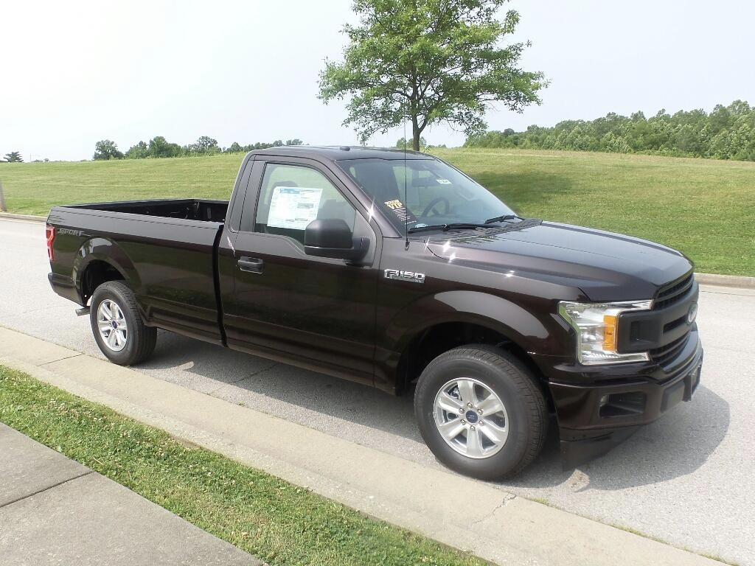
Hard to Value Vehicles - Light Trucks
Example:
F-150 STYLESIDE XL 4X4
28 2019 Sales: $19,200 - $42,554
Median: $26,327
2019 TEC Value $24,120

Slide 11
Hard to Value Vehicles - Trailers
Lack of VIN -> Model Mapping
No consistent way of indicating Length in VIN
Shared SAE Manufacturer Identifiers (First 3 digits of the vin)

Slide 12
Hard to Value Vehicles - RVs
VIN assigned to the chassis & cab.
Highly custom.
Solution: lumping RV makes into classes based on what they generally produce.

Slide 13
Compared to other sources
TEC uses primarily NC sales data for determining values.
Other national sources (NADA, KBB, etc) use national sales data and provide national or regional values.

Slide 14
TEC Website
tecdatasystems.com
Warning! Dated design! We are in the middle of a redesign that’s not quite ready.
If you need an access code email jason@tecdatasystems.com
The redesigned website will use a more traditional email/password system.

Slide 15
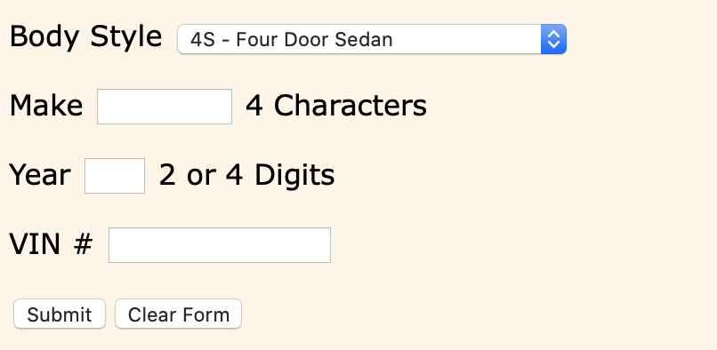
TEC Website

Slide 16
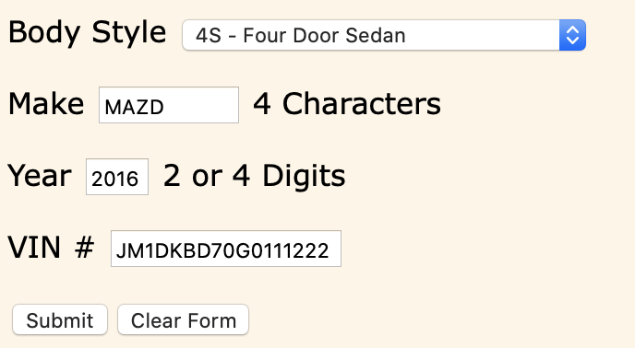
TEC Website

Slide 17
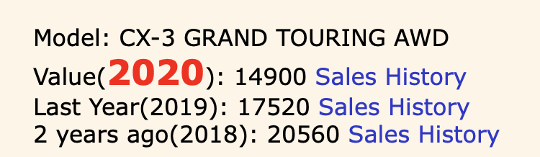
TEC Website

Slide 18
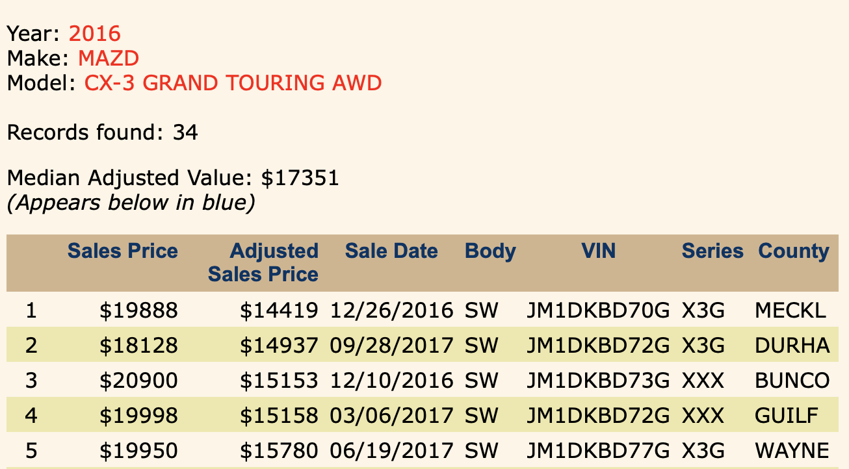
TEC Website

Slide 19
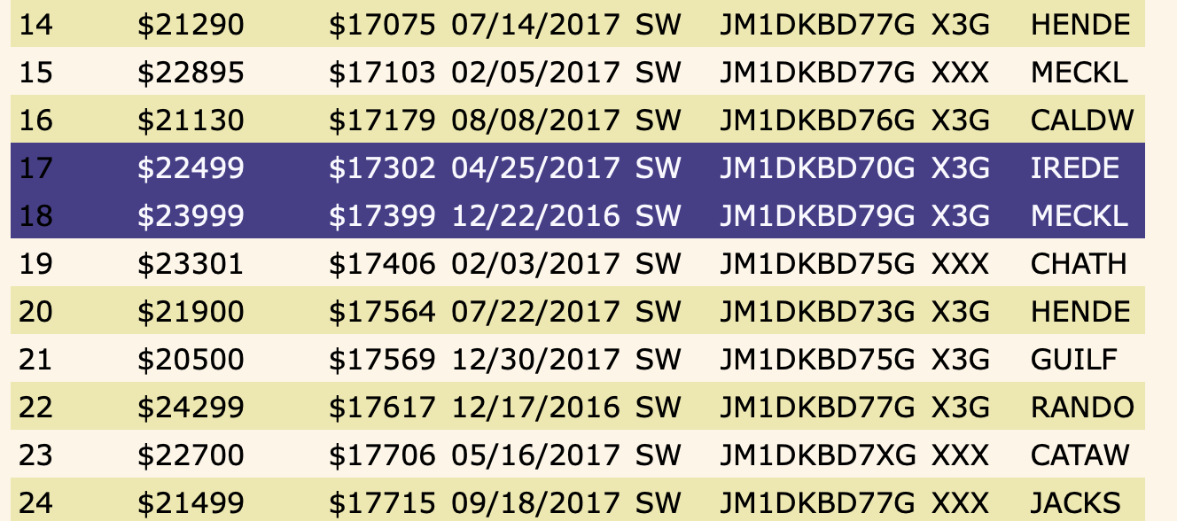
TEC Website

Slide 20
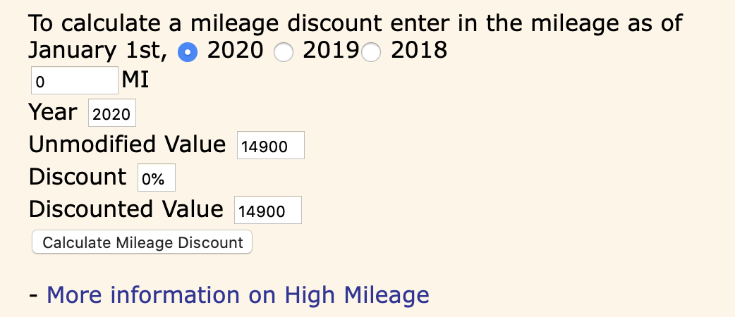
TEC Website - High Mileage

Slide 21
High Mileage Calculation
15,000 miles allowed per year.
If it exceeds that mileage by 10,000:
10% discount
2% per 5000 miles

Slide 22
High Mileage Calculation - Example 1
2016 Vehicle with 54,000 miles. 0 discount for high mileage.
  It does not exceed 3 * 15,000 = 45,000 by 10,000 miles.

Slide 23
High Mileage Calculation - Example 2
2016 Vehicle with 74,000 miles. 18% discount.
  10% because they are over the 55,000 mi threshold (15,000 * 3) + 10,000
  + 8% (2% for each 5,000 miles over 55,000. )
    74,0 00 - 55,000 = 24,000.
    24,000 / 5 = 4.
    4 * 2% = 8%

Slide 24
Questions?

Slide 25
Contacting US:
Jason Rahaim
jason@tecdatasystems.com
TEC Data Systems, Inc
4915 Waters Edge Dr, Suite 280
Raleigh, NC 27606
Office: 919-858-8096

