Slide 1
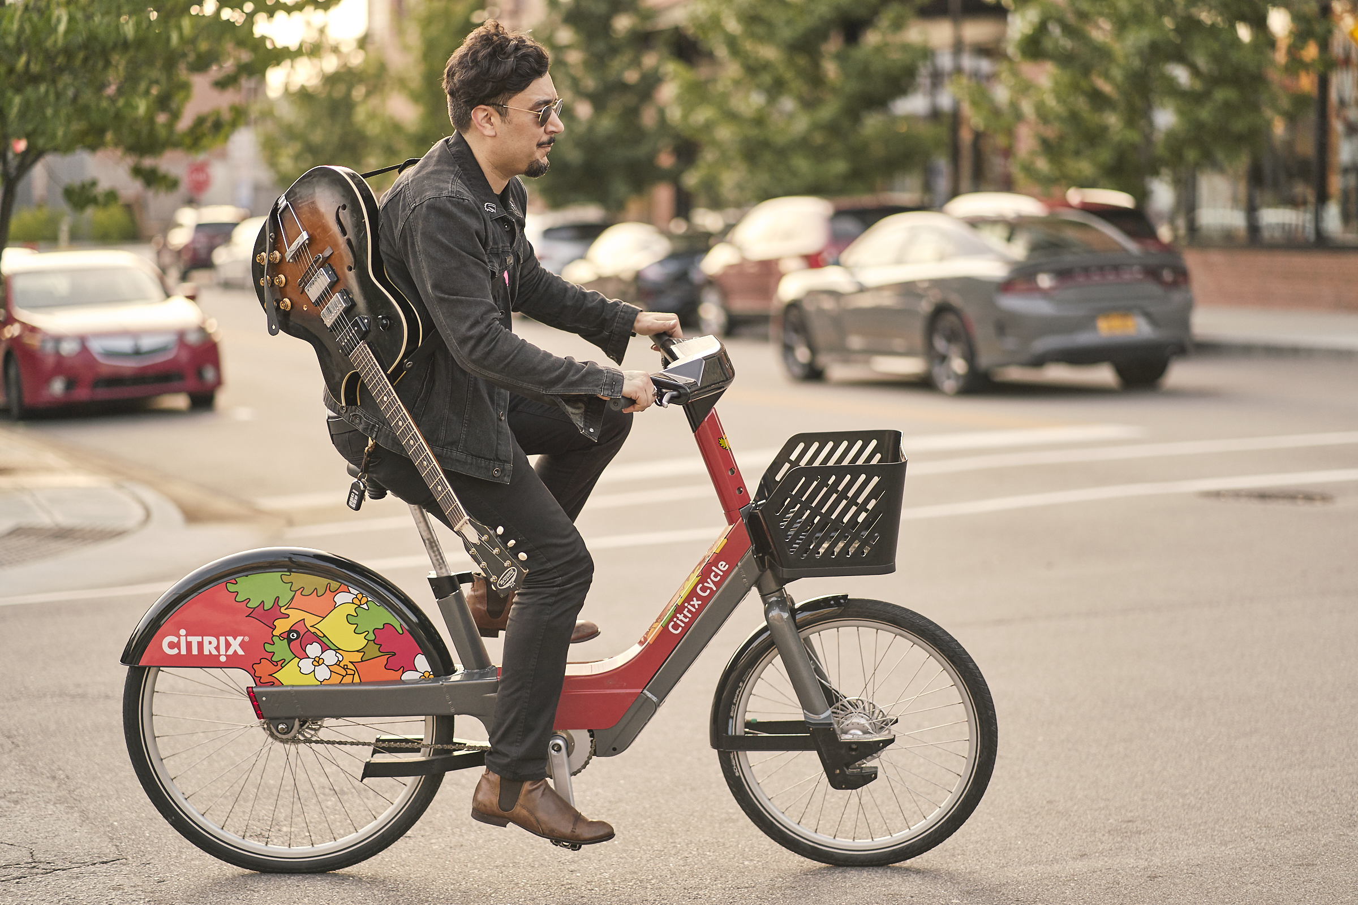
Electric-Assist Active Transportation Valuation of Citrix Cycle Bike Share Program
Gabriel Patry-Desjardins
Gabriel@Bewegen.com

Slide 2
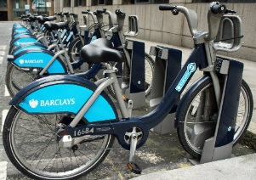
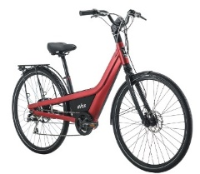
Vertical Integration
ONE STOP SHOP
Bike-Sharing
Expertise
Excellence
In Operations
Bike Design
& Manufacturing
Integrated
Pedelec System
Proven
IT Solution
Financial Stability
OVER 200 DEDICATED PROFESSIONNALS

Slide 3
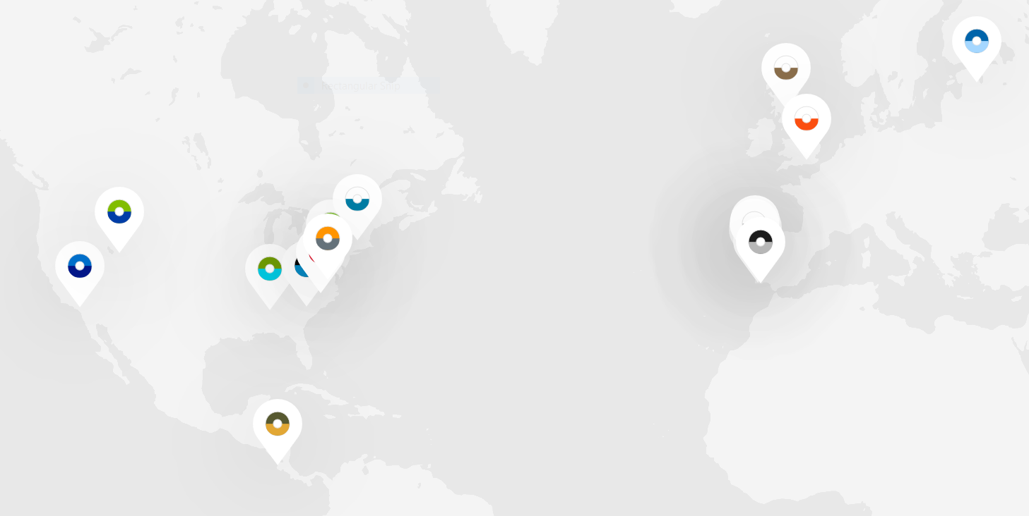
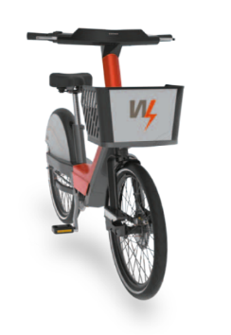
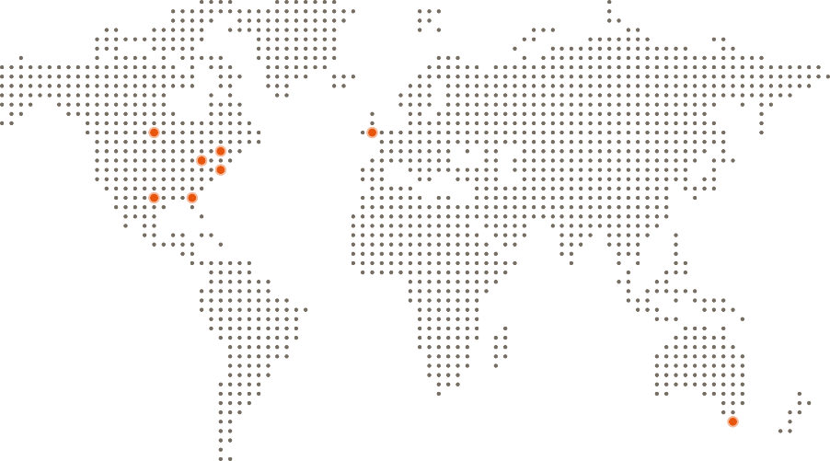
Bewegen Bike Share Around the World
PROVEN PEDELEC SYSTEMS
First E-Bike Share in the Americas (Birmingham, U.S.A.)
First 100% Regional E-Bike Share in the Americas (Summit County, U.S.A.)
First Regional E-Bike Share System in the United Kingdom (Forth Valley, Scotland)
GROWTH THROUGH INNOVATION

Slide 4
Bewegen Bike Share Around the World
Bewegen Bike-Share Systems Rapidly Expanding Around the World
LOCATION | COUNTRY | NAME | BIKES | % E-BIKE | LAUNCH
Tartu, Estonia | EST | Tartu Bike Share | 750 | 66% | June 2019
Pioneer Valley, MA | USA | Valley Bike | 500 | 100% | Jun. 2018
Birmingham, AL | USA | ZYP Bike Share | 400 | 25% | Oct. 2015
Raleigh, NC | USA | Citrix Cycle | 330 | 55% | Apr. 2019
Richmond, VA | USA | RVA Bike Share | 220 | 100% | Aug. 2017
Summit County, UT | USA | Summit Bike Share | 130 | 100% | July 2017
Columbia, SC | USA | Blue Bike | 135 | 37% | Oct. 2018
Howard County, MD | USA | HoCo Bike Share | 78 | 36% | Jul. 2017
Riverside, CA | USA | Bike Riverside | 55 | 50% | Nov.2018
University of Leiria | PRT | U of Leiria Bikes | 220 | 100% | May 2018
Figueira da Foz | PRT | Figueira Bikes | 65 | 100% | UPCOMING
Lagoa | PRT | Lagoa Bike Share | 30 | 66% | Feb. 2017
Vale de Lobo | PRT | Infralobo Bikes | 30 | 100% | Mar. 2018
Almeirim | PRT | Almeirim Bikes | 30 | 100% | UPCOMING
Coruche | PRT | Campinas | 27 | 37% | Mar. 2018
Rio Maior | PRT | Rio Maior Bikes | 24 | 100% | Oct. 2017
Barreiro | PRT | TCB Barreiro | 10 | 100% | Feb. 2017
Forth Valley | SCO | Forth Bike | 100 | 100% | May 2019
Peninsula Papagayo | CRI | Papagayo Bikes | 60 | 100% | Jun. 2018
Guildford | GBR | Cathedral Sq. | 20 | 100% | Nov. 2017
17 Bewegen Systems Worldwide
PROVEN PEDELEC SYSTEMS
First E-Bike Share in the Americas (Birmingham, U.S.A.)
First 100% Regional E-Bike Share in the Americas (Summit County, U.S.A.)
First Regional E-Bike Share System in the United Kingdom (Forth Valley, Scotland)
GROWTH THROUGH INNOVATION

Slide 5
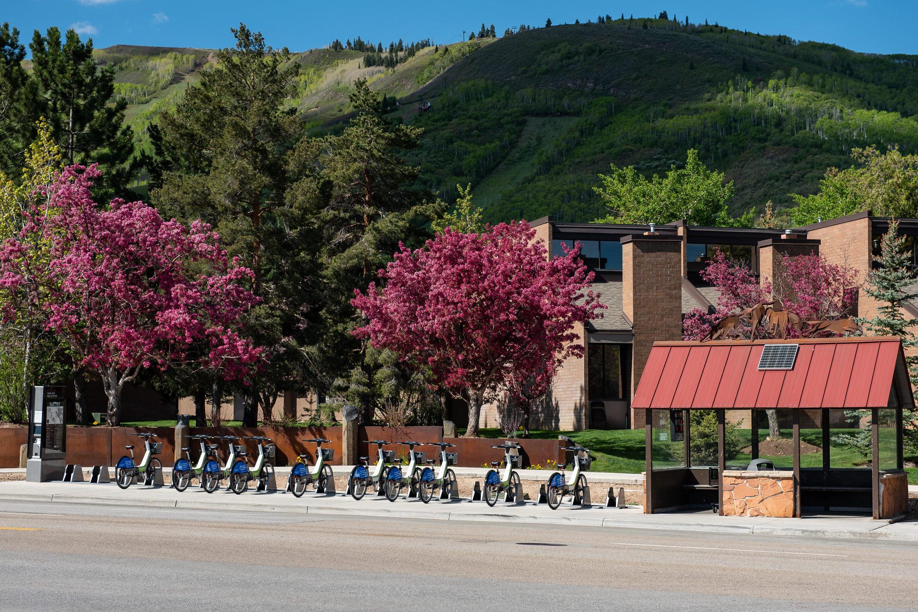
CUTTING EDGE PRODUCTS

Slide 6
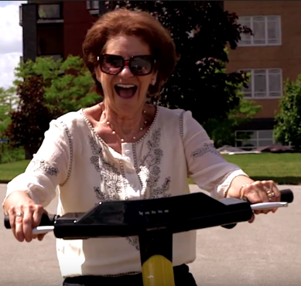
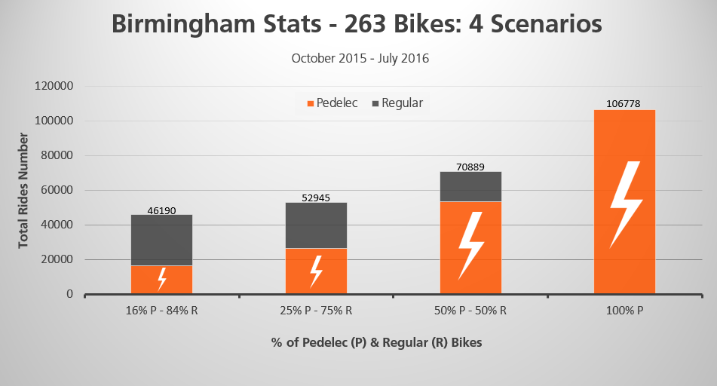
The Pedelec Bicycle
Pedelec enables users to ride bicycle:
More often
To more distant locations
With more cargo
Attractive for people with physical limitations
Proven to draw more users from automobile mode than traditional bicycles
Proof in numbers:

Slide 7
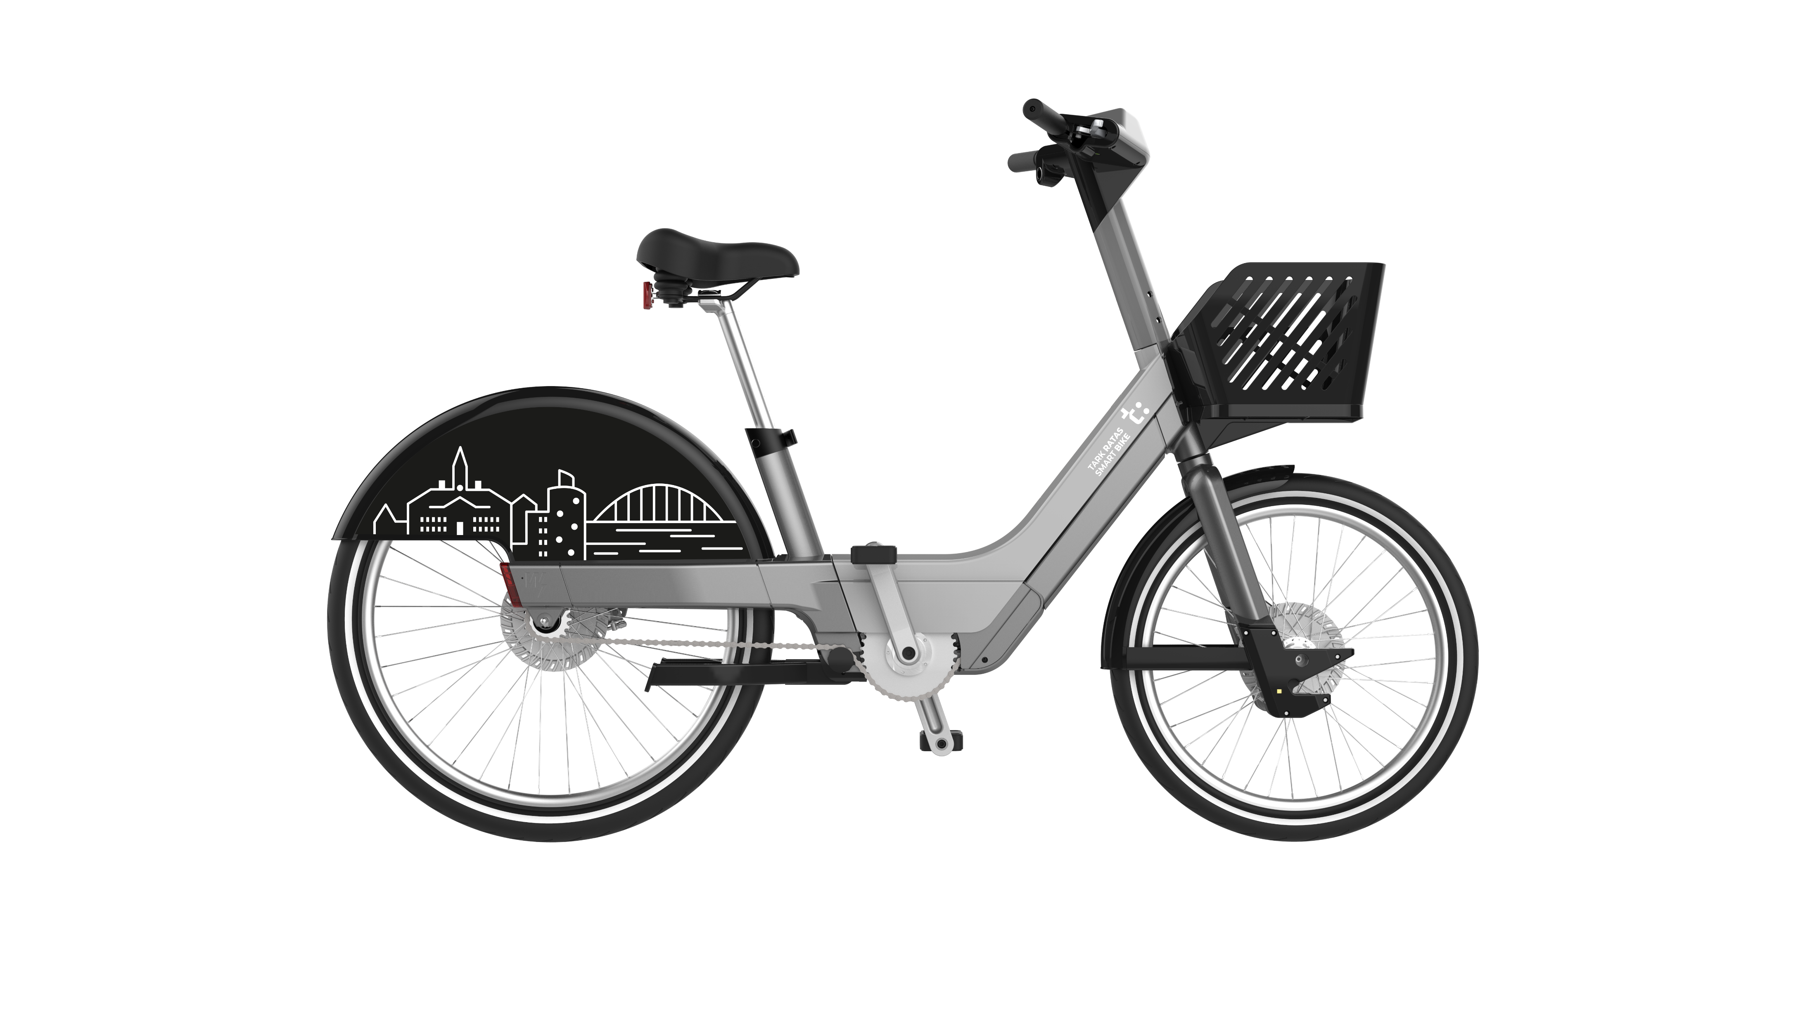
The Bewegen Pedelec
Sealed bottom-bracket electric motor
48v high-efficiency lithium battery
Secondary lock
Integrated GPS tracking and SIM card
Digital screen
Heavy duty basket

Slide 8
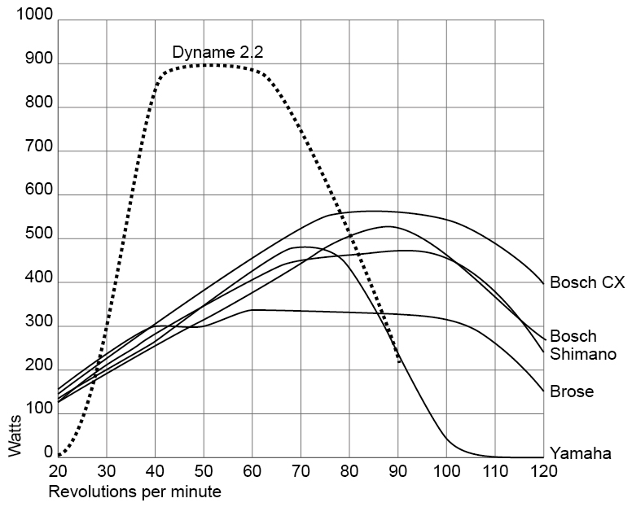
Bewegen Bottom Bracket Motor
POWER AT THE RIGHT PLACE
Power in the pedals not wheels
SEALED MOTOR
Reduced maintenance
OUR OWN IP RIGHTS
Flexibility and integration
MADE IN CANADA
Quality & testing
 | None | Low | Medium | High | Full
Assistance | 0% | 35% | 45% | 60% | 100%
Ratio | 0x | 1.2x | 1.6x | 2.1x | 3.5x

Slide 9
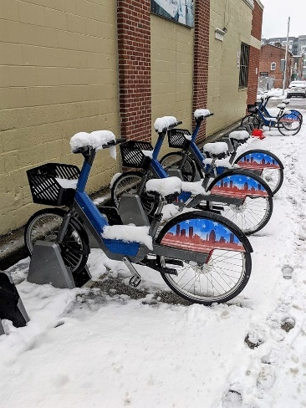
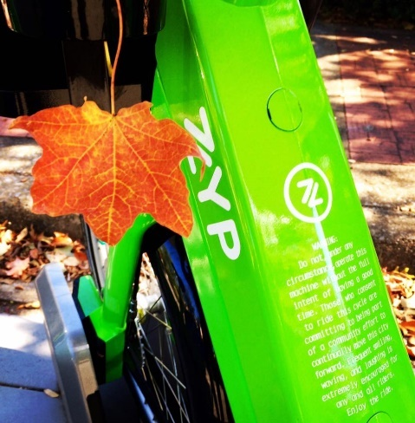
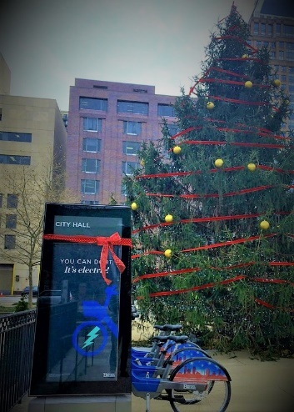
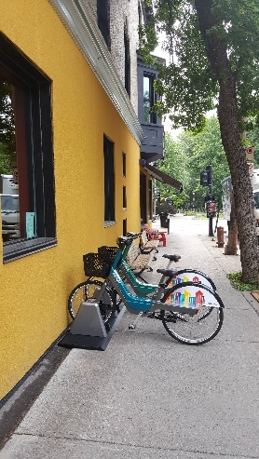
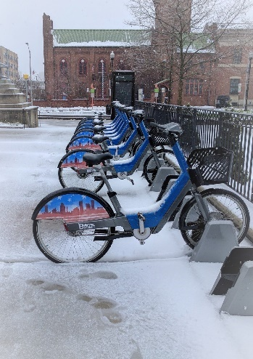
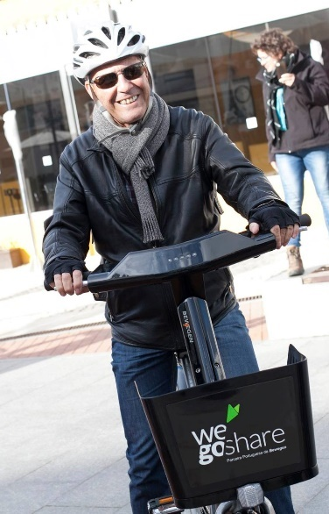
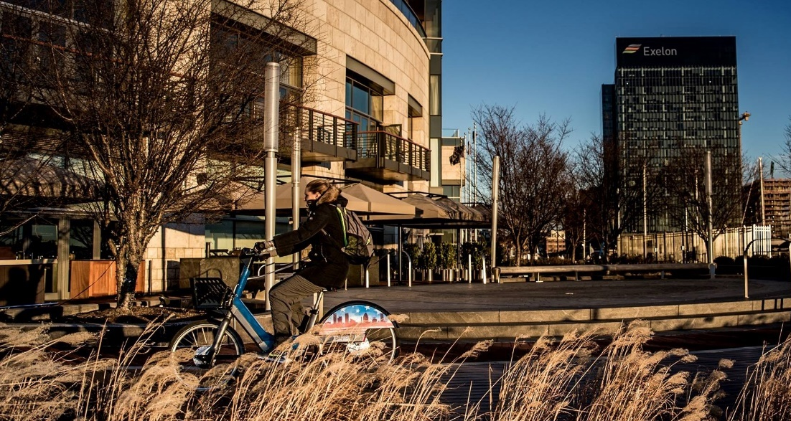
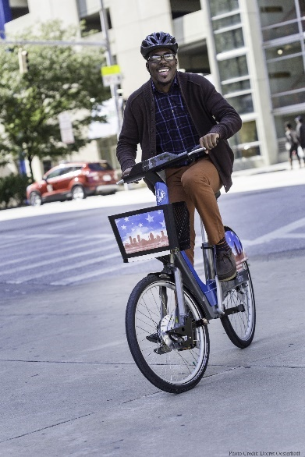
All Season Bike Share Equipment
Withstands Ice & Snow
Equipment functions without issue through extreme cold conditions
Long-Term Resistance
High resistance to corrosion, rust, salt, sand, etc.
Continued Convenience
Standardized initiatives to ensure bike share functionality ALL year

Slide 10
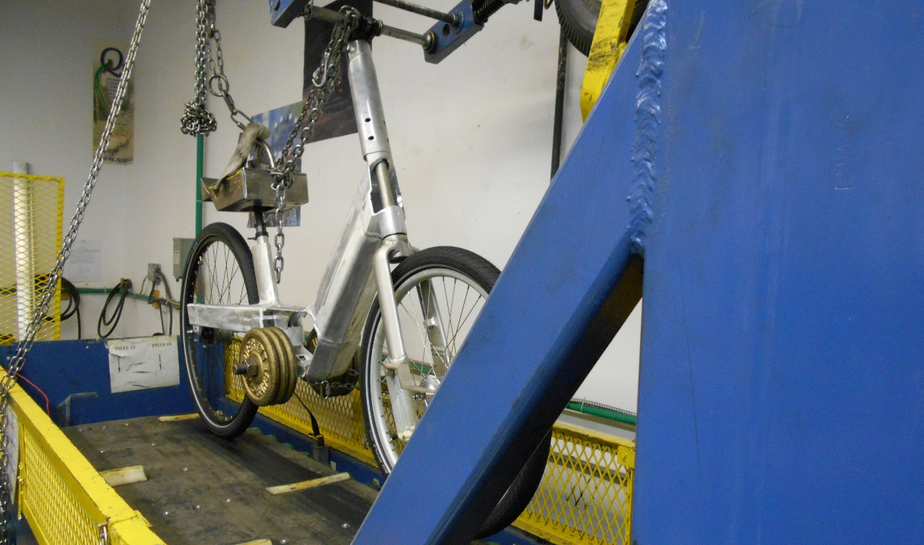
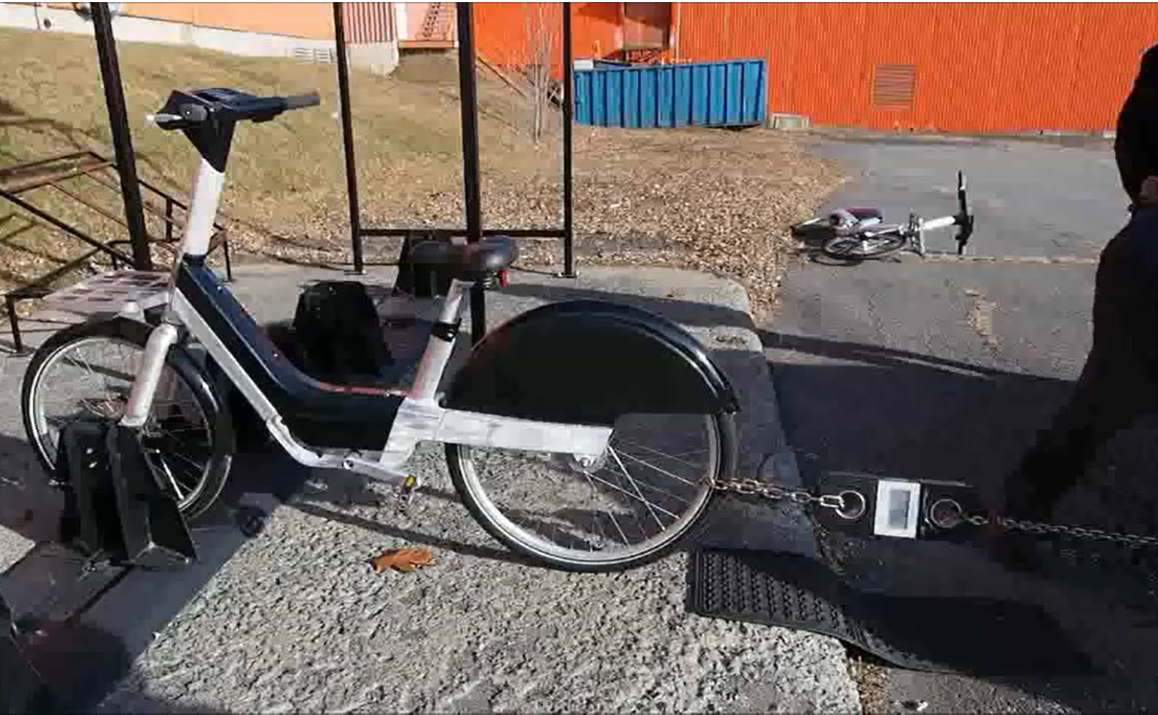
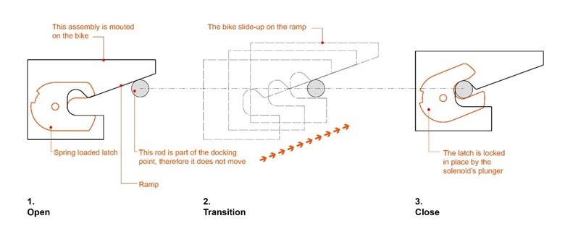
Testing and Performance
Secure and theft proof
Simple and intuitive locking mechanism
Extensive theft and vandalism testing
High quality manufacturing

Slide 11
New Cargo Bike Product

Slide 12
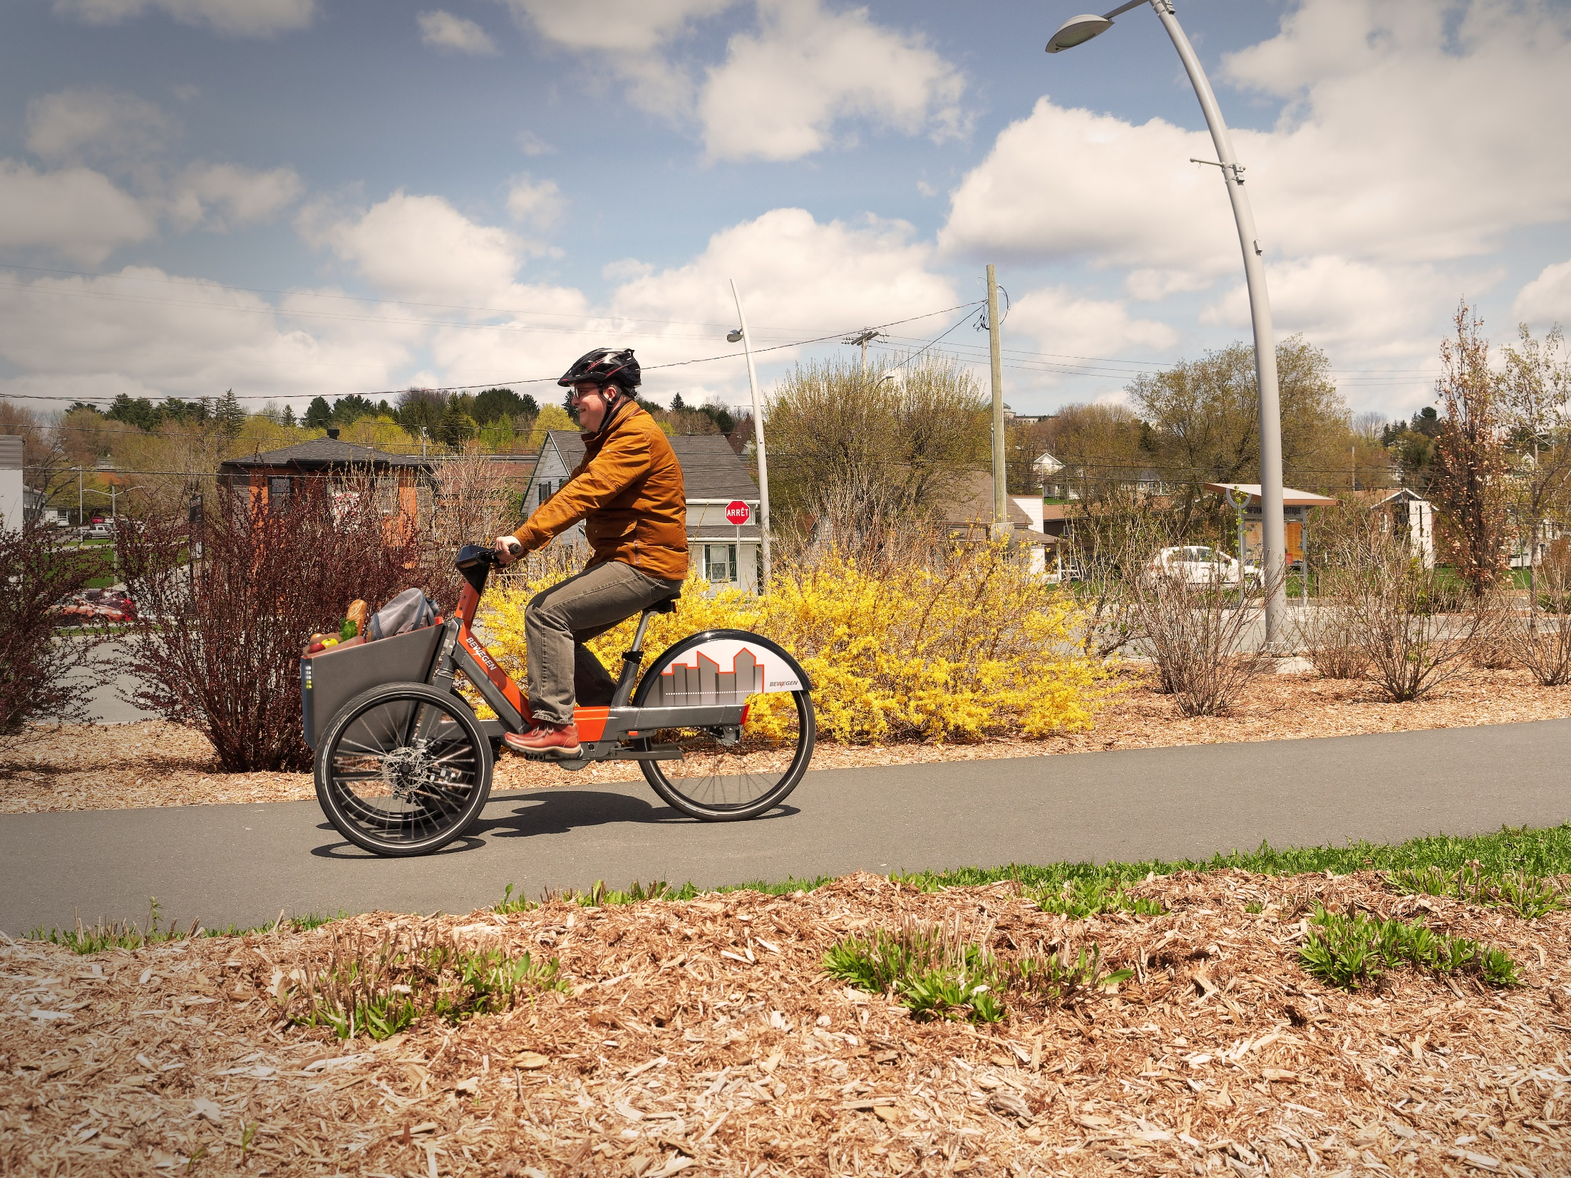
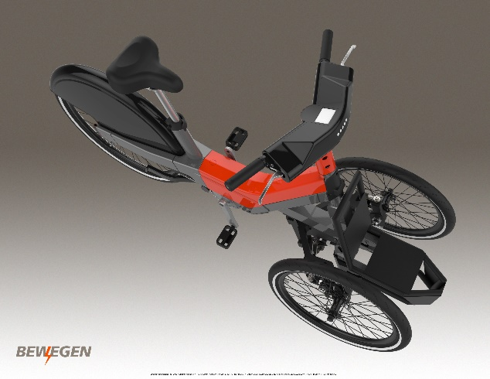
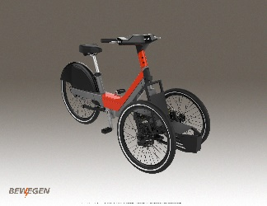
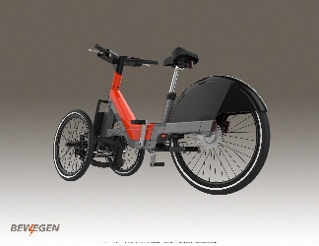
The Bewegen Trike
Modular Cargo Addition Can Hold Up to 200 lbs.
Designed to Maximize Balance & Control
Charging Compatible With Bewegen Stations

Slide 13
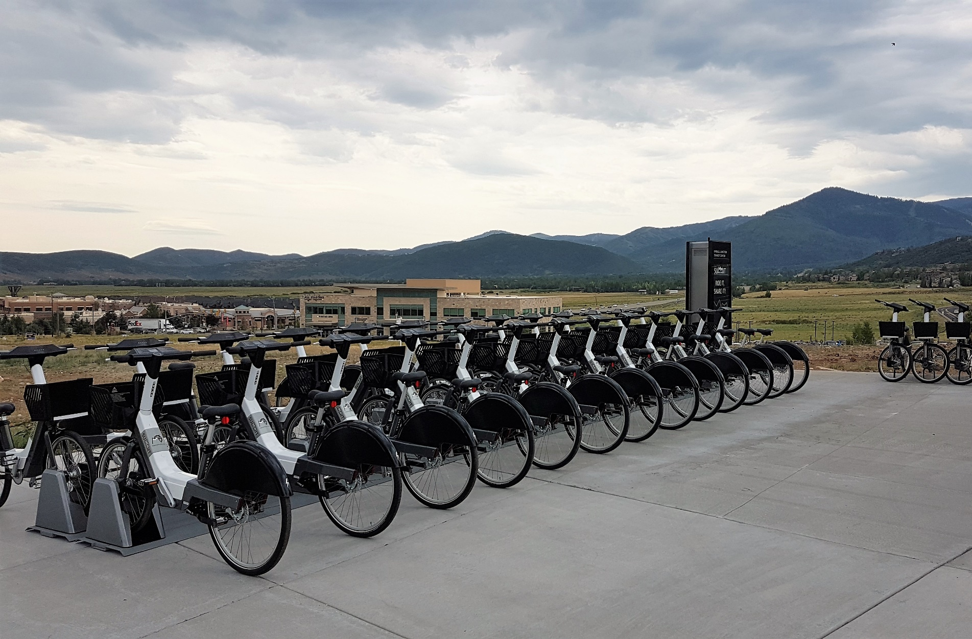
FLEXIBLE EQUIPMENT OPTIONS

Slide 14
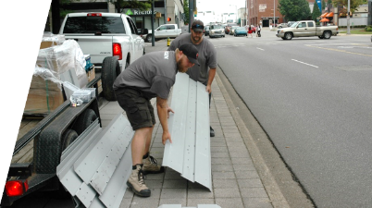
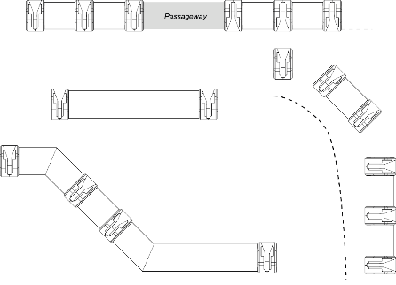
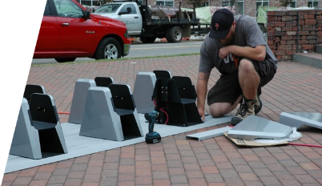
The Bewegen System
Bike Sharing Station
Smart Rail Technology
Allows easy assembly and
and infinite configurations
to suit any location
PORTABLE, ADAPTABLE, FLEXIBLE
Requires no major construction work

Slide 15
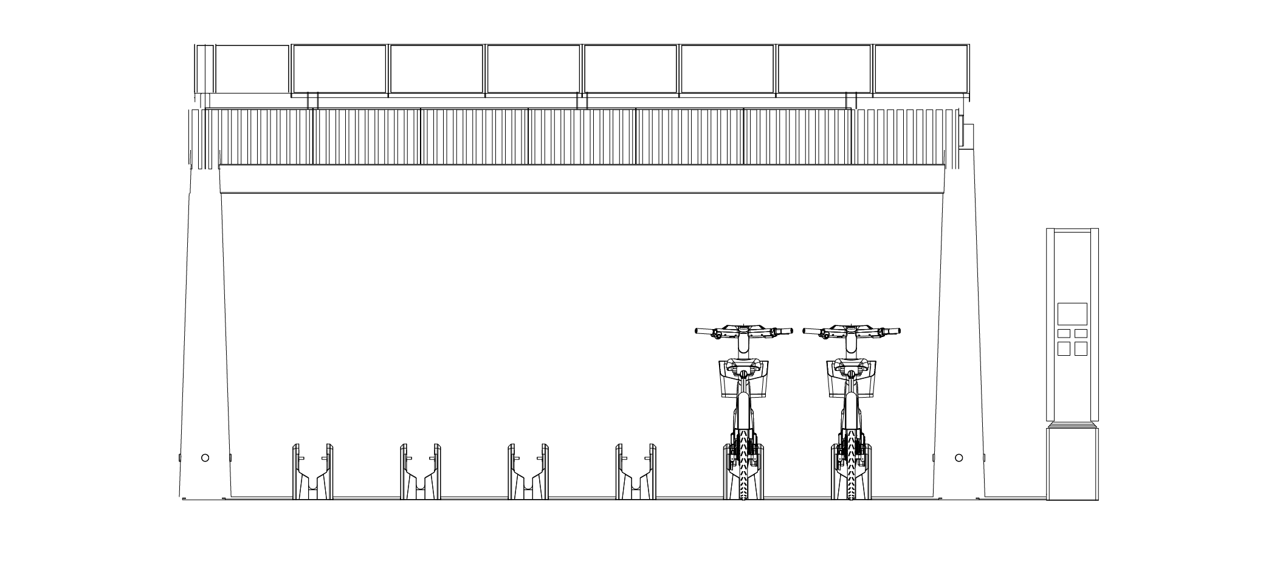
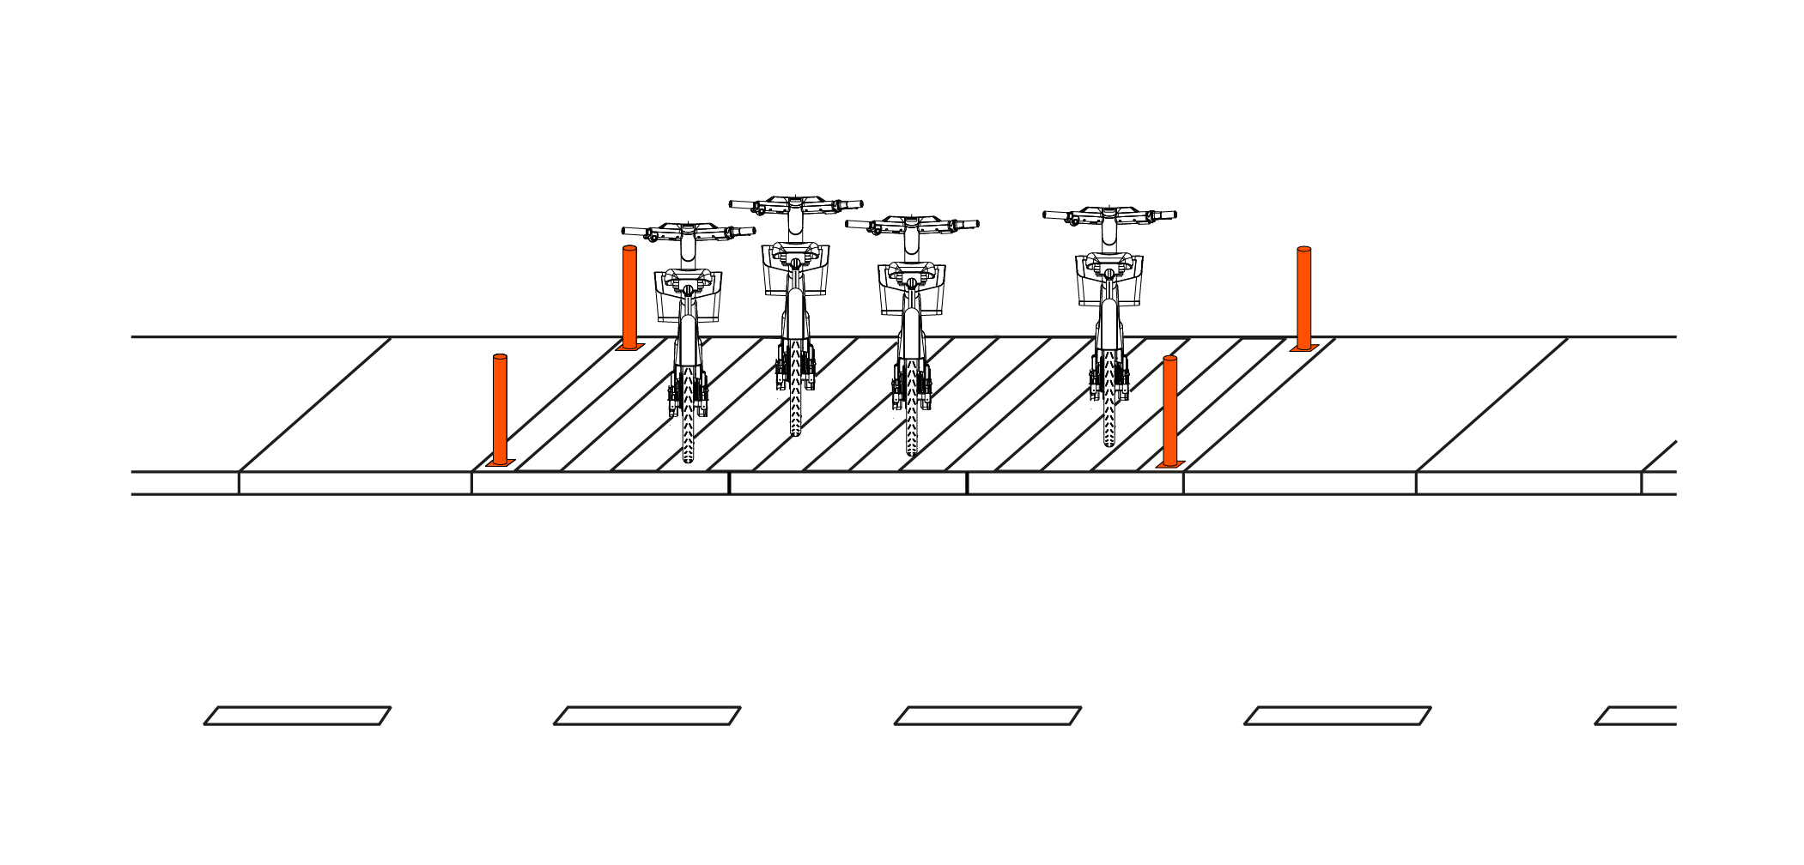
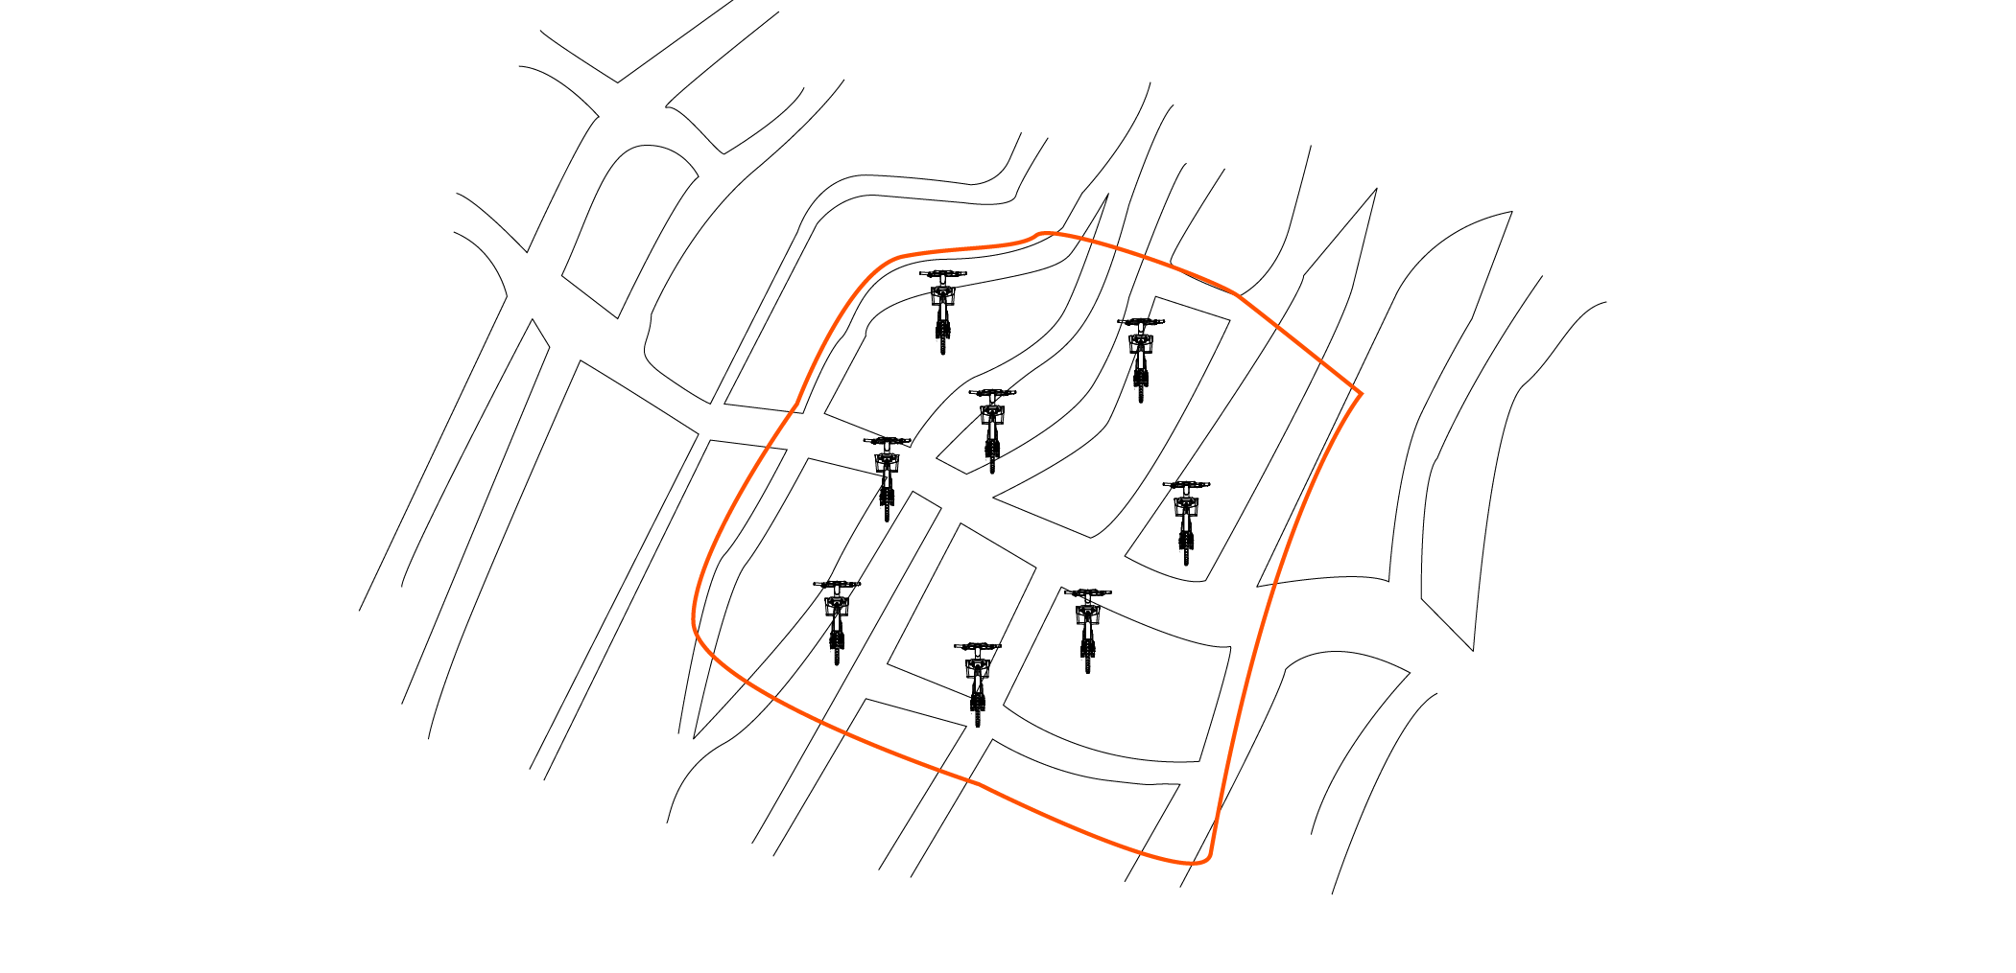
The Bewegen System
Variety of Bike Sharing Station Options
Geofencing and Virtual Station Technology

Slide 16
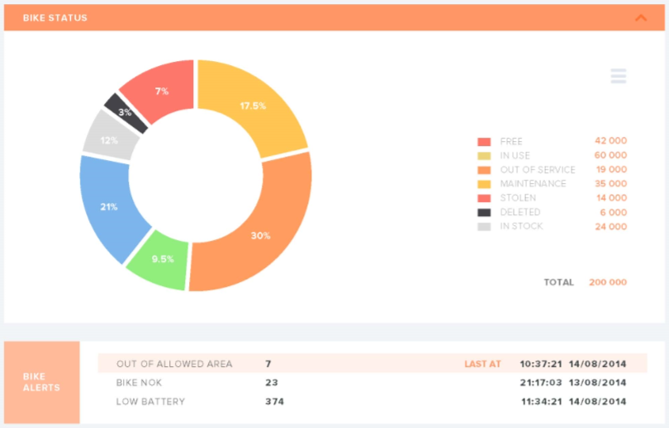
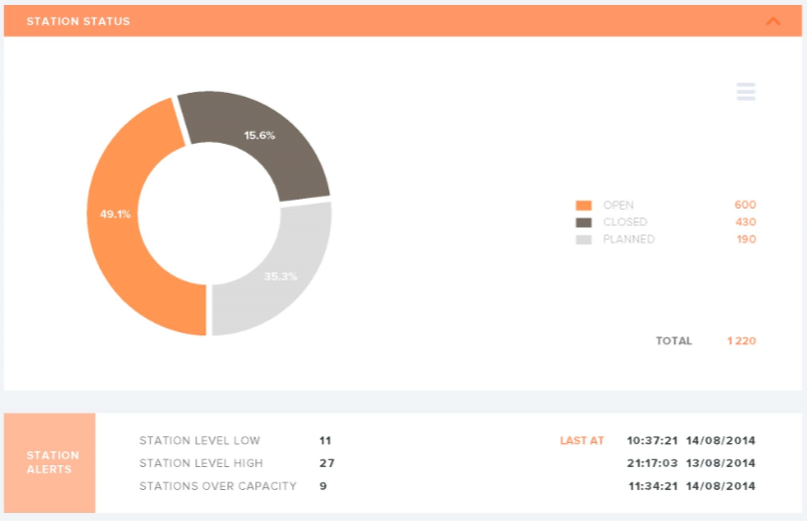
The Bewegen Bike Share Operating Platform
Award-winning IT solution
Strong and solid platform
Advanced GPS capabilities
GEO/Personalized
Highly reliable: 95.56% of uptime
Automated reports:
Performance
Demographics
Technical
More!

Slide 17
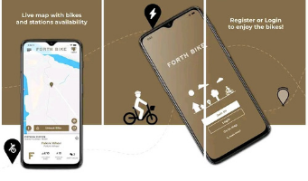
The Bewegen Mobile App
Live system map
Available bicycles
Station capacity
Register and renew membership
Retrieve user’s routes data
Modify personal settings
Communicate with Customer Service

Slide 18
Flexible Pricing Solution
Annual Membership
Unlimited system access
Membership key or mobile app
Daily
Access to bike for 24 hours
First 30 minutes of each ride is included
$90 /year
$2 /trip
ANY pricing structure
ANY membership structure
Convenient Pay Per Ride option
Option for specialized rates
Different structures possible for each municipality
Any Pricing Model Desired!

Slide 19
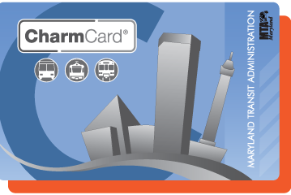
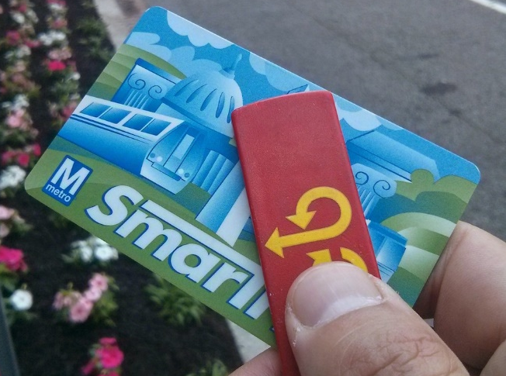
Multimodal Integration
Flexible integrations
Wolfsburg, Leiria University,
Barreiro, Papagayo, Tartu
TARTU SMART BIKE
Integration with Public Transportation System
PENINSULA PAPAGAYO
Personalized tourism features
LEIRIA UNIVERSITY
University bike share integration
ZIPCAR
Local, but same technology worldwide
FULLY INTEGRATED CITY-WIDE, REGIONAL, STATE-WIDE OR MULTI STATE

Slide 20
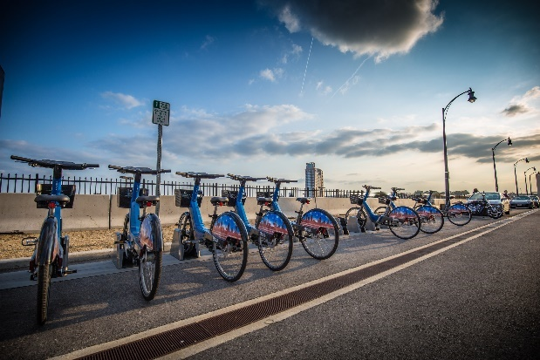
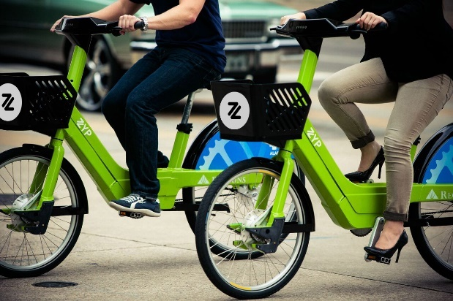
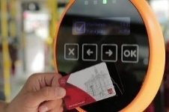
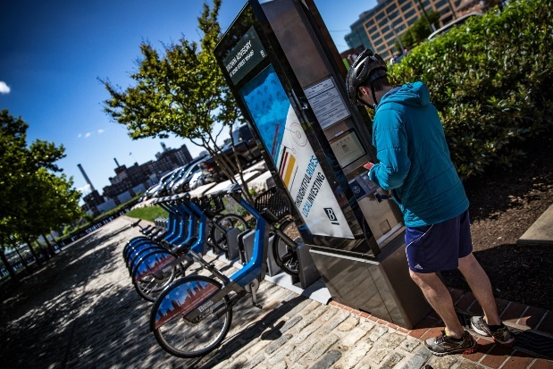
The Bewegen Approach: Collaboration
Multi-Modal Transportation
Support existing public transportation system and facilitate inter-modality
Data Sharing
Data sharing with governmental institutions and local authorities
Customized Equipment & Branding
The sky is the limit for personalization of a bike share program
A Personalized Bike Share Program for Your Unique Region

Slide 21
Regional Bike Share Program Experts
Regional bike share program specialists with experience launching successful bike share programs in partnership with multiple governmental institutions.

Slide 22
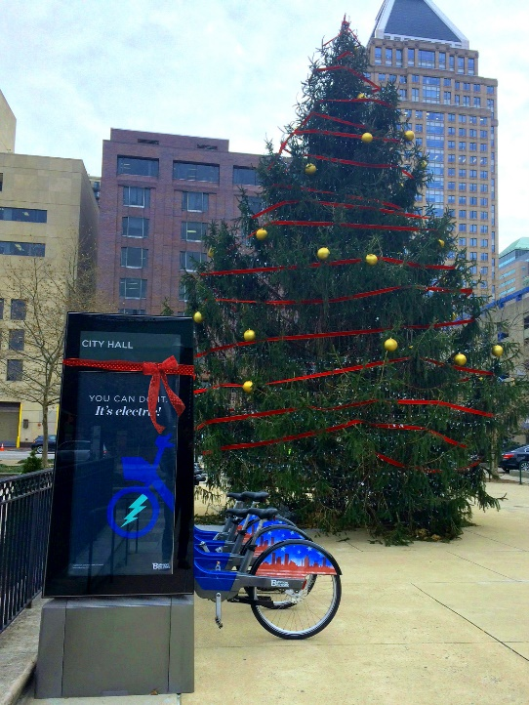
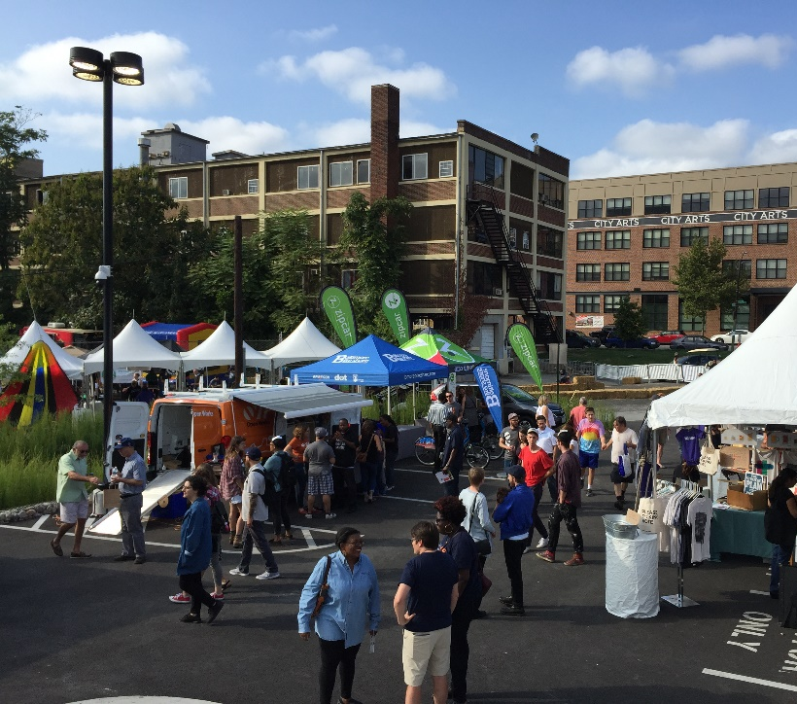
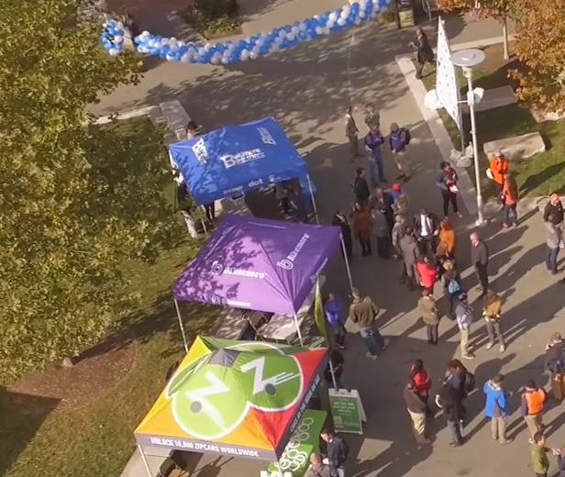
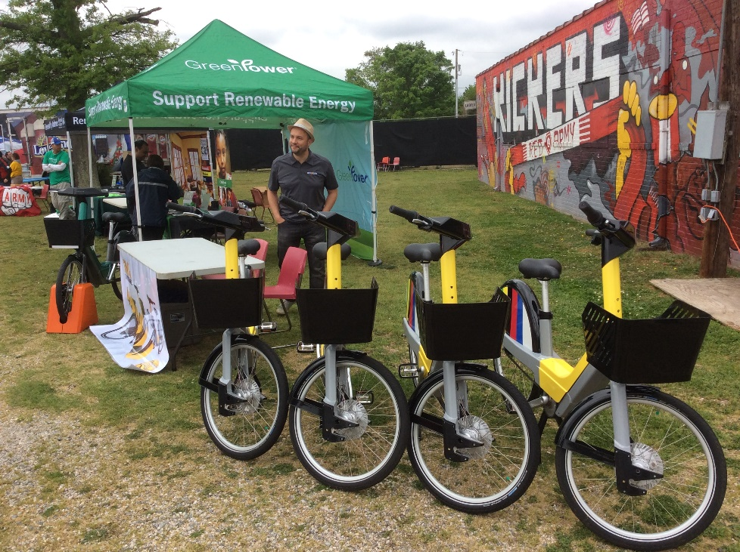
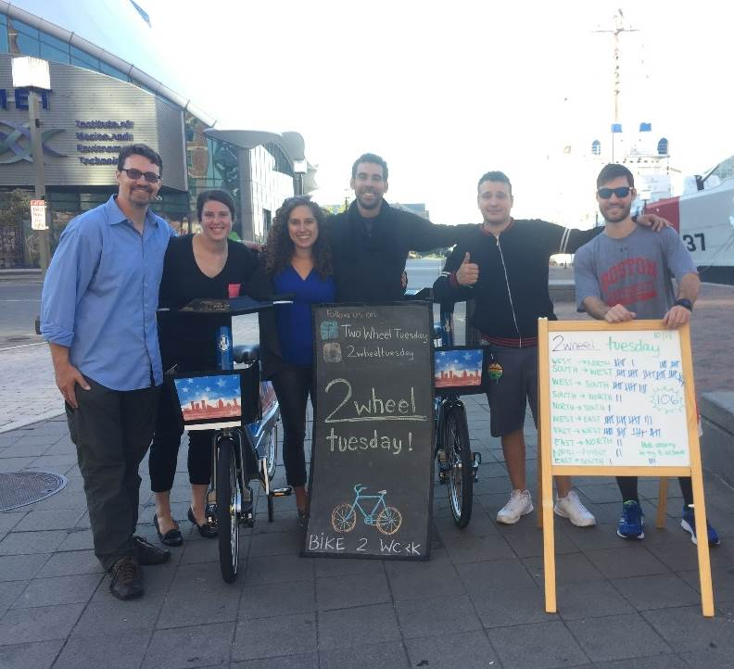
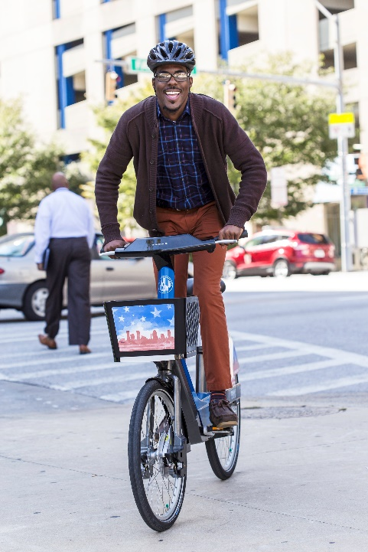
Marketing, Outreach and Equity

Slide 23
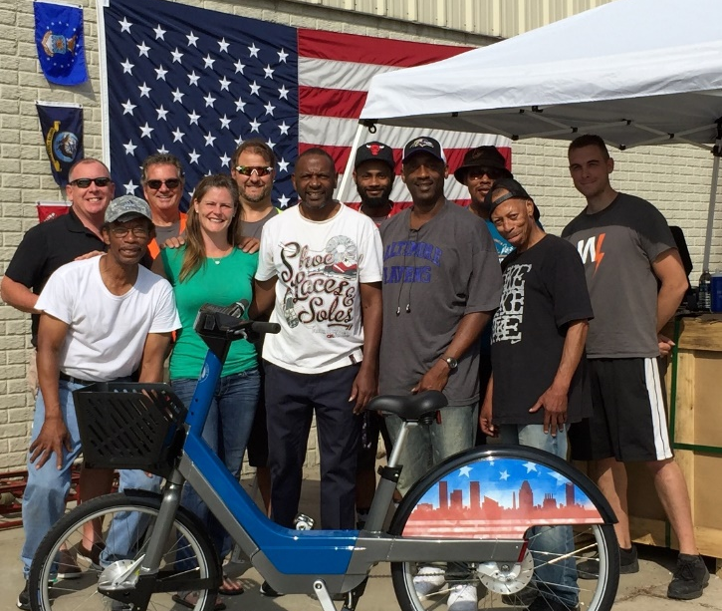
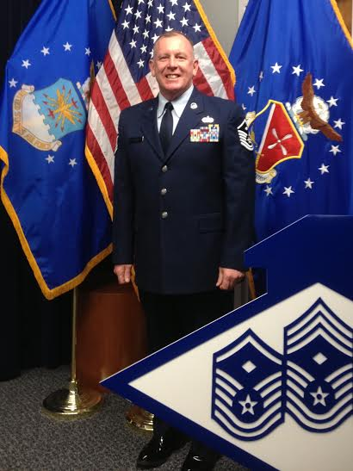
Local Operations
1ST SGT. JIM DUFFNEY

Slide 24
Commercially Sustainable Business Models
Capital & Revenue Input
Price of System Equipment
Self-Funding Operations
Revenue Sharing Models
Business Models
Collaborations with Governments,
Non-Profits, Private Industry
Option to Fund Ongoing Operations
with Sponsorship & Users Fees

Slide 25
Commercially Sustainable Business Models
Sponsorship Acquisition
Quality Partners
Efficient Use of Space
Local Involvement

Slide 26
Citrix Cycle at a Glance
Launch Date: March 14, 2019
300 Bicycles
200 Pedelec Cycles
100 8-speed Cycles
Statistics Since Launch:
19,190 rides taken
More than 35,000 miles ridden
August, 2019: roughly 1 ride/bike/day

Slide 27
THANK YOU
Gabriel Patry-Desjardins
Gabriel@Bewegen.com

