Slide 1
North Carolina Department of Revenue
2019 Advanced Personal Property Seminar
Greensboro, NC
September 17, 2019

Slide 2

Mecklenburg County (N.C.)
BPP Canvassing Initiative
(aka the “DIY” Approach)
Sandy Martin, PPS
Personal Property
Appraisal Manager

Slide 3
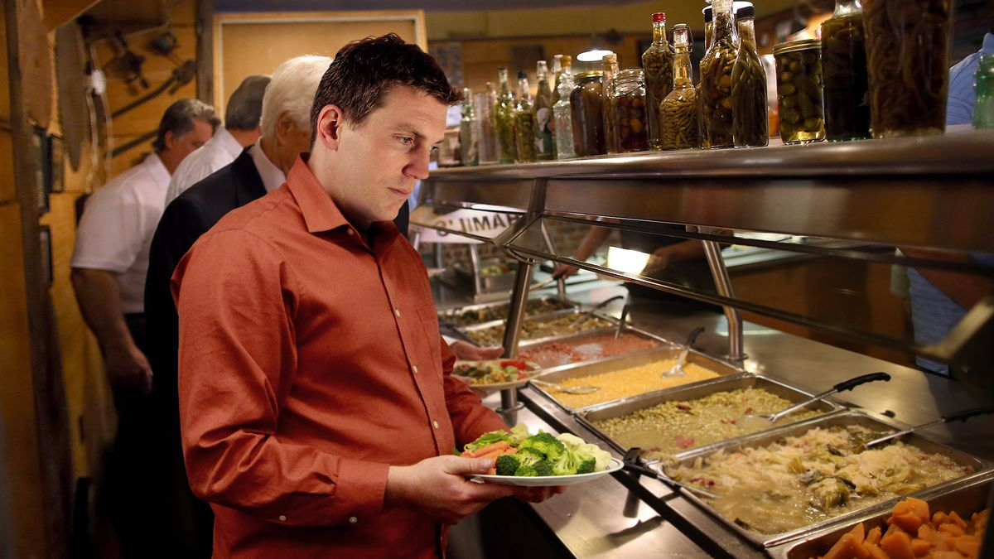
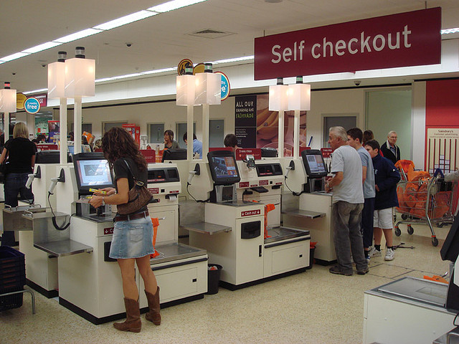
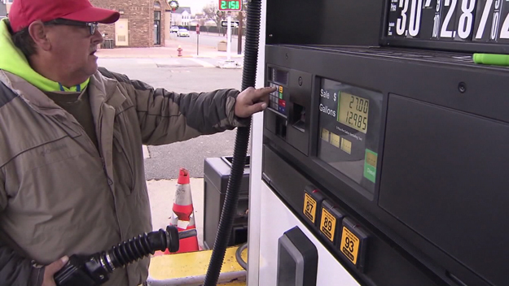
DIY
“ Do It Yourself ”

Slide 4

Discovery Process
For
Business Personal Property
(A)
-
(B)
Fixed Asset Detail
- Listing Form
= Potential Discovery
= (C)

Slide 5
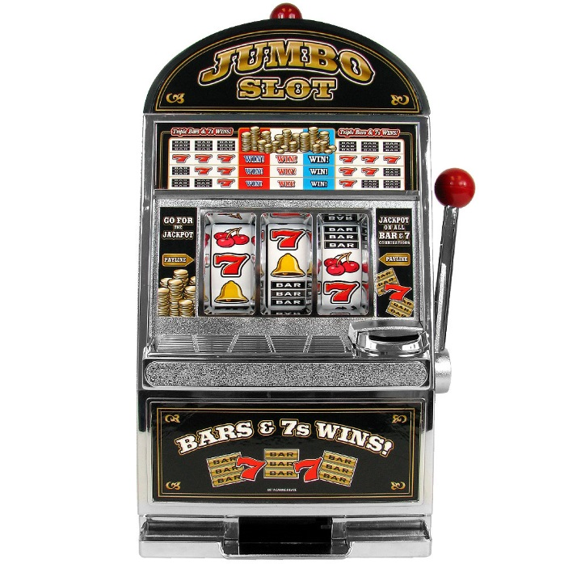


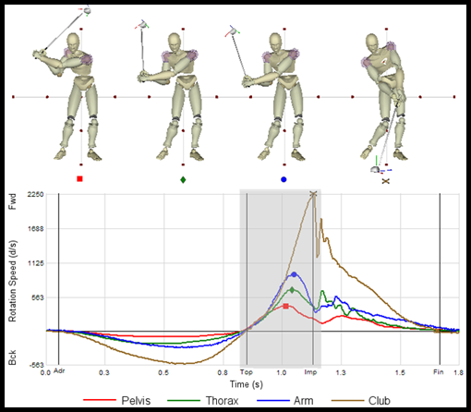
“Simple is not the same as easy”

Slide 6
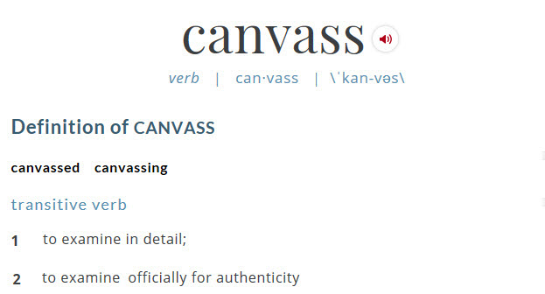
Definition

Slide 7

Mecklenburg County
BPP Canvassing Initiative
Summary
3rd Party Overture
Internal Brain Storming
Strategy
Plan of Attack
Enhancements / Improvements
Canvassing Team
Dashboards
Routing Software
County Map
Door Hangers
Results

Slide 8
Mecklenburg County
BPP Canvassing Initiative
3rd Party Overture
Identify “leads” to current businesses not listing
Current county tax scroll
Comparison of databases vs. county scroll
Fee:
$25,000 First 100 discovered businesses
$250 /each > 100 discovered businesses

Slide 9
Im
possible
?
’

Slide 10
Mecklenburg County
BPP Canvassing Initiative
Internal Brain Storming
Current county tax scroll
Identify sources to build a comprehensive database
Mecklenburg County BBB
NC Secretary of State
Chamber of Commerce
Mecklenburg County Environmental Health
NC Alcoholic Beverage Controls
Leasing Companies

Slide 11
Mecklenburg County
BPP Canvassing Initiative
Strategy
Approached it like a “discovery”
Instead of comparing “$ values”
Compared “taxpayer names” and “business addresses”
Database = “Actuals”
County Tax Scroll = “Reported”
Variances = “Potential Discovered Business”

Slide 12

Mecklenburg County
BPP Canvassing Initiative
Plan of Attack
Collect company information from various sources
Format different information into a standard format
Data mining using Excel:
“VLookups” - Exact matches
“Fuzzy Lookups” - Similar matches
Field work:
Site visits for validation

Slide 13
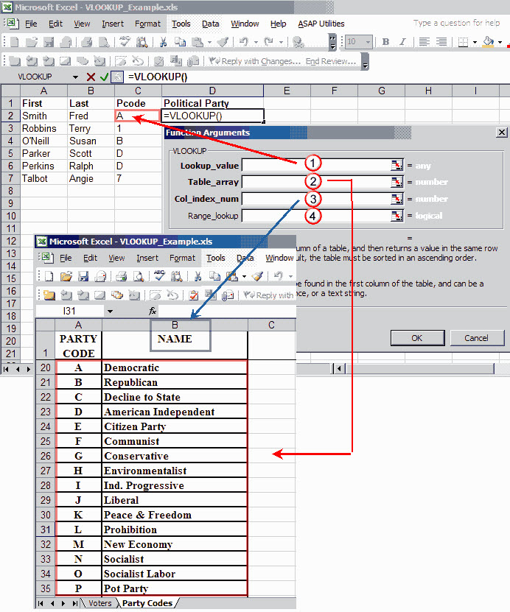
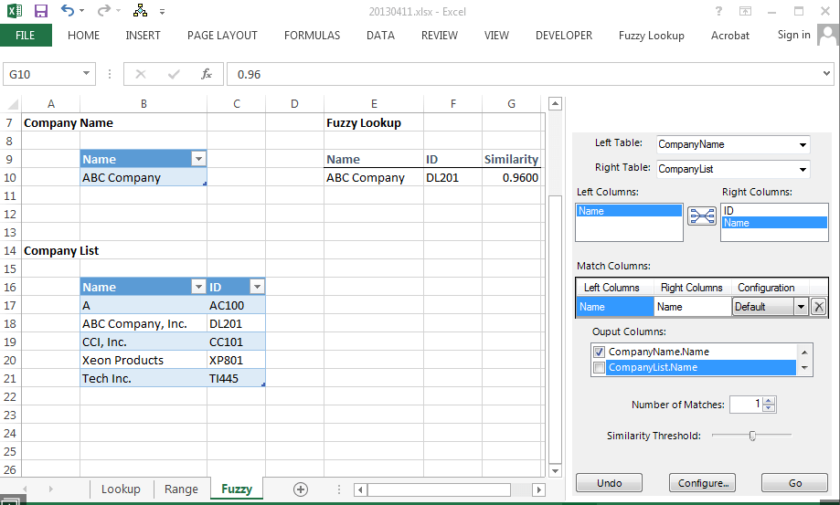
Mecklenburg County
BPP Canvassing Initiative
Excel Functions
VLookup
Fuzzy Lookup

Slide 14

Mecklenburg County
BPP Canvassing Initiative
“Fuzzy Lookup” Example

Slide 15
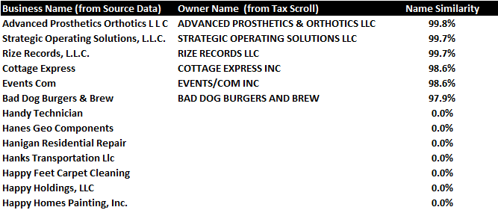
Mecklenburg County
BPP Canvassing Initiative
“Fuzzy Lookup” Example

Slide 16
Mecklenburg County
BPP Canvassing Initiative
Enhancements & Improvements
Two county vehicles
Computers and cell phones
Route planning software
Custom 8’ x 8’ map
Printed bilingual door-hangers
Tracking dashboard reports

Slide 17
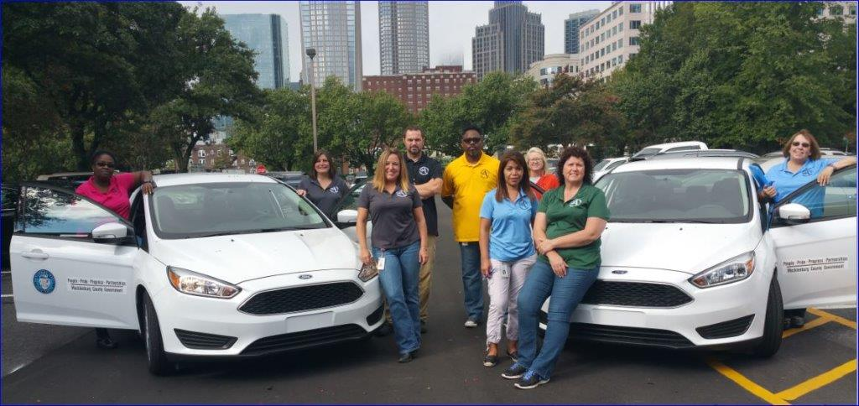
Mecklenburg County
BPP Canvassing Initiative
The Canvassing Team

Slide 18
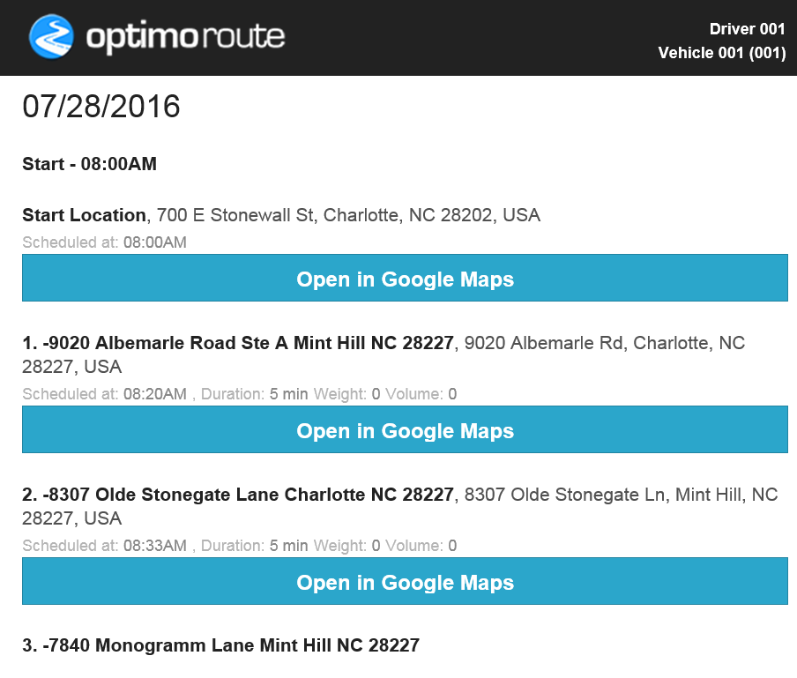
Mecklenburg County
BPP Canvassing Initiative
Routing Software

Slide 19
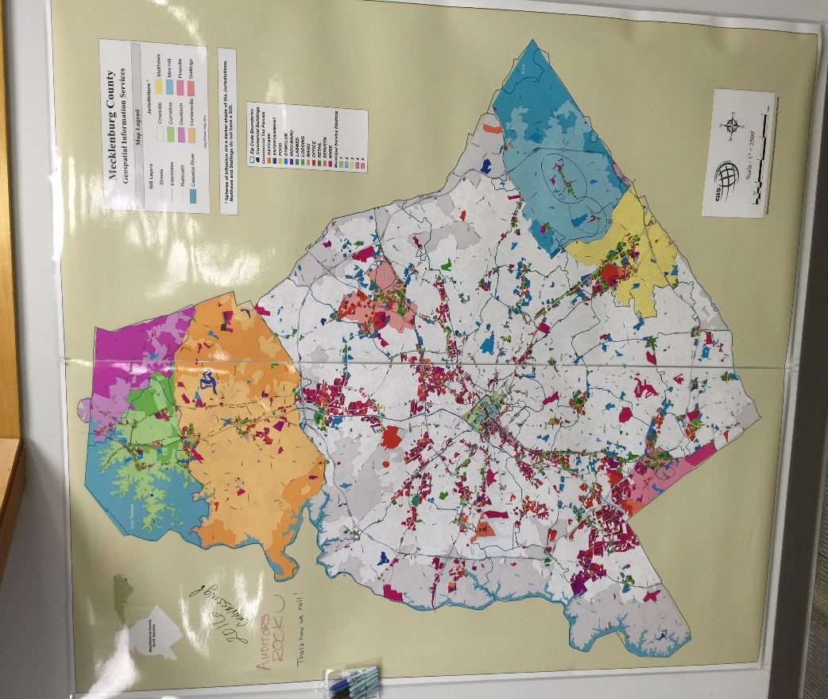
Mecklenburg County
BPP Canvassing Initiative
County Map

Slide 20
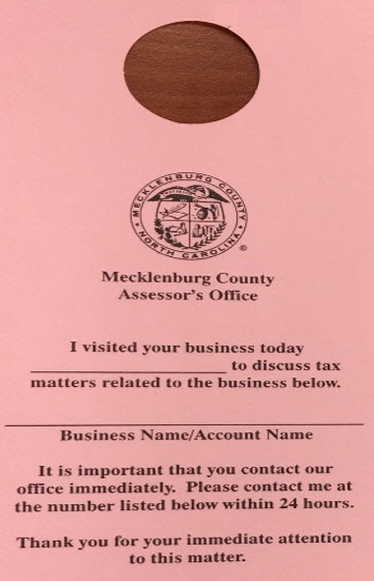
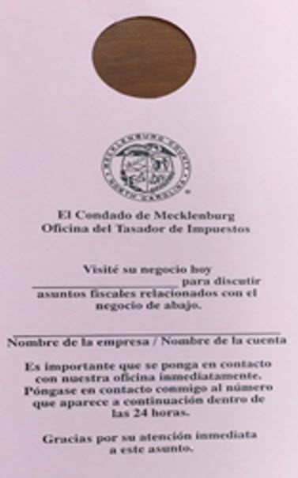
Mecklenburg County
BPP Canvassing Initiative
Door Hangers
English
Spanish

Slide 21
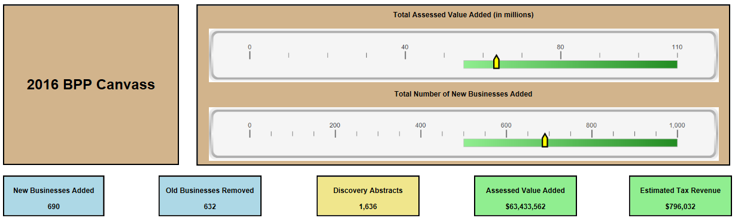
Mecklenburg County
BPP Canvassing Initiative
Dashboards

Slide 22
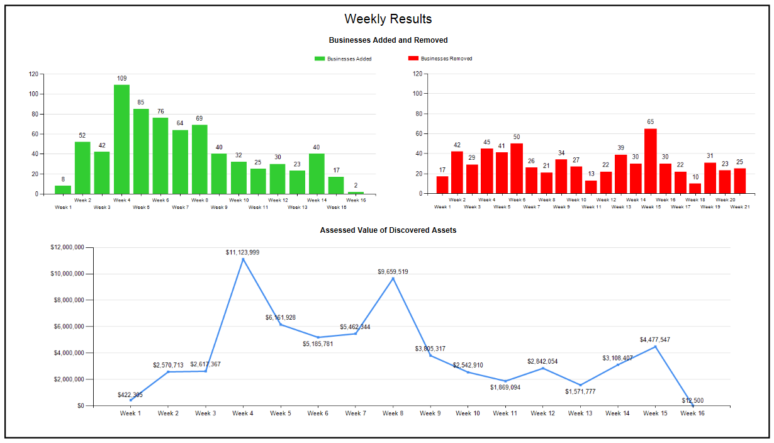
Mecklenburg County
BPP Canvassing Initiative
Dashboards

Slide 23
Mecklenburg County
BPP Canvassing Initiative
Results
CURRENT
“Win / Win” situation
$51M discovered value
541 new businesses discovered
$565K estimated additional tax revenue
Saved $71K in external fees
Removed 2200 accounts from current scroll
FUTURE
541 new businesses added to future tax scrolls
Elimination of non-operational entities from future tax scrolls

Slide 24
Mecklenburg County
BPP Canvassing Initiative
Summary / Conclusions
Started as a proof of concept idea
2 year pilot project
Significant learnings after the 1st year benefited future years
Feasible and successful initiative for Mecklenburg County

Slide 25
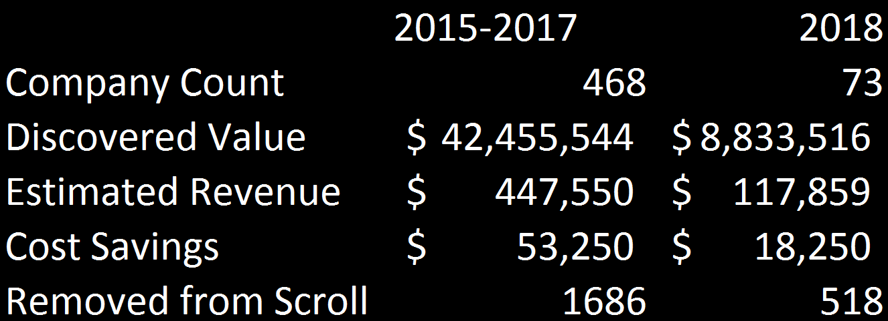
Mecklenburg County BPP Canvassing Initiative Summary / Conclusions

Slide 26

Mecklenburg County
BPP Canvassing Initiative
Questions / Comments

