Slide 1
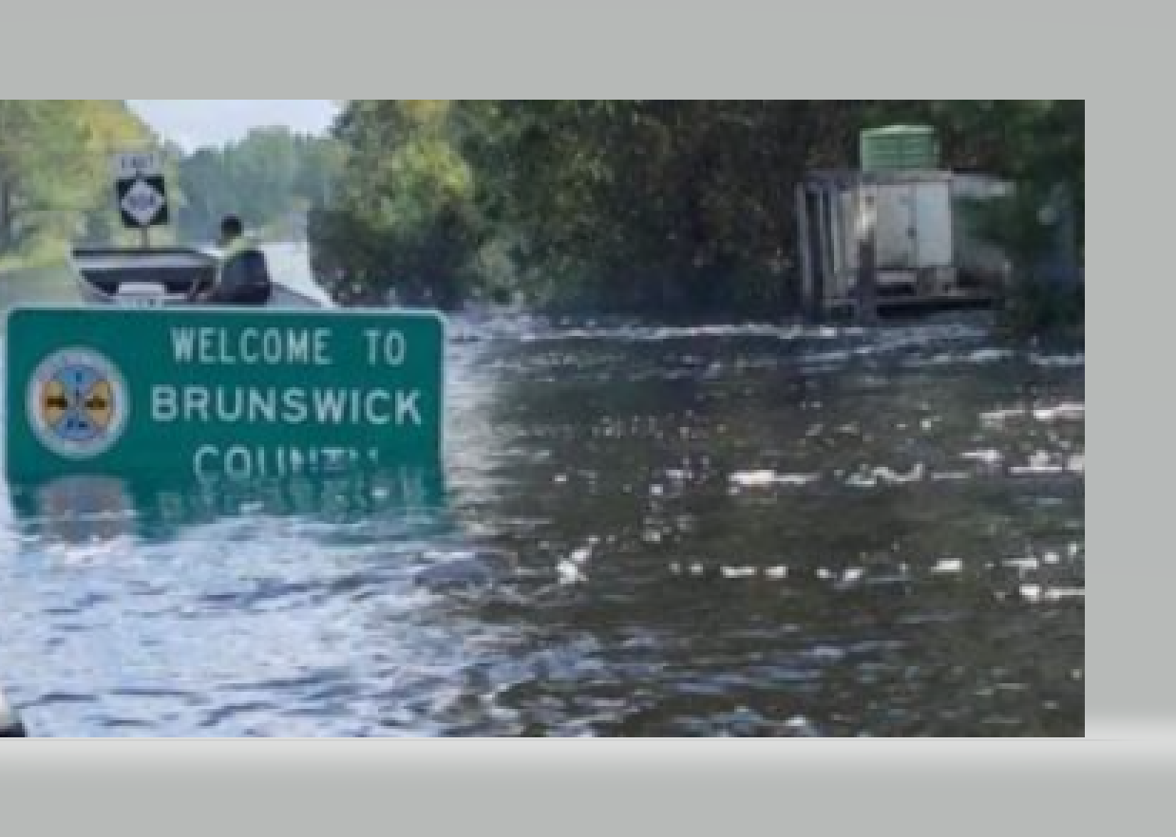
Brunswick County Hurricane Florence & 2019 Revaluation

Slide 2
Pre Storm Preparation Removal of important documents from floor level Covering all equipment with trash bags, including phones, power down equipment, unplug equipment, elevate CPU. Power off, unplug, elevate and cover. Perform backup, files and data. All vehicles full of fuel or gas and placed in safe location. All contacts updated.

Slide 4
During the storm
Know location of staff that has evacuated and provide constant updates.
Prepare for their safe return. Contacts, NC Highway Patrol and local Sheriffs office road openings and closures.

Slide 5
What to do when you arrive and your office has over 3” of flooding.

Slide 6
Within 24 hours, you move to new location. Brunswick County Senior Center Ballroom. Resources, IT, Operation Services and ATMC(phone and internet provider).

Slide 7
Damage Assessment Begins and Reval Continues.
Identify and begin creating Damage Assessment Teams.
Determine teams weakness and strengths.
Created two teams , one to continue reval, the other performs damage assessment.
Worked with other County agencies to determine flooded areas, road closures and also assisting homeowners with storm recovery information.
Permit management / home repairs, power restoration

Slide 8
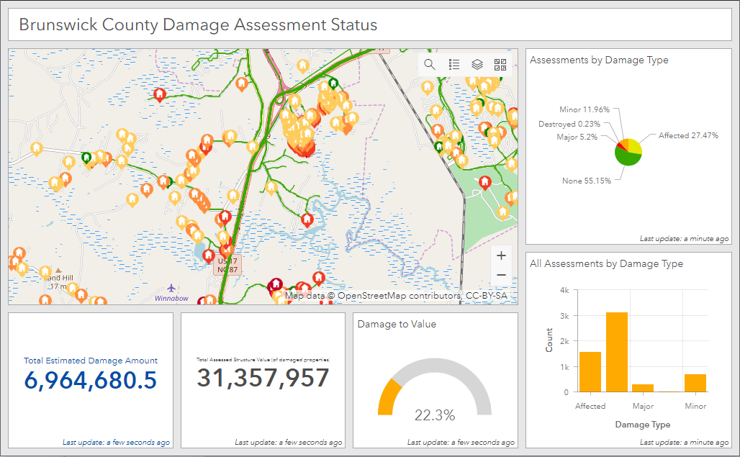
ARC
Damage Assessment Reporting & Tracking Teams. Tools Used. Crisis Tracker MI Fleet / Vehicle GPS Arc GIS

Slide 9
Crisis Tracker

Slide 10
Damage Estimates

Slide 11
Why we survived
Started revaluation with Data Cleansing.
Reviewed neighborhoods with slower growth in the beginning.
Maintaining up to date sales file, sales verification, visited all improved sales for data accuracy.
Teamwork.

Slide 12
Teamwork
A Crew Merging Into a Single Force That is Unstoppable!

