Slide 1
Economic Outlook 2019
Ron W. Loftis, Jr., MAI CRE
Acknowledgements:
SIOR – Stewart Title
CRE – Mirador Realty Partners

Slide 2
Economic Drivers
I. Global Trade
II. Employment
III. Interest Rates
IV. Sale - Retail, CRE Housing
V. NC Realty Markets
VI. Trends

Slide 3
Global Trade

Slide 4
Trade Deficit

Slide 5
What the US Bought from China - 2018

Slide 6
What China bought from US - 2018
China Trade
($Billions)
$539.0 Imported
$120.3 Exported
$418.7 Deficit

Slide 7
Employment

Slide 8
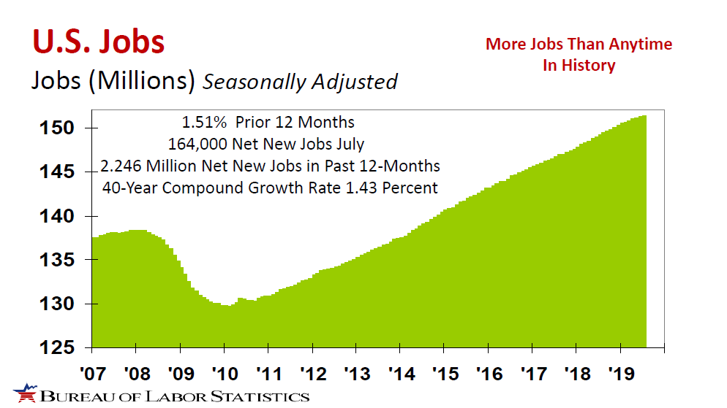

Slide 9
3.2%
Increase in Income for 12 months
Inflation Rate 1.8%
3.7%
Unemployment Rate
Lowest in
50 years

Slide 10
61.5%
Percent of Workers confident in finding new job if they lost their current job.
Federal Reserve Bank of New York

Slide 11
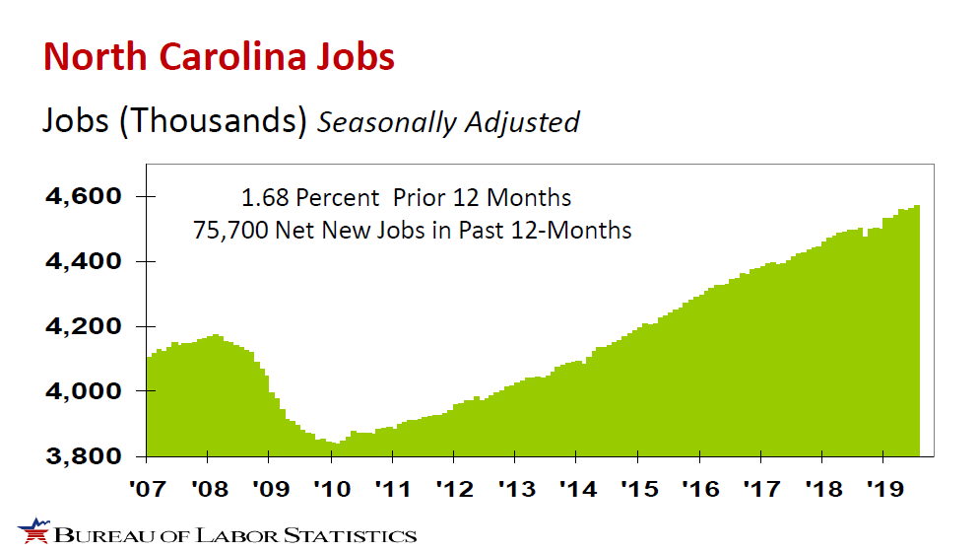

Slide 12
State Job Growth 12 Months ending July 2019
Tennessee 1.80%
North Carolina 1.68%
Georgia 1.64%
South Carolina 1.55%
Virginia 0.57%

Slide 13
MSA & Division Job Growth 12 Months Ending June 2019
Jobs - Thousands
MSA-Division | % | New | Total | 2 Yrs | 5 Yrs | 10 Yrs
Asheville | 3.62% | 7.1 | 203.0 | 6.79% | 15.34% | 22.88%
Burlington | -0.48% | (0.3) | 62.5 | 1.79% | 5.75% | 8.13%
Charlotte-Concord-Gastonia | 2.48% | 30.0 | 1238.1 | 5.11% | 16.23% | 29.49%
Durham-Chapel Hill | 0.70% | 2.2 | 317.6 | 3.12% | 9.78% | 14.78%
Fayetteville | 0.84% | 1.1 | 132.3 | 2.56% | 4.01% | 2.32%
Greensboro-High Point | -0.58% | (2.1) | 359.7 | -0.19% | 3.51% | 5.92%
Greenville | -1.10% | (0.9) | 81.1 | 1.88% | 4.65% | 9.74%
Raleigh | 1.24% | 7.9 | 645.8 | 4.96% | 15.28% | 29.32%
Winston-Salem | 1.64% | 4.4 | 271.9 | 3.54% | 7.47% | 11.16%
Total Job Growth

Slide 14
Interest Rates

Slide 15
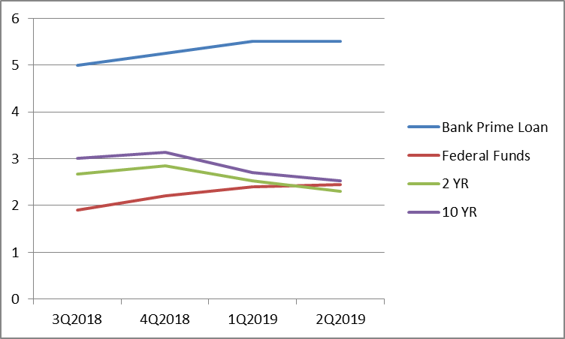
Federal Reserve

Slide 16
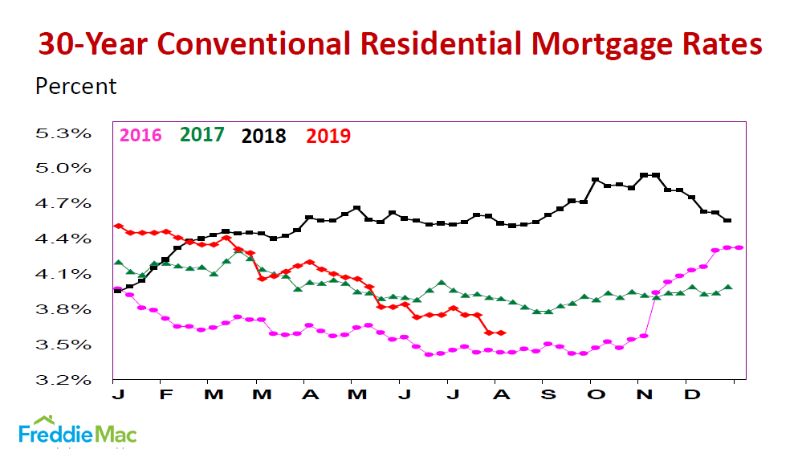

Slide 17
30 Year
Conventional
Rates
3.60%
Week Ending
August 15, 2019
Lowest
Since
November 2016

Slide 18
Yield Curve Predictor
“The flattening and inverted yield curve has been an accurate predictor of economic recessions. A yield curve inversion along the 2 year and 10-year spread has come before the last seven recessions.”

Slide 19
Federal Reserve Rates Aug - Sept

Slide 20
SALES

Slide 21
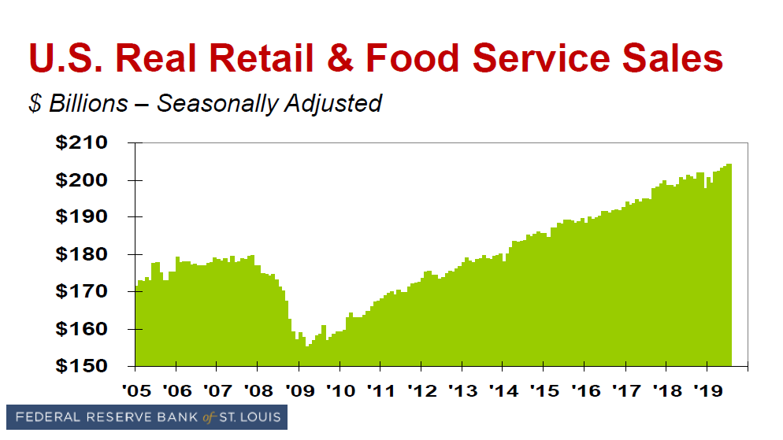

Slide 22
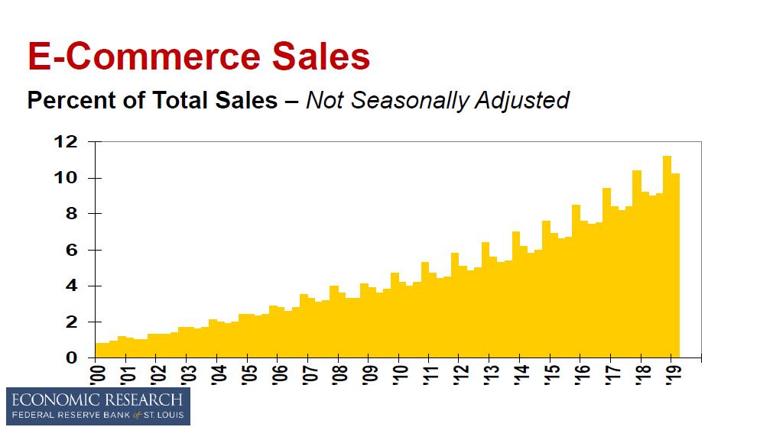

Slide 23
Omnichannel Marketing
Shoppers both Online & In-Store on Cyber Monday was up 40% over 2017
Multichannel Shoppers out spent single channel shoppers by up to $93
49% of all e-commerce traffic came from smart-phones

Slide 24
Retail Sales – No Recession
Approx. 68% of GDP
Up 0.7% in July 2019
Double of Forecast of 0.3%

Slide 25
Digging Deeper: US RETAIL
Retail sales remain strong even as store closings are growing.
Closures down 32% in 2018, but are up YTD.
Expect increase from bankruptcies including Sears, Payless, Mattress Firm, Toys R Us, etc.
Payless closing 2100 stores.
Wayfair opens 1st store,
Hobby Lobby opens 65 new stores
E-Commerce gains Market Share (9% of Sales)
Stresses increase for Retail Real Estate

Slide 26
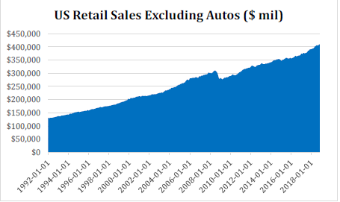
Digging Deeper: US Retail

Slide 27
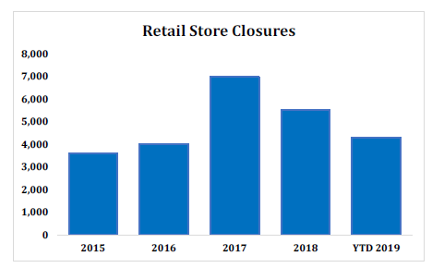
Digging Deeper: US Retail

Slide 28
Digging Deeper: Retail
Carolina Metros continue to benefit from strong HH growth.
Retail space demand per HH is declining with shift to e-commerce.
Triad & RDU – best potential for retail development.
Charlotte – highest oversupply risk
Single tenant drug & food anchored neighborhood & community centers are probably most durable, along with urban & infill locations.

Slide 29
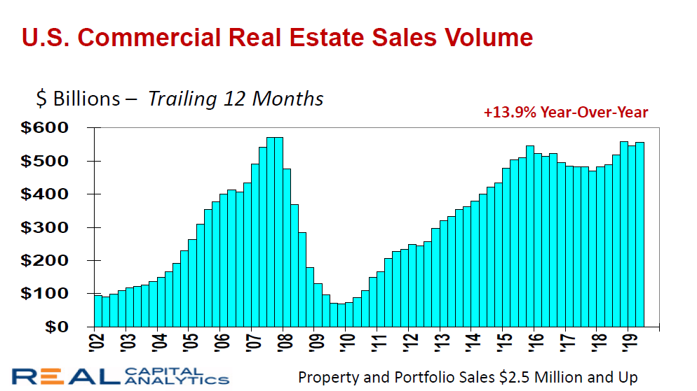

Slide 30
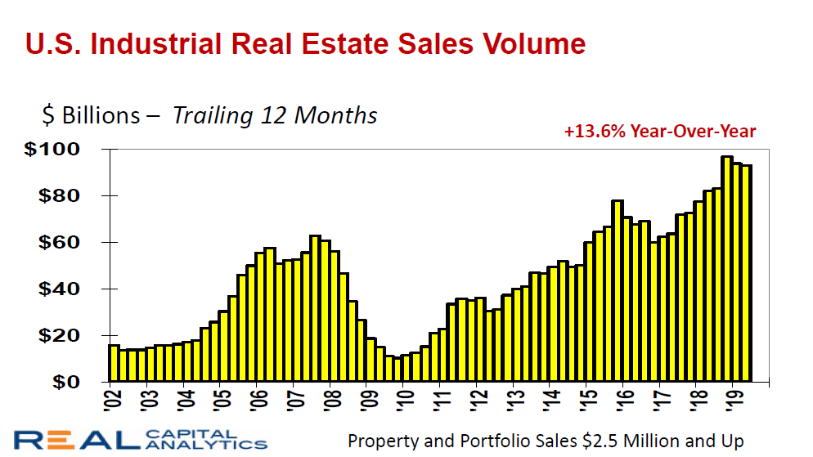

Slide 31
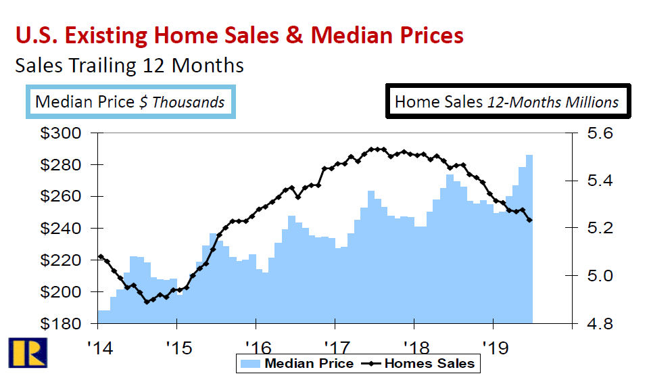

Slide 32
90%
Pay less taxes
$80
Billion
Extra Money Spent on Real Estate Annually due to Tax Cuts
USA TODAY
Zillow

Slide 33
1.5 Million
Net New
Households
In 2018
Built
Less Than
1.2 Million
New
Dwelling
Units

Slide 34
13.6%
Percent of U.S. Population Aged 25-34
37%
Percent of Homes Purchased Last 12 Months
Millennials #1 Homebuyers
6 Years in a Row

Slide 35
90.6%
Percent of Americans with
Health Insurance in 2018
Department of Health & Human Services

Slide 36
TRENDS

Slide 37
Rent Relativity Ranking
Sector | Score | Metro | Rent | Compare to US
Apartment | Stable | Triad (G- WS- HP) | $783 | -42.7%
Apartment | Stable | Raleigh-Durham | $1,041 | -23.8%
Apartment | Stable | Charlotte | $1,042 | -23.8%
IND | Growth | Charlotte | $4.00 | -21.3%
IND | Growth | Raleigh-Durham | $4.19 | -17.5%
Office | Stable | Triad (G-WS-HP) | $13.71 | -49.3%
Office | Stable | Raleigh-Durham | $18.43 | -31.8%
Office | Stable | Charlotte | $20.92 | -22.6%
Retail | Stable | Triad (G-WS-HP) | $13.17 | -28.9%
Retail | Stable | Raleigh-Durham | $16.74 | -9.7%
Retail | Stable | Charlotte | $16.91 | -8.7%

Slide 38
CAP RATES
Institutional Grade Assets unmoved
Non-institutional assets increase slightly 4Q2018
Low Concern for Rate increases
Remain stable given their behavior pattern & muted outlook on interest rate increases.

Slide 39
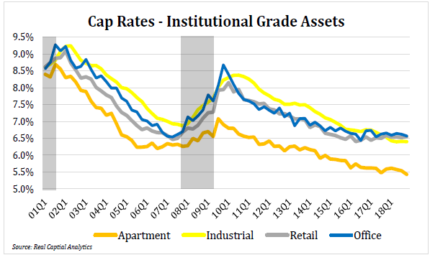

Slide 40
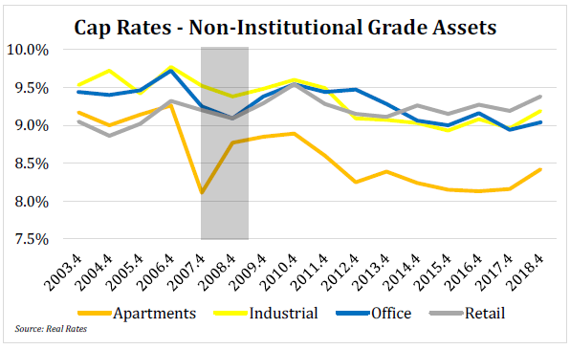

Slide 41
Digging Deeper: Apartments
Further study suggests affordability and household (HH) growth may be more closely linked to apartment demand than job growth.
Apartment supply growth will outrun growth in all Carolina Metros, particularly in Charlotte and Raleigh-Durham.

Slide 42
Digging Deeper: Apartments
Recent trends undermine the reliability of job growth as a predictor of apartment demand.
Several factors are in play to complicate apartment demand forecasting.
Fewer and fewer new jobs and households are required for apartment absorption.

Slide 43
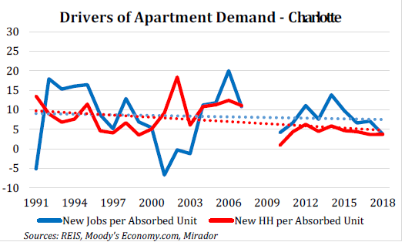

Slide 45
Revenue Score & Ranking | Metro Sector | Annual Change in Effective Revenue |  |  | Revenue Volatility |  | Current Performance Effective Revenue PSF |  |  |  |  | Vacancy
 |  | 2019 F | 2020 F | 2021 F | 1990-2018 |  | Current | Ave. | Delta | Rating |  | Current | YoY Chg
GROWTH | Raleigh Durham Industrial | 4.20% | 4.30% | 4.30% | 4.00% |  | $3.76 | $4.36 | -13.30% | Under |  | 10.20% | -220
GROWTH | Charlotte Industrial | 3.40% | 3.50% | 4.50% | 3.20% |  | $3.56 | $4.11 | -13.30% | Under |  | 11.00% | 0
Stable | Triad (GSO-W/S-HP) Retail | 1.90% | 2.20% | 2.50% | 2.40% |  | $11.83 | $13.05 | -9.40% | Under |  | 10.20% | 20
Stable | Raleigh- Durham Retail | 1.50% | 2.20% | 2.40% | 3.20% |  | $15.48 | $16.79 | -7.70% | Under |  | 7.50% | 20
Stable | Charlotte Office | 1.80% | 1.70% | 1.70% | 4.80% |  | $17.41 | $19.59 | -11.60% | Under |  | 16.80% | 80
Stable | Raleigh-Durham Office | 1.20% | 1.30% | 1.80% | 4.80% |  | $15.54 | $18.38 | -15.50% | Under |  | 15.70% | 140
Stable | Charlotte Retail | 1.10% | 1.40% | 1.30% | 3.40% |  | $15.22 | $16.51 | -7.80% | Under |  | 10.00% | 110
Stable | Triad (GSO-W/S-HP) Office | 0.90% | 1.00% | 1.10% | 3.60% |  | $10.28 | $13.15 | -21.80% | Under |  | 25.00% | 10
Stable | Raleigh Durnham Apartment | -0.20% | -0.40% | 2.00% | 3.70% |  | $978.00 | $552.00 | 10.80% | Over |  | 6.20% | 10
Stable | Triad (GSO-W/S-HP) Apartment | 0.90% | 0.10% | 0.00% | 2.60% |  | $733.00 | $691.00 | 6.20% | Over |  | 6.30% | 50
Decline | Charlotte Apartment | -1.30% | -0.80% | 10.00% | 3.90% |  | $976.00 | $845.00 | 15.50% | Over |  | 6.30% | 50

Slide 46
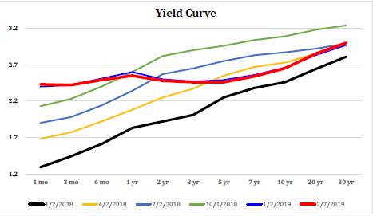
Economy & CRE
US Economy slowing, but solid.
Global synchronized growth subsided.
Yield curve flattened.

Slide 47
CMBS & balance sheet CRE Loan is superb.
Rising Construction costs.
Market conditions – limiting retail growth.
Equity & Debt readily available.
Areas to watch: Negative trends in Manufacturing, retarded job creation, record Corporate & Fed. debt levels, auto loan default trends.

Slide 48
2019+ Economic Outlook
Strong Economy
Growing Jobs & Wages
Declining Interest Rates
Rising Home Prices
Cheap (Profitable) Energy
Manufacturing Comeback Continues

Slide 49
Metro View Observations
Strengths:
Industrial
Charlotte, Raleigh/Durham
Retail (Anchored)
Raleigh/Durham, Triad
Weakness:
Apartment
Charlotte, Raleigh/Durham, Triad

Slide 50
METRO VIEW OBSERVATIONS
Industrial Demand – Strong
Warehouse & logistic facilities.
Apartment Sector – Over supplied
Waning Growth & Continued Building through 2020.
Enhanced Apartment Demand
relative affordability of apartments vs home ownership.

Slide 51
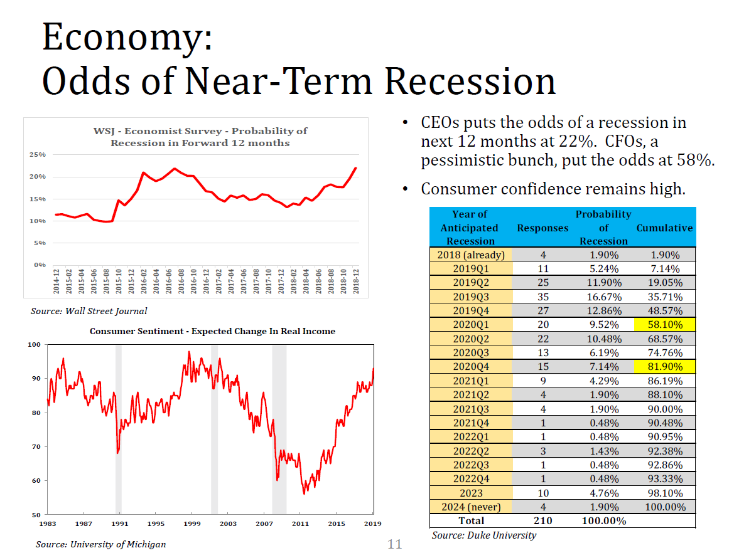

Slide 52
Counsel for CRE Investors
Solid Real Estate Investment opportunities
NOI & Value Growth through 2020
Growth or Stable Markets/Sectors
RDU & CLT industrial market – best position for continued expansion & revenue growth
Increase in Interest Rates anticipated
Limit Retail Acquisitions
Apartment Sector – over supply risk.

Slide 53
Thanks for coming!
Ron W. Loftis, Jr. MAI, CRE
Email: rloftis@loftiscompanies.com
D. Richard Brant, MAI
Email: rbrant@loftiscompanies.com
Phone: 336-768-6801
Website: www.loftiscompanies.com

