Slide 1
Eminent Domain Appraisal
Case Studies from the field
Ron W. Loftis, Jr., MAI, CRE
D. Richard Brant, MAI
© 2018 Ron W. Loftis, Jr. MAI, CRE

Slide 2
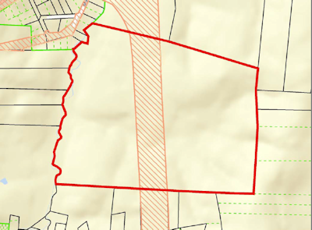
Today’s Goal
To broaden your perspective regarding highest and best use of the property subject to eminent domain proceedings

Slide 3
Eminent Domain
Eminent Domain is the right of the government to take private property for public use upon payment of just compensation.

Slide 4
Condemning Authorities
Federal, State & Local Governments
Public Utilities
School Systems
Railroads

Slide 5
Types of Property Taken
Right of Way for Roads, Railroad, Utilities
Easements for Roads, Railroads, Utilities

Slide 6

Easements
An interest in the land owned by another person…
Land burdened by the easement is called servient estate
Types of Easements
  Right of way
  Right of entry for the dominate estate
  Right to support of the land or building
  Right to light and air
  Right to water
  Right to do an act the would otherwise be a nuisance
  Right to place something in the servient estate
Property Owner

Slide 7
Methodology on
Date of Taking
Value Before the Taking
Value After the Taking
  Difference is Just Compensation for Damage
  Full Taking
  Partial Taking

Slide 8
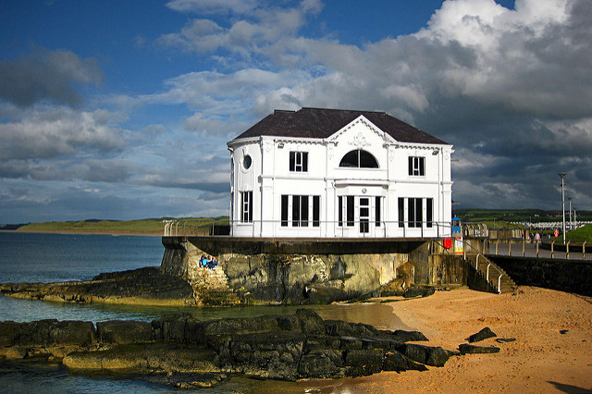
Highest & Best Use
Two Conditions
  As if Vacant
    Legally Permissible
    Physically Possible
    Financially Feasible
    Maximally Productive
  As if Improved
    Legally Permissible
    Physically Possible
    Financially Feasible
    Maximally Productive
Concepts
  Legally Non-Conforming Use
  Conformity
  Interim Use

Slide 9
Case One
Proposed HV Power Line
Tower
Dwelling
Fall Radius

Slide 10
Case One: Power Tower
Proposed High Voltage Power Line Easement
Dwelling outside of easement
Tower near dwelling
Dwelling inside fall radius of tower
What is the impact?

Slide 11
Case Two

Slide 12
Case Two: Right of Way & Aerial Easement
Damages:
  Proximity
  Loss of Utility of Carport
  Loss of Septic Repair

Slide 13
Case Three
Lot B
NC Highway
US Highway
Subject
New Utility Easement
Lot C
Lot A
Public Road
Public Street
XXXXXXXXXXXXXXXXXXXXXXXX
Existing Sewer

Slide 14
Case Three: W/S Access
Party 1 owned Lots A, B, and C. Party 2 owned the subject
Subject had no access to water/sewer before
Owner of A, B, and C refused access and city would not condemn for w/s lines
Subject appraised without access to water/sewer lines
Condemning authority agreed to sewer easement along new utility easement
Subject owner believed property should be valued as if it had water and sewer before

Slide 15
Case Four

Slide 16
Case Four: Right of Way
& Septic Drain Field
Damage:
  Proximity
  Loss of Septic System
  Loss of Drain Field & Repair Area

Slide 17
Case Five
Existing HV Power Line Easement
781 ft
451 ft
FF Restaurant
Existing ROW
New PUE
New ROW
Existing ROW

Slide 18
Case Five: ROW Squeeze
Existing fast food restaurant on outparcel with high tension power line to the rear of property
New ROW and PUE reduces site size
What is the highest and best use after the taking?

Slide 19
Before Taking
Mixed Use
Case Six

Slide 20
Assemblage and SFR
Case Six

Slide 21
Case Six:
Altered Highest and Best Use
Before Taking: Mixed Use
After Taking: Assemblage & Single Family Residential
Damage:
  Loss of Commercial Frontage
  West Remainder is Land Locked
  Modification of Highest and Best Use

Slide 22
Case Seven
Platted Access
Dedicated ROW
Proposed C-Store Outparcel
Proposed Gas Easement
Buffer
State Road
L1

Slide 23
Case Seven: Loss of Access
Vacant outparcel for proposed convenience store
Single platted access to outparcel
Proposed gas line easement
Owner argues loss of access

Slide 24
Case Eight
Building 1
Building 2
Building 3
Building 4
Proposed Greenway Easement

Slide 25
Case Eight: Privacy/Security
Existing apartment complex
Local authority condemned greenway along southern boundary
Greenway presented privacy and security issues
Cured with fence and shrubbery to hid greenway

Slide 26
Case Nine
US Highway
Public Road
Drainage Easement
Driveway
T
Area Taken
House
Drain Line
W
Deck
River

Slide 27
Case Nine: Drainage
Existing SFR located between street and river
Public street closed as part of road widening
New cul-de-sac at east end of property
Area taken included area for repair system for septic
New drainage easement may impact well
Damages based on cost to screen cul-de-sac and reduced economic life of house
Unknown factor was drainage easement around well

Slide 28
Case Ten
Residential HOA
Tennis
Parking
Residential Subdivision Street
Clubhouse
New PUE
New ROW
Pool
State Road

Slide 29
Case Ten: Amenities
Residential Homeowners Association
  Clubhouse, pool, tennis courts, parking lot
New ROW impacts pool area
New PUE very close to edge of 5-foot overhang of clubhouse
Missing information? Damages?

Slide 30
Case Eleven (1)
US Highway
Existing Right of Way
Driveway

Slide 31
Case Eleven (2)
Highway Elevation After
2 ft
10 ft
Highway Elevation Before

Slide 32
Case Twelve: Street Elevation
Local business repairs large trucks
Existing ROW included large portion of driveway and parking area
US Highway being widened and raised two feet in elevation
New profile too steep to access building with large trucks
Potential cure to change building orientation to street

Slide 33
Thanks for coming!
Ron W. Loftis, Jr. MAI, CRE
Email: rloftis@loftiscompanies.com
D. Richard Brant, MAI
Email: rbrant@loftiscompanies.com
Phone: 336-768-6801
Website: www.loftiscompanies.com

Slide 34
Encore:
Loss of Outparcels

Slide 35
Before Taking: Shopping Center with Three Outparcels

Slide 36
After Taking: Shopping Center with Two Outparcels

