Slide 1
2019 Advanced Personal/Real Property Seminar Signs of Human Trafficking
Margaret Henderson, Lecturer

Slide 2
Learning Goals
To learn the basics about sex and labor trafficking
To learn how the indicators might be visible in your work.
To learn what to do if you DO see indicators of human trafficking

Slide 3
How does human trafficking show up?
Human trafficking can occur anywhere, in large cities, small towns and rural areas.
The form it takes will depend on local characteristics.
The traffickers, victims, and customers can look like any of us.
Notes:
(discuss each point)
The question to ask is not “Does trafficking happen here?” but “What kinds of trafficking happen here?”

Slide 4
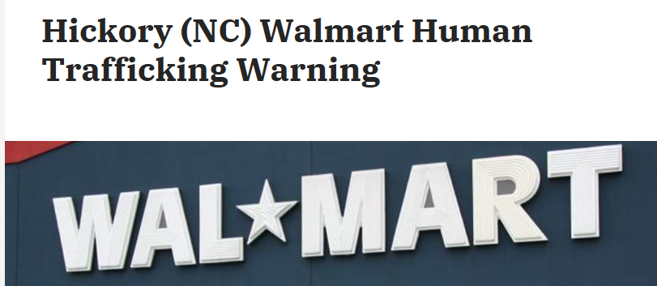
What have you seen or heard lately about sex or labor trafficking?
Notes:
Take a moment to consider what you’ve heard or seen lately about human trafficking.
Stories in the media
Arrests or trials
Plots in movie or tv shows
Warnings through social media
No matter who we are or what our life experiences have been – unless we have made a focused effort to study any specific wicked problem - we probably have gaps in our knowledge.
We probably hold both accurate and inaccurate information.
We might hold stereotypes that are inaccurate – either by content (victims and traffickers are people from other countries – not true) or by form (most incidences of trafficking involve kidnapping – not true) or by the number of people affected by the problem.

Slide 5
Basic Definitions
Human trafficking is defined as using force, fraud, or coercion to manipulate someone into performing labor or sex acts for profit.
Trafficking = F/F/C + labor or sex acts for the profit of a third party
F/F/C can be independent or intertwined.

Slide 6
Examples:
Force
Violence; physical harm; sexual assault
Fraud
Recruitment fees
Bait and switch tactics
Coercion
Psychological manipulation
False promises
Wage and hour violations
Restricted access
Locks preventing exit
Postings/no trespassing signs
Document confiscation
Threats to family
Black listing
Worsening work conditions
Shame and fear-inducing threats
Monitoring

Slide 7
Is it Force, Fraud, or Coercion?
Gang members approach young neighborhood girls to work for them by selling sex.
The girls resist but are told that if they don’t do it, their younger siblings “are next.”
They can protect their siblings by complying.

Slide 8
Is it Force, Fraud, or Coercion?
Young men are recruited for post-hurricane work crews. The contractor offers an hourly wage with room and board. They are driven to unfamiliar locations, working long hours.
The contractor holds their phones. The young men sleep six to a cheap motel room and are given one meal a day.
If they want more food they must buy it from the contractor. At the end of the month, they find that they have made about $100.00 each.
When they challenge the contractor to leave, he puts his hand on the gun he carries in his waistband.

Slide 9
Is it Force, Fraud, or Coercion?
A pre-teen in foster care runs away and is befriended by a young adult, who allows him to crash on his couch.
After a week, the adult tells the boy that he needs to start paying rent, and he has an idea about how.

Slide 10
Is it Force, Fraud, or Coercion?
A foreign national is recruited and receives a visa to become a massage therapist in the US. She incurs debt for the opportunity.
At her new job, she learns she has to live in the massage parlor, pay the house for her room and board, and offer sex acts as well as massage. She cannot leave the building without escort.
The business owner holds her passport and insists on being paid for its return. Her debt grows by the day.

Slide 11
Traffickers target vulnerabilities.
Sexual Orientation or Gender Identity
Homelessness
Hunger
Human Trafficking
Financial Stress
Addictions
Natural Disasters
Immigration Status
History of Physical or Sexual Trauma
Social Isolation
Family Conflict/Instability
Notes:
Since many of our communities already have problem-solving groups that focus on vulnerabilities like these, we have an opportunity to ask those groups to take time to consider how trafficking might show up within that context.
A trafficker doesn’t care whether the vulnerability is chronic or new, whether the vulnerability relates to the family or the larger society. Traffickers are highly skilled at recognizing and exploiting any kind vulnerability.
All of these vulnerabilities are connected with other wicked problems, too.

Slide 12
“Red Flags” of Potential Trafficking
An amusement park hires European college students as staff, who are rarely seen off-site. During a site visit, an appraiser notices that the staff dorms seem overcrowded and unhygienic. She sees a supervisor making an employee uncomfortable through unwanted touching.

Slide 13
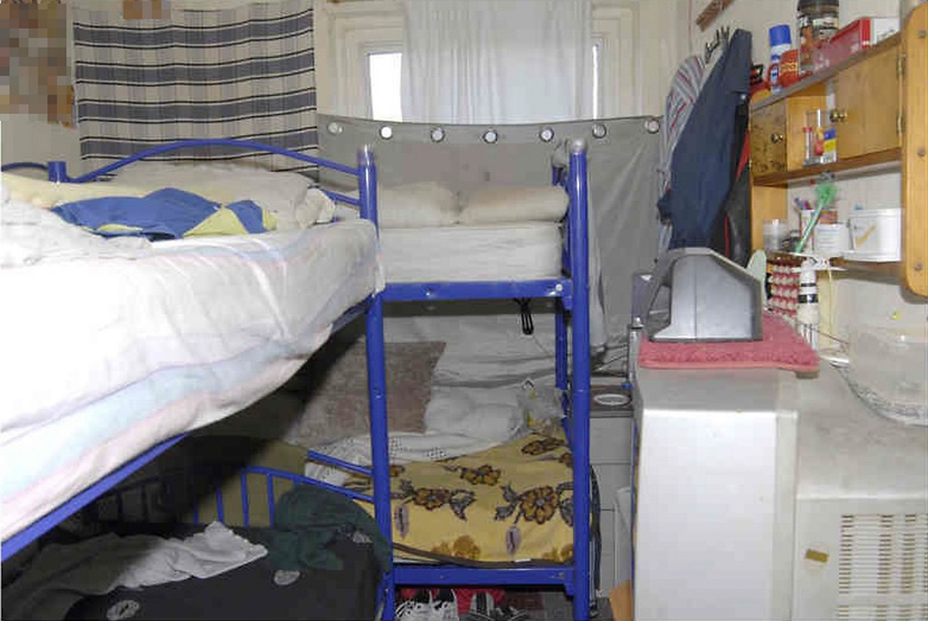
“Red Flags” of Potential Trafficking
The storage room of a restaurant contains bunk beds and personal items.

Slide 14
“Red Flags” of Potential Trafficking
Image from Times Union
While in the field making contact with delinquent taxpayers, the tax collector notices a sign on a massage business reading “entrance around back” and an arrow pointing down an alleyway to the back of the building. It is open until midnight.

Slide 15
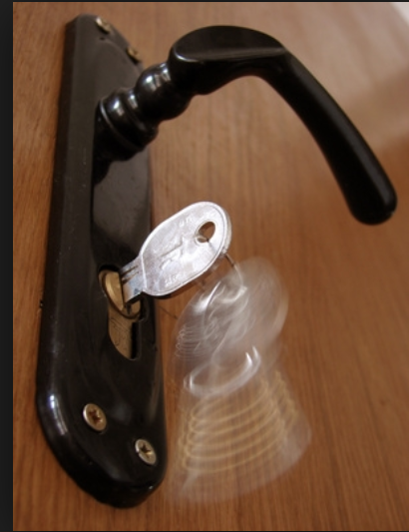
“Red Flags” of Potential Trafficking
While reviewing an upscale home under appeal, the appraiser notices that the maid's room locks from the outside.

Slide 16
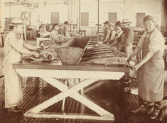
“Red Flags” of Potential Trafficking
In a food-processing plant, the auditor notices that the workers seem to have an unusually high number of visible injuries that are crudely cared for.
The site supervisor diverts the auditor’s attention away from the employees and moves into another area of the plant.

Slide 17
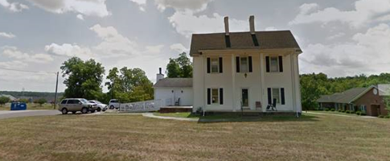
“Red Flags” of Potential Trafficking
A large, old home has been repurposed as a halfway house. All of the tenants spend long hours together at a local business, traveling to and from the workplace together in a van.

Slide 18
“Red Flags” of Potential Trafficking
They can’t hold their own identification papers
They live and work together, on site or in a home
A third person controls movement and contact
They pay excessive room/board/transportation
They don’t receive all pay owed
They can’t contact friends/family easily
Something bad will happen if they try to leave
Exampl

Slide 19
Traffickers use specific environmental conditions
Recruit – Transport – Market
Tourist destinations
Large public events
Seasonal farm work
Online advertising opportunities
Interstate highways
Truck stops
Highway rest stops
Military bases
Factories
International borders
Colleges and universities
Notes:
Look over this list and assess which conditions are in your area.
These environmental conditions enable traffickers to recruit, exploit, or transport victims.
You might want to check in with communities with similar characteristics – even in another part of the country – to learn about their experience with identifying, preventing, or intervening with trafficking.

Slide 20
Traffickers employ 25 business models for financial benefit
Notes:
The more we learn about a wicked problem, the better we are able to introduce disruption strategies.
The Polaris Project used data from the National Human Trafficking Hotline to identify twenty-five business models of sex and labor trafficking. When we start thinking about human trafficking as a profit-making enterprise, we can adjust our thinking to focus on disrupting the profit generated by the illicit business.
Two potential local government leadership strategies in dealing with human trafficking are these:
Since local government staff work with or see vulnerable populations every day in homes, businesses, and public spaces, we have an opportunity to develop strategies for identifying potential abuse through trafficking.
Since local government staff – according to SOG research – are in positions to see indicators of 19 of these 25 business models of trafficking, we have an opportunity to train staff to recognize and report potentially dangerous situations.
By naming these vulnerabilities, environmental conditions, and business models, we begin to also name potential problem-solving strategies.

Slide 21
The 25 Business Models of Trafficking
We conducted four focus groups:
Two municipalities (Chapel Hill and Greensboro)
Two counties (Pitt and Rockingham)
15 Departments participating (27 individuals):
Library, Tax, Emergency Services, Environmental Health, Engineering, Public Utilities, Register of Deeds, Solid Waste/Recycling, Licensing, Neighborhood Development, Inspections, Economic Development, Manager, Public Health

Slide 22
Why local government?
City and county staff …
Are in homes, businesses, and public spaces every day,
Encounter vulnerable populations,
Know and care about their communities.

Slide 23
The 25 Business Models of Trafficking
The question we posed for each model of trafficking:
“If this business model of trafficking
were operating in your (city)(county),
which governmental departments, functions, or services might intersect with it?”

Slide 24
Business Models – most visible to local government
Escort services
Illicit massage
Outdoor solicitation
Residential brothels
Domestic workers
Bars/strip clubs/cantinas
Traveling sales crews
Restaurants/food service
Peddling and begging rings
Agriculture
Construction industry
Hotels/hospitality
Landscaping
Illicit activities
Factories
Carnivals
Forestry/logging
Recreational facilities
Health care settings

Slide 25
Untapped Observers:
First responders to emergencies
Any kind of inspector (environmental health, code enforcement, etc.)
Water/sewer/solid waste management/recycling
Any licensing function (business, professional, marriage, etc.)
Library staff
Anyone who works in public waiting areas, especially related to transportation
Business registration functions

Slide 26
Along with awareness training…
…create protocols for reporting
Clarify legal requirements affecting your profession.
Clarify the expected sequence of events.
Clarify expectations for involving external authorities.
Debrief and readjust the protocol as necessary

Slide 27
What to do?
Examples of reporting options:
Report to a supervisor
Report to law enforcement
Report to the National Human Trafficking Hotline
Call 888 373 7888
Text 233733
Humantraffickinghotline.org

Slide 28
Available to everyone:
The Polaris Project (reports and statistics)
https://polarisproject.org/

Slide 29
How big is the problem?
287 cases reported in 2018 to National HT Hotline:
192 sex trafficking 54 labor trafficking
14 sex and labor 27 type not specified
Five Project NO REST pilot sites: 300 victims in 18 months.
Cumberland County: 48 charges
Wake County: 33 charges
SBI reports 731,500 online ads for sex in 2018 in NC.

Slide 30
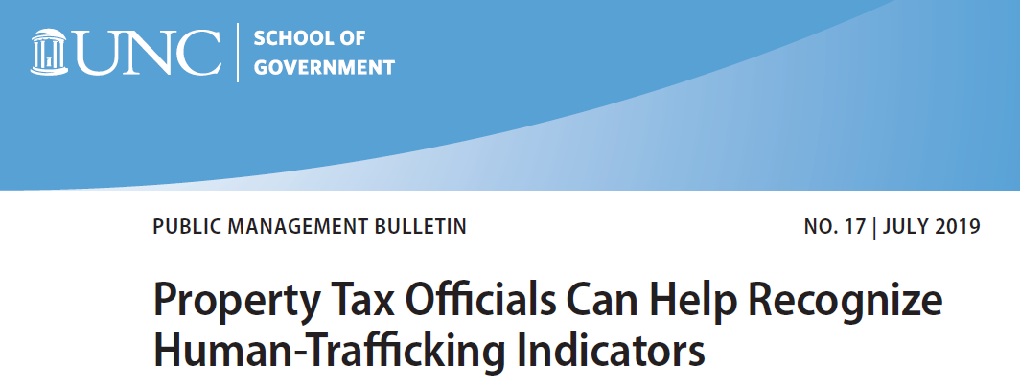
Questions?
For more information or more training, contact:
Margaret Henderson, The School of Government, margaret@sog.unc.edu
sog.unc.edu >>search for “human trafficking”

