Slide 1
2019 Billboard Structures Valuation Guide
Tuesday September 17, 2019
11:00 a.m. to 11:50 a.m.
Sheraton Four Seasons Hotel - Greensboro
Dave Duty- NCDOR Local Govt. Division - Property Tax Section
Ana Maria Bynoe – BI-Tek Software Company

Slide 2
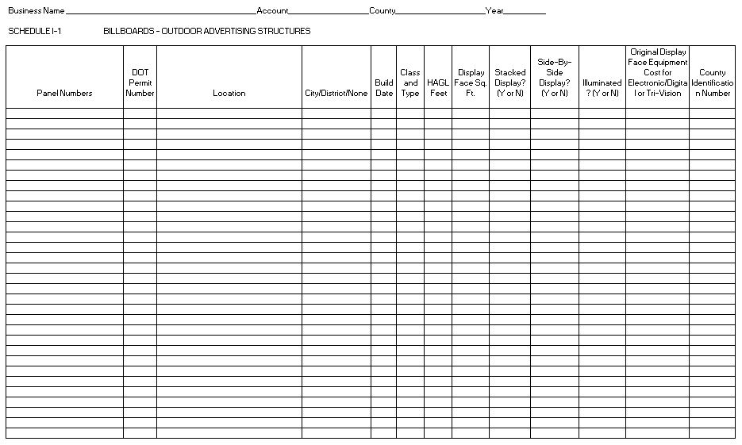
Property Tax Section Listing Form
I-1 Form

Slide 3
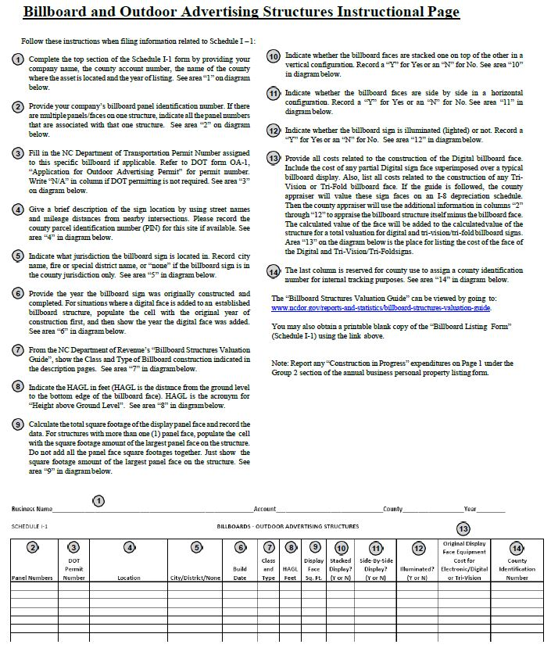
Instruction Page; I-1 Form

Slide 4
Categories; I-1 Form
Panel Numbers
DOT Permit Number
Location
City/District/None
Build Date
Class & Type
HAGL Distance
County ID Number
Display Face Sq. Feet
Stacked Display ?
Side-By-Side Display
Illuminated ?
Original Display Face Equipment Cost for Electronic/Digital or Tri-Vision

Slide 5
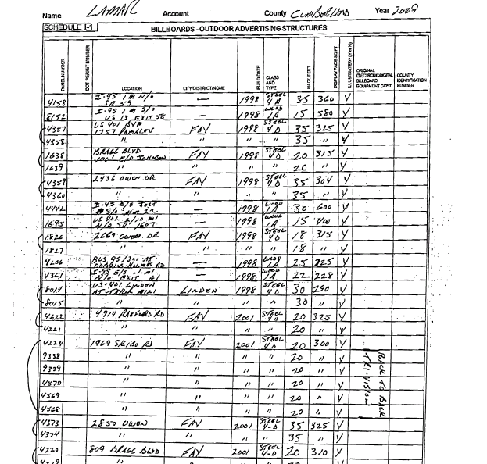
Lamar helped design and develop the I-1 schedule

Slide 6
Pro-Active County Business Practices for Listing Forms
Mail manual & I-1 Schedule to T.P.
Use the manual to value billboards
Require T.P. to use the I-1 form
Compare old worksheets to I-1 form
Use the income approach on the land
Create Excel program that values your B.B.

Slide 7
Guess What?
You too can develop your own excel valuation worksheet!
Just contact your County IT Dept. for help!
When you do create your own sheet, share it with all the other counties!
But wait, if you call now, we’ll double this offer at no extra charge!
BONUS: Software vendor program will be presented very soon!

Slide 8
Valuation-Sales Comparison & Income Approaches
Due to the many difficulties inherent in the appraisal of billboards when applying the sales and income approach to value, we recommend appraising and assessing these structures using the cost approach to value after they are listed as personal property.

Slide 9
Valuation-Cost Approach
Industry wide use of cost approach
An efficient methodology; uniformly & consistently reaches fair market value
The RCN less depreciation method is simple
Helps avoid the complicated allocation process when using the income and market approach.

Slide 10
Applying the Cost Approach
To value; calculate replacement cost new (RCN), then remove depreciation.

Slide 11
Depreciation Schedule
Billboard depreciation schedule; little, if any depreciation.
Schedule uses an effective/physical age approach when estimating loss of value.
Value loss from physical depreciation, functional obsolescence or economic obsolescence.

Slide 12
Depreciation Schedule
The depreciation schedule;
25-year life for wooden structures,
50-year life for steel structures.
Do not go below a 35% percent residual value.

Slide 13
A Completed I-1 Form
Lamar helped design and develop the I-1 schedule
Comes from the taxpayer after the tax office mails it

Slide 14

The Billboard Structures Valuation Guide
Focus of this workshop – Major tool needed

Slide 15
Base Cost Tables
Starting point for valuation

Slide 16
Valuation Worksheet
Organizes your approach to getting a value

Slide 17
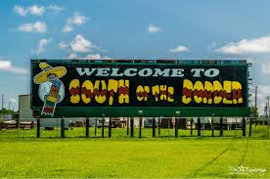
Appraise this billboard:
2005 1A 25’HAGL 300 sq. ft. w/lights
Use a blank worksheet – pg. 15
Use Depreciation Schedule – pg. 25
1224 × 811Images may be subject to copyright

Slide 19
Solution
From Manual: 1A @ 25 ft. HAGL with face at 300 sq. ft. & lights= $8,340
Year is 2005, and will be 14 yrs. old in 2019:
From Depreciation Table, 14 yr. Wood = 44%
Multiply $8,340 by .44 to arrive at value:
$8,340 x .44 = $3,669
The value for 2019 is $3,669

Slide 20
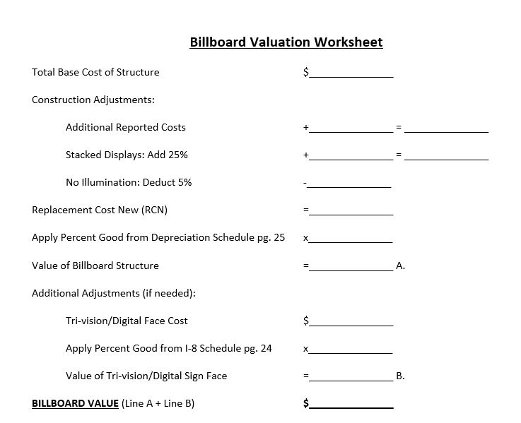
B) 3B 378 sf 25’ HAGL Lights 2011 Stacked
41,570
10,393
51,963
51,963
.84
43,649
0
43,649

Slide 21
INTERSTATE OUTDOOR, INC. VS. JOHNSTON COUNTY
11 PTC 1062

Slide 22
North Carolina Court of Appeals: Interstate Outdoor, Inc. vs. Johnston County, 9-16-14
We affirm the Commission’s decisions because Interstate failed to produce substantial evidence that the valuation method used by Johnston County was arbitrary or illegal.
The PTC found that Interstate failed to show that the quotes it used “included all the costs that make the property ready for its intended uses,” or a substantial connection between the quotes and the actual costs of constructing the billboards at issue.

Slide 23
North Carolina Court of Appeals: Interstate Outdoor, Inc. vs. Johnston County, 9-16-14
N.C.G.S. 105-291(g) authorizes the Department of Revenue to “develop and recommend standards and rules to be used by tax supervisors and other responsible officials in the appraisal of specific kinds and categories of property for taxation.” The Local Government Division of the Department of Revenue created a Billboard Structures Valuation Guide…
The use of schedules of values and rules of application not only makes the valuation of a substantial number of [pieces] of property feasible, but also ensures objective and consistent countywide property valuations and corollary equity in property tax liability.”
The impracticality of assessing each and every billboard based on the precise soil conditions at its base and wind load is a valid consideration for the county.

Slide 24
North Carolina Court of Appeals: Interstate Outdoor, Inc. vs. Johnston County, 9-16-14
…it was not illegal or arbitrary for Johnston County to appraise Interstate’s billboards in bulk. The method followed by Johnston County took into account the relevant properties of the billboards, such as their size, design, and age. Interstate has failed to show that the method prescribed by the Billboard Guide produces a value significantly higher than the true value.

Slide 25


Billboard Valuation
Notes:
(INTRO) The Bi-Tek billboard valuation calculation and tracking that we have in our system, and it’s been in our system for quite a while, is based on ANSI DOR Billboard Valuation Guide. What it will do for you is calculate the value of the billboard by simply you entering the physical attributes in the information that you get from the taxpayer. What it does is eliminate the need for you to manually figure and calculate the value, so you get a nice accurate value in a lot less time and we think you might like it.

Slide 26
Overview
  Bi-Tek Billboard Valuation
  Based on the NCDOR Billboard Structures Valuation Guide
  Calculates the value of a billboard by entering physical attributes.
  Eliminates the need to manually figure the value!

Slide 27
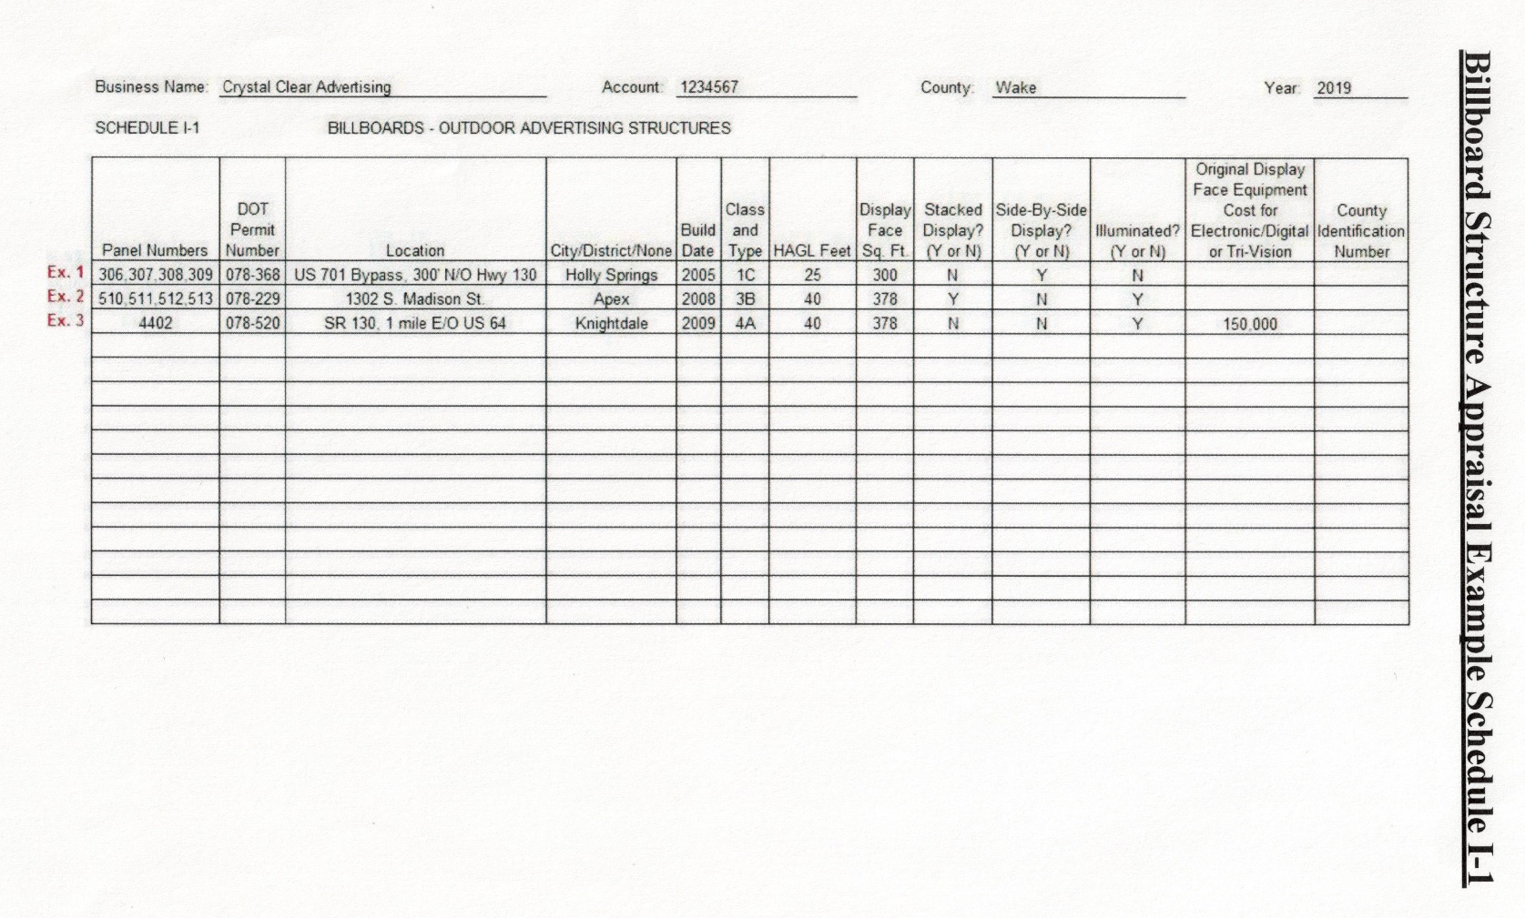
Schedule I
Completed by the Taxpayer with their Billboard information
Notes:
It’s going to start from you getting the information from the taxpayer, what you see here is the sample schedule I received from the taxpayer, with all the information about their billboards.

Slide 28
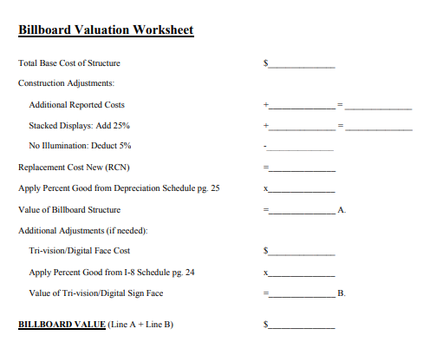
Manual Calculation
THERE’S AN EASIER METHOD!
YOUR CHOICE: Do the math, or let Bi-Tek software do it for you!
Notes:
When you look at the NCDOR Valuation Guide, it gives you this nice valuation worksheet of what you need to do in order to come up with the value of the billboard. There is an easier method than to work through this worksheet on every one of your billboards.

Slide 29
Setup
  Bi-Tek performs the initial setup and can work with you year-to-year to ensure we maintain the most up-to-date acquisition value calculations.

Slide 30
Setup
  Billboard valuation setup consists of:
  Depreciation Schedule
  Billboard Models
  Billboard Acquisition Value Calculator
Notes:
The Depreciation Schedule is added from the Billboard Structure Valuation Guide for 25-year/wooden and 50-year/steel structures. The different billboard models are added for single face, v-built, a-frame, etc. from the Billboard Structure Valuation Guide. The billboard acquisition value calculator is the table that calculates the acquisition value, based on the model and the size of the billboard. *Note: Additional models/values that are not in the guide can be added as needed. Example a steel framed 3-sided billboard. Once setup is complete you are ready to enter your billboard data.

Slide 31
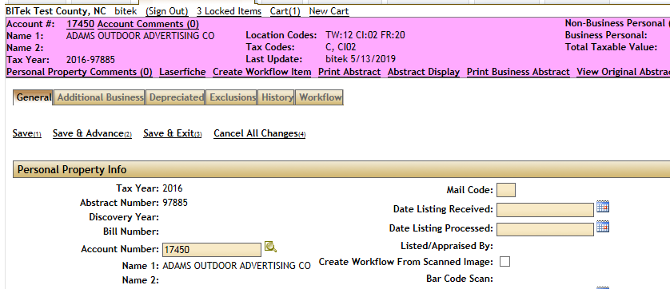
Overview
Billboards would be entered while recording your Personal Property
Notes:
You receive the taxpayers Schedule I/H for data entry. Our system records Personal Property under Additional Business or Non-Depreciated assets. We are currently working on a solution that would allow you to import your Personal Property information (such as billboards) from the schedules provided by the taxpayer.

Slide 32
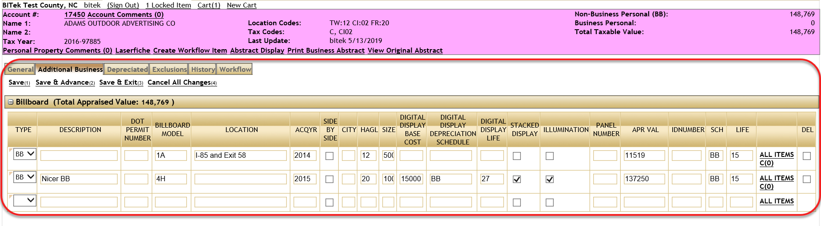
Overview
The user can enter the data from the Schedule I/H provided by the taxpayer to the appropriate fields in the Personal Property Billboard table.
Notes:
The ability to enter the data in the fields while the worksheet calculations are completed in the background. The appraised value is automatically calculated based on the information provided in the table. No need to manually calculate. The worksheet works similar to the worksheet provided by NCDOR. You can also copy/paste the information from an Excel version of the Schedule I.

Slide 33
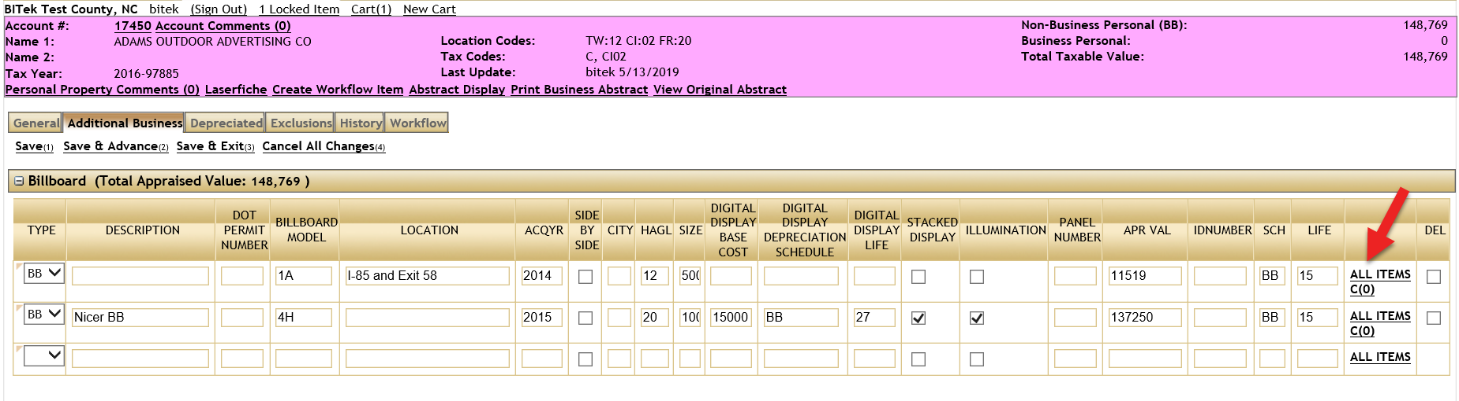
Overview
The worksheet is contained within the All Items link within the table. Select the link to be taken to the calculations worksheet and to modify the Appraised Cost.
Notes:
To view the calculation details, select the ALL ITEMS link and it will take you to the worksheet that automatically calculates the billboard based on the information provided.

Slide 34
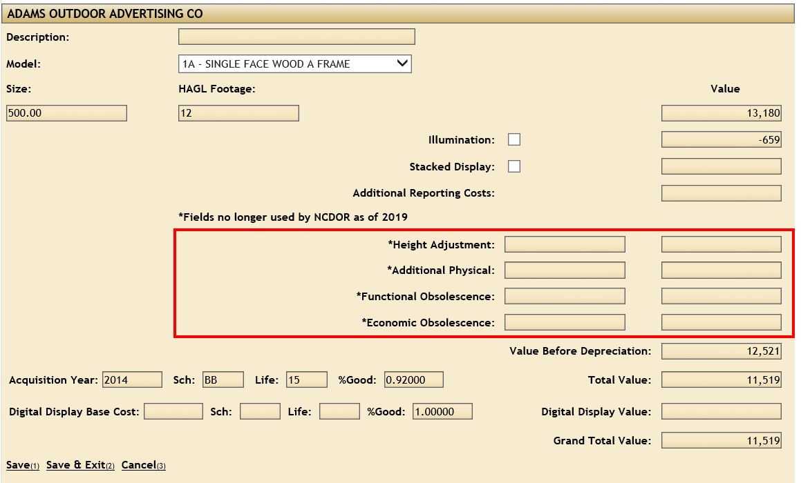
Overview
The worksheet is populated with all of the information contained on the previous screen billboard table with the exception of Additional Reporting Costs and any adjustments.

Slide 35
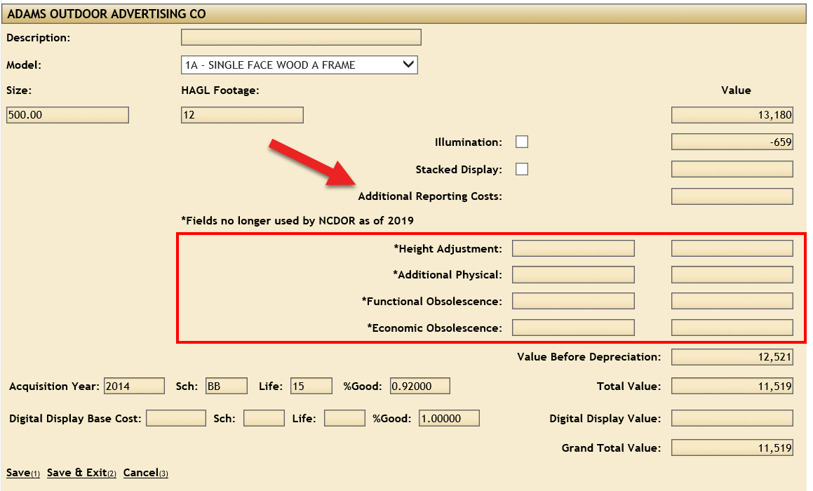
Overview
Adding Additional Reporting Costs will increase the Grand Total Value as an adjustment would decrease the Grand Total. You can also modify any existing information.
Notes:
You can update any information here and it will automatically update the billboard table on the prior screen.

Slide 36
Overview
Save & Exit on this page takes you back to the billboard table and applies any Additional Reporting Costs or adjustment to the APR Value.

Slide 37
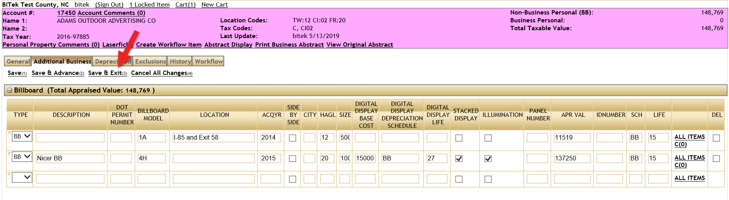
Overview
Once you Save & Exit on the Personal Property page your billboard valuations are saved.
Notes:
Now you’re done adding your billboard valuation and can report on this information.

Slide 38
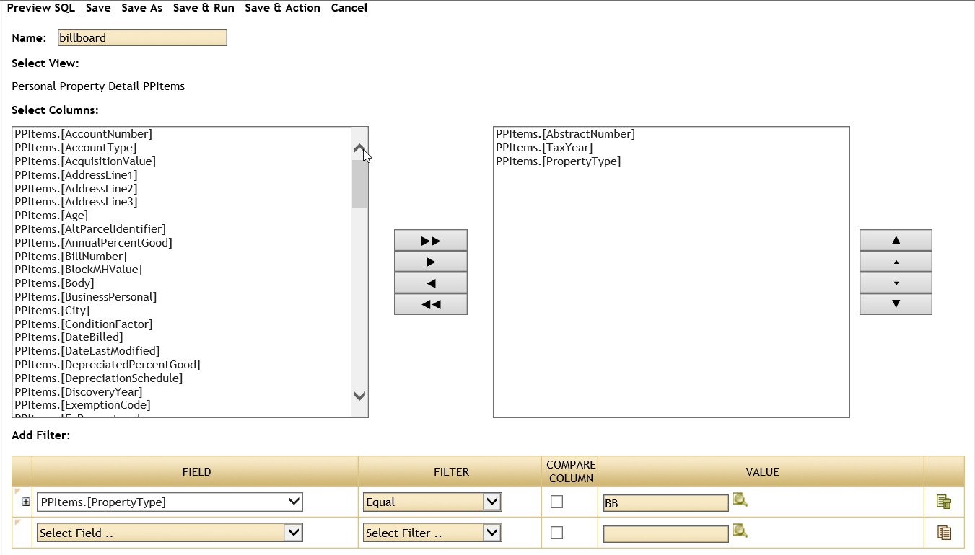
Reporting
Queries can be created to retrieve all Personal Properties containing billboards by adding a Boolean search for the Property Type = BB.

Slide 39
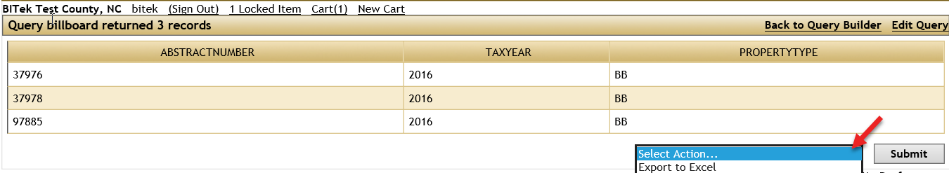
Reporting
The results of the query can contain all or some of the columns in the billboard table and can be exported in different formats like excel.

Slide 40
Take-aways
BI-Tek removes the need for manual calculations of Billboards
Minimal setup required
Data entry made easy
Reporting is customizable
For questions on how to use this feature and or the Bi-Tek system, or how to get this feature added to your existing Bi-Tek system, please feel free to contact us at +1-800-333-3341.

Slide 41

Summary

Slide 42
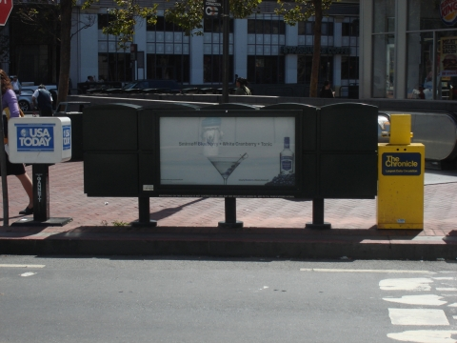

Slide 43
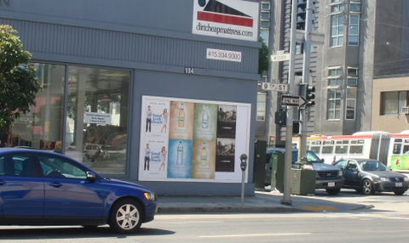
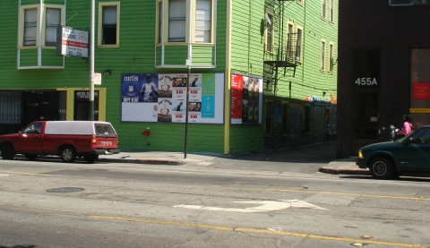

Slide 44
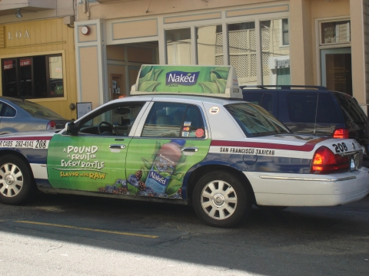

Slide 45
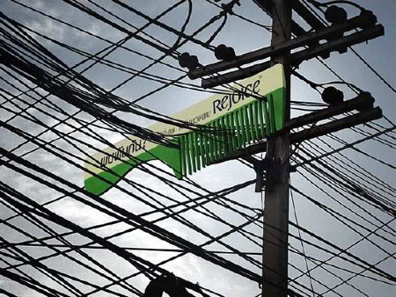

Slide 46


Slide 47


Slide 48
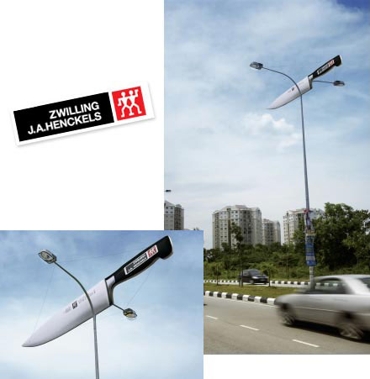

Slide 49
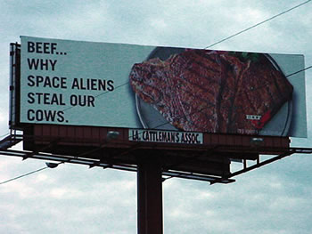

Slide 50
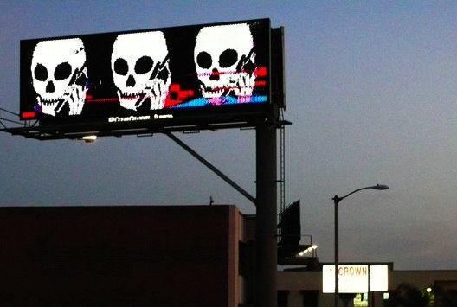

Slide 51


Slide 52
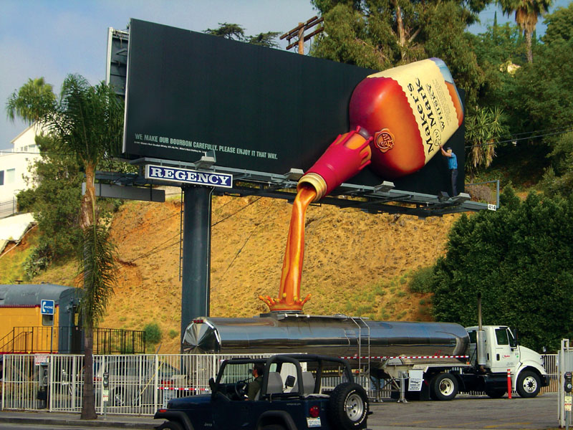

Slide 53
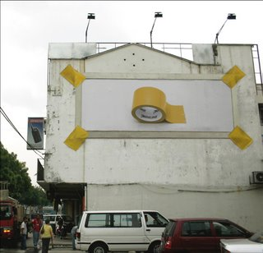

Slide 54
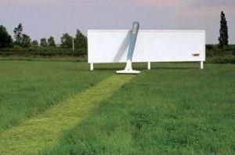

Slide 55
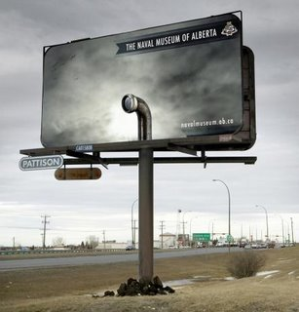

Slide 56


Slide 57
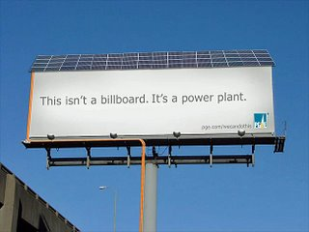

Slide 58
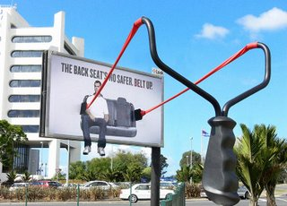

Slide 59
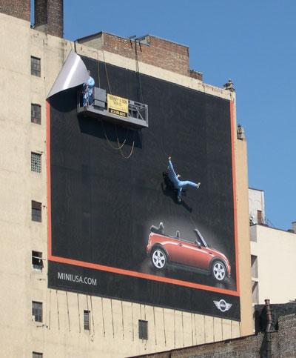

Slide 60
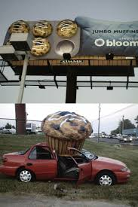
Thanks for attending the 2019 Billboard Structures Valuation Guide Workshop!!!
640 × 960Images may be subject to copyright
640 × 960Images may be subject to copyright

