Slide 1
David Baker, MPA, PPS NCACC Director of Tax and Revenue Outreach
NCDOR Advance Appraisal Seminar
September 17, 2019 Guilford County

Slide 2
Personal Property Issues
Mass Appraisal and the Trending Schedules
Trailers Registered in Other States
Multiple Business Owners
Tax Consultants

Slide 3
Mass Appraisal and the Trending Schedules
Mass appraising
Trending Tables – Cost Index and Depreciation Schedules.
Developed in the late 70’s and early 80’s
Uses the cost approach to appraise business personal property.

Slide 4
Mass Appraisal and the Trending Schedules
Major categories of property:
Group (1) MACHINERY & EQUIPMENT This is the group used for reporting the cost of all machinery and equipment. This includes all store equipment, manufacturing equipment, production lines (hi-tech or low-tech), as well as warehouse and packaging equipment
Group (2) Construction in Progress (CIP) CIP is business personal property which is under construction on January 1

Slide 5
Mass Appraisal and the Trending Schedules
Major categories of property:
Group (3) Office Furniture & Fixtures This group is for reporting the costs of all furniture & fixtures and small office machines used in the business operation. This includes, but is not limited to, file cabinets, desks, chairs, adding machines, curtains, blinds, ceiling fans, window air conditioners, telephones, intercom systems, and burglar alarm systems.

Slide 6
Mass Appraisal and the Trending Schedules
Major categories of property:
Group (4) Computer Equipment This group is for reporting the costs of non-production computers & peripherals.
Group (5) Improvements to Leased Property This group includes improvements made by or for the business to real property leased or used by the business.

Slide 7
Mass Appraisal and the Trending Schedules
Major categories of property:
Group (6) Expensed Items This group is for reporting any assets which would typically be capitalized, but due to the business’ capitalization threshold, they have been expensed.
(Group (7) Supplies Almost all businesses have supplies. These include normal business operating supplies.
(8) Other This group will not be used unless instructed by authorized county tax personnel.

Slide 8
Mass Appraisal and the Trending Schedules
Retail Store: What schedules to use?
D10 Store equipment
K10 Office furniture and fixtures
U5 Computer
D6 Point of Sale

Slide 9
Mass Appraisal and the Trending Schedules
D10 K10
U5 D6
J10 A10
B8 B10
C9 C10
E10 I8
A16 N2
N7

Slide 10
Mass Appraisal and the Trending Schedules
Value using 15 schedules = $1,573,138
Value using 4 schedules = $1,546,283
Difference in Value = $ 26,855
1.7% Difference

Slide 11
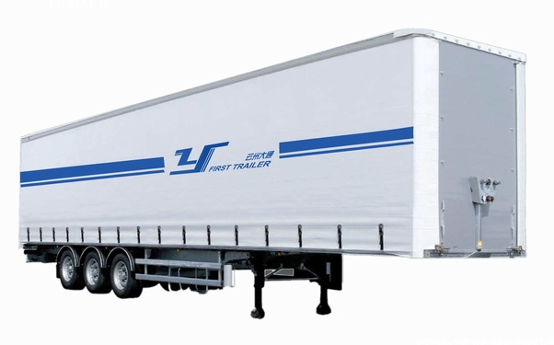
Trailers Registered in Other States

Slide 12
§ 105-330.1. Classification of motor vehicles. (a) Classification. - All motor vehicles other than the motor vehicles listed in subsection (b) of this section
(b) Exceptions:
(1) Motor vehicles exempt from registration pursuant to G.S. 20-51.
(2) Manufactured homes, mobile classrooms, and mobile offices.
(3) Semitrailers or trailers registered on a multiyear basis.
(4) Motor vehicles owned or leased by a public service company and appraised under G.S. 105-335.
(5) Repealed by Session Laws 2000, c. 140, s. 75(a), effective July 1, 2000.
(6) Motor vehicles registered under the International Registration Plan.

Slide 13
Trailers Registered in Other States
“Of the 810,933 “long-term trailers” registered in Maine this year, 784,328 have a mailing or legal address outside of Maine — in virtually every other state, including Hawaii. Some 150,810 of those registrations are linked to New Jersey. Only 26,605 trailers have both a Maine mailing and legal address.”

Slide 14
“Connecticut had some heartburn over this,” says an unapologetic Dunlap, when officials there noticed more and more Connecticut residents driving cars with Maine plates.
In Connecticut, residents who owe property taxes can’t register their vehicles until the debt is paid.
Maine, incidentally, also prohibits its residents from registering their home-based cars in other states.
Of the Connecticut dustup and Maine’s easy registration practices, Dunlap says Maine is just being competitive.
“This is a program that works for us.”

Slide 15
Trailers Registered in Other States
https://mainetrailerregistrations.com

Slide 16
Trailers Registered in Other States
Maine Trailer Registrations is a licensed Registration Agent for the State of Maine Bureau of Motor Vehicles.
We are able to register and title trailers for in and out-of-state individuals, as well as all size businesses from Maine to California – this means YOU!

Slide 17
https://staabagency.com/
We processes Maine trailer Registration & title applications for trucking, shipping & railroad companies, including ... Maine offers license plates that will expire from one through 12 years. You are tax exempt being an out of state customer.

Slide 18
Trailers Registered in Other States
Our registration service is the largest and fastest in the State of Maine. We are very efficient and cost-effective to your Company. We are equipped to process one to thousands of registrations and or titles in any given order. We have over 75,000 customers.
Order a plate at two o’clock today and have it by next morning!

Slide 19
$99/5 Years
Processed Within 10 Business Days
Rush Available
Title Extra
Easy Renewals
Register Now!
12 Year Registration
$229/12 Years
Best Value!
Processed Within 10 Business Days
Rush Available
Title Extra
Easy Renewal
Register Now!
10 Year Registration
$189/10 Years
Processed Within 10 Business Days
Rush Available
Title Extra
Easy Renewals
Register Now!

Slide 20
Multiple Business Owners
Businesses where the owners of the real property and the personal property are different.
Businesses where there are multiple owners of the personal property.
Businesses operating out of the same location but using the same address.

Slide 21
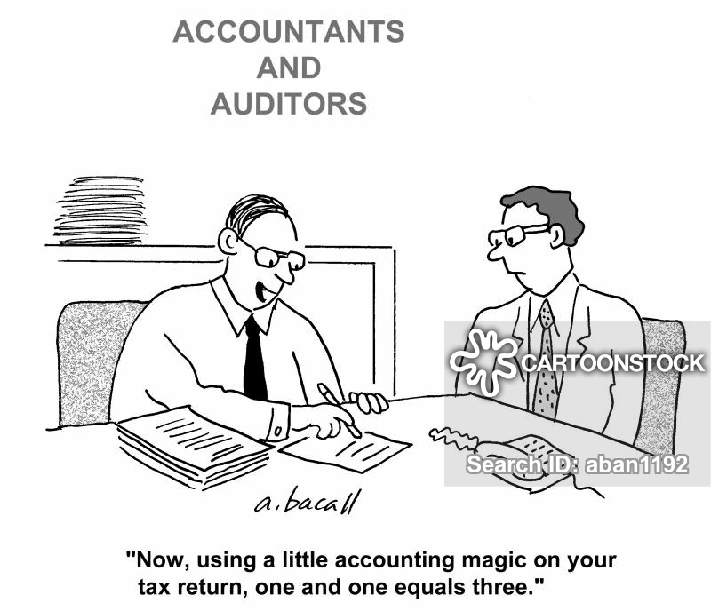
Tax Consultants

Slide 22
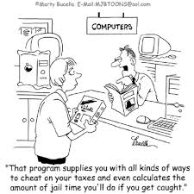
Tax Consultants

Slide 23
Questions?????

Slide 24
Thank you!
David Baker, MPA, PPS
Director of Tax and Revenue Outreach
David.baker@ncacc.org

