Slide 1

Running a Successful PUV Auditing Program
Presented by the Alamance County Tax Office
Administration & Present-Use Appraisal Staff

Slide 2

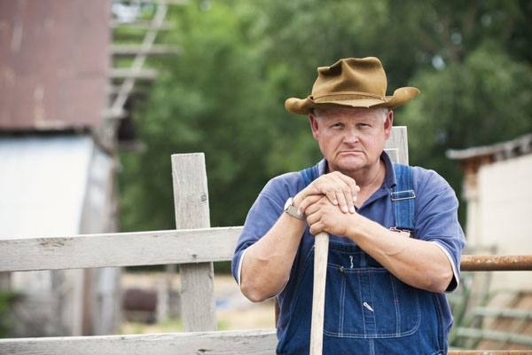
“Don’t mess with the farmers!”

Slide 3
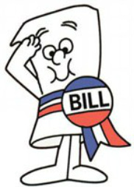
A History of PUV in Alamance County
1973 – The Present-Use Value Program is enacted.
  The program was implemented according to the statutes.
  Awareness of the program grew among our citizens.

Slide 4

A History of PUV in Alamance County
1980’s – The Board of County Commissioners, sitting as the Board of Equalization and Review, discovered that they could pacify citizens by placing appellants into PUV.
Enforcement of PUV stops. Parcels are given present-use status on-demand regardless of qualifications.

Slide 5
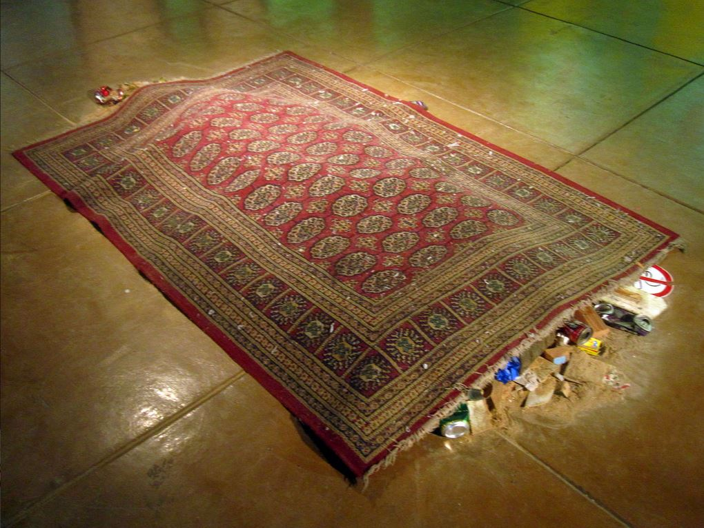
A History of PUV in Alamance County
1990’s – The Board of County Commissioners appoints a Board of Equalization and Review and stops hearing direct appeals.
Due to the large number of persons placed in PUV without qualification in recent years, no effort is made to audit the program.

Slide 6
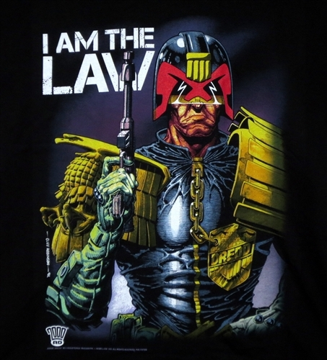
A History of PUV in Alamance County
2000’s – Our first across-the-board PUV auditing program is undertaken.
  This was done unilaterally by county staff.
  The goal was enhanced revenue.
  Statutory requirements were strictly enforced.

Slide 7

A History of PUV in Alamance County
Result…
Farmers felt bullied and banded together to submit a signed petition requesting the immediate end of the audit program. The program was quickly scrapped.

Slide 8
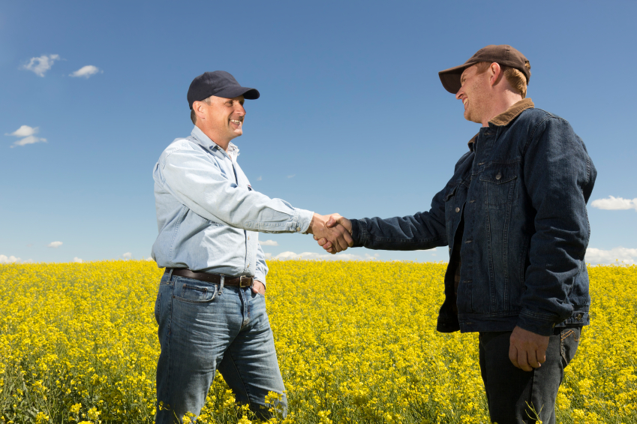
A History of PUV in Alamance County
2010’s – Our second major PUV auditing program begins.
  This was done bilaterally in cooperation with farming community leaders.
  The goal was to clean up the program.
  Lenience was given in which non-conforming farms had the opportunity to come back into conformity with the program.

Slide 9

A History of PUV in Alamance County
Result…
  The farm community has warmly received our current auditing program and respects our farm/PUV appraisers. The program provides a good return on investment.

Slide 10


Slide 11

The Secret to PUV Success
Step 1: Start with the Farmers
  Establish rapport.
    Farm Bureau
    Cattleman’s Association
    Voluntary Ag District
  Identify concerns.
  Gather allies.
    Leaders in the farm community.
    Soil & Water
    Ag Extension Office
    NC Forestry Service

Slide 12

The Secret to PUV Success
Step 2: Build Credibility
  Hire credible staff.
  Proactive Communication / Education
    Participate in farm community events.
    Develop informational materials.
    Build relationships.
  Audits are a PR tool.
    Listen.
    Educate.
    Be gentle and consistent.

Slide 13

The Secret to PUV Success
Step 3: Sell the Bottom Line
  You can only do what the political will supports.
  The Commissioners and other “power players” are conflict averse.
    If you offend the farmers and they get complaints, you’re done.
    If you are perceived as wasting taxpayer dollars, you’re done.
    Keep the farmers happy and show a “profit”, you’re gold.

Slide 14

Key Points
Work with your farm community.
Hire credible people.
Be gentle and consistent.
Report your successes.

Slide 15

Questions?

Slide 16
Thank You.

